Slide 1
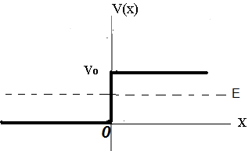
Incident particle
Reflected particles particle
Wave traveling to the right
Wave traveling to the left

Slide 2
D=0
x
Wave traveling to the right
Transmitted particle

Slide 4
Observables and operators
To every physically measurable quantity A, to be called an observable or
Dynamical variable, there corresponds a n operator .
Observable
Corresponding operator
x

Slide 5
Operators and expectation values
Example

