Slide 1
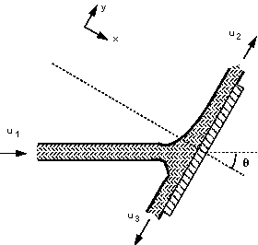
Force due to a jet hitting an inclined plane

Slide 2
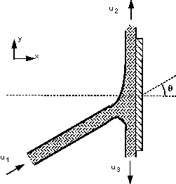
We want to find the reaction force normal to the plate
so we choose the axis system as above so that is
normal to the plane. The diagram may be rotated to
align it with these axes and help comprehension, as
shown below Rotated

Slide 3
The velocities are not known, therefore we apply Bernoulli’s equation
The height difference is negligible and the pressures are atmospheric, then
u₁ = u₂ = u₃ = u
By continuity
Q₁=Q₂+Q₃
i.e. A₁=A₂+A₃

Slide 4
then,
Q₁=A₁u Q₂=A₂u Q₃=(A₁-A₂)u
Using this we can calculate the forces in the same
way as before.
1. Calculate the total force
2. Calculate the pressure force
3. Calculate the body force
4. Calculate the resultant force

Slide 5
1 Calculate the total force in the x-direction
But u_{2x} & u_{3x} are zero then
F_{Tx} = - ρ Q₁ u₁ cos θ
The pressure forces are zero and the body forces are neglected (small).

Slide 6
4. Calculate the resultant force
F_{Tx} = F_{Rx}
i.e.
F_{Rx} = - ρ Q₁ u₁ cos θ
exerted on the fluid.
The force on the plate is the same magnitude but in the opposite direction
R = - F_{Rx} = ρ Q₁ u₁ cos θ

Slide 7
To find the discharge distribution, we use the fact that the total forces along Y is zero ?
As forces equal to zero

Slide 8
From above, A₁ = A₂+A₃
Then,
Finally,

Slide 9
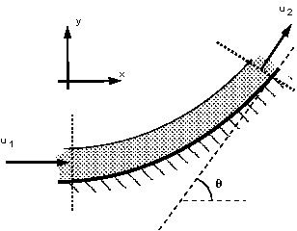
Force on a curved vane
This case is similar to that of a pipe, but the analysis is
simpler because the pressures are equal - atmospheric,
and both the cross-section and velocities remain
constant. The jet, vane and co-ordinate direction are
arranged as in the figure below.

Slide 10
Calculate the total force in the x direction
but
Then

Slide 11
and in the y-direction
Calculate the pressure force.
Again, the pressure force is zero as the pressure at both
the inlet and the outlets to the control volume are
atmospheric.

Slide 12
Calculate the body force
No body forces in the x-direction. In the y-direction the body force acting is the weight of the fluid but it is usually small enough to be ignored.
Calculate the resultant force
The force on the vane is the same magnitude but in the opposite direction.

