Slide 1
Application of the Momentum Equation
We will consider the following examples:
1. Force due to the flow of fluid round a pipe bend.
2. Force on a nozzle at the outlet of a pipe.
3. Impact of a jet on an inclined plane surface.
4. Force due to flow round a curved vane.

Slide 2
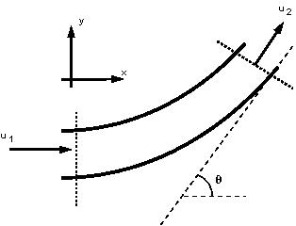
The force due the flow around a pipe bend
Consider a pipe bend with a constant cross section lying in the horizontal plane and turning through an angle of θ

Slide 3
Because the fluid changes direction, a force (very large in the case of water supply pipes,) will act in the bend. If the bend is not fixed it will move and eventually break at the joints. We need to know how much force a support (thrust block) must withstand.
Step in Analysis:
1. Draw a control volume
2. Decide on co-ordinate axis system
3. Calculate the total force (rate of change of
momentum)
4. Calculate the pressure force
5. Calculate the body force
6. Calculate the resultant force

Slide 4
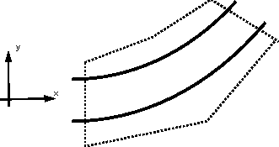
The control volume is draw in the above figure, with faces at the inlet and outlet of the bend and encompassing the pipe walls.
It is convenient to choose the co-ordinate axis so that one is pointing in the direction of the inlet velocity.
In the above figure the x-axis points in the direction of the inlet velocity.

Slide 5
Calculate the total force:
In the x-direction:
In the y-direction:

Slide 6
Calculate the pressure force
F _{p} = pressure force at 1 - pressure force at 2
F_{px} = p₁ A₁ cos 0 – p₂ A₂ cos θ = p₁ A₁ – p₂ A₂ cos θ
F_{py} = p₁ A₁ sin 0 – p₂ A₂ sin θ = – p₂ A₂ sin θ
Calculate the body force
There are no body forces in the x or y directions. The only body force is that exerted by gravity (which acts into the paper in this example - a direction we do not need to consider).
F_{bx} = F_{by} = 0

Slide 7
Calculate the resultant force
F_{Rx} = F_{tx} - F_{px -} F_{bx}
F_{Ry} = F_{ty} - F_{py} - F_{by}

Slide 8
And
The force on the bend is the same magnitude but in the opposite direction
R = - F_{resultant}

Slide 9
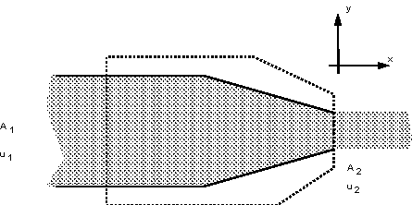
Force on a pipe nozzle
Force on the nozzle at the outlet of a pipe. Because the fluid is contracted at the nozzle forces are induced in the nozzle. Anything holding the nozzle (e.g. a fireman) must be strong enough to withstand these forces.

Slide 10
The same analysis will be followed as before.
Step in Analysis:
1. Draw a control volume
2. Decide on co-ordinate axis system
3. Calculate the total force
4. Calculate the pressure force
5. Calculate the body force
6. Calculate the resultant force

Slide 11
1 & 2 Control volume and Co-ordinate axis are shown in the figure above.
3 Calculate the total force
Using the continuity, Q = A u

Slide 12
4 Calculate the pressure force
F_{p} = F_{px} = pressure force at 1 - pressure force at 2
Friction is neglected for short distance and the nozzle is horizontal i.e. z₁ and z₂ are equal and p₂ is atmospheric i.e. 0 and with continuity

Slide 13
5 Calculate the body force
The only body force is the weight due to gravity in the y-direction - but we need not consider this as the
only forces we are considering are in the x-direction.
6 Calculate the resultant force

Slide 14
So the fireman must be able to resist the force of

