Slide 1
Flow Over Notches and Weirs
A notch is an opening in the side of a tank or reservoir which extends above the surface of the liquid. It is usually a device for measuring discharge. A weir is a notch on a larger scale. It may be sharp crested but also may have a substantial width in the direction of flow - it is used as both a flow measuring device and a device to raise water levels.
Weir Assumptions
We will assume that the velocity of the fluid approaching the weir is small so that kinetic energy can be neglected. We will also assume that the velocity through any elemental strip depends only on the depth below the free surface. These are acceptable assumptions for tanks with notches or reservoirs with weirs, but for flows where the velocity approaching the weir is substantial the kinetic energy must be taken into account (e.g. a fast moving river).

Slide 2
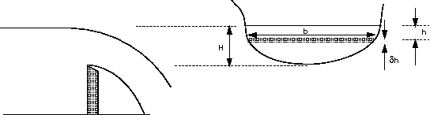
A General Weir Equation
Consider a horizontal strip of width b and depth h below the free surface, as shown in the figure below.

Slide 3
Velocity through the strip
Discharge through the strip
integrating from the free surface, h = 0, to the weir crest, h = H gives the expression for the total
theoretical discharge
This will be different for every differently shaped weir or notch. To make further use of this equation we
need an expression relating the width of flow across the weir to the depth below the free surface.

Slide 4
Rectangular Weir
For a rectangular weir the width does not change with depth i.e. b is constant = B
B
H

Slide 5
‘V’ Notch Weir
If the angle of the ‘V’ is θ then the width, b, a depth h from the free surface is
So the discharge is
b
h
H
θ

Slide 6
The Momentum Equation
Moving fluids exert forces. The lift force on an aircraft is exerted by the air moving over the wing. A jet of water from a hose exerts a force on whatever it hits. In fluid mechanics the analysis of motion is performed in the same way by use of Newton’s laws of motion.
The momentum equation is a statement of Newton. s Second Law and relates the sum of the forces acting
on an element of fluid to its acceleration or rate of change of momentum.

Slide 7
Newton’s second law
The Rate of change of momentum of a body is equal to the resultant force acting on the body, and takes place in the direction of the force.

Slide 8
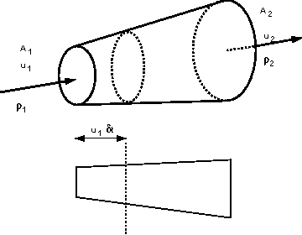
We start by assuming that we have steady flow which is non-uniform flowing in a stream tube.

Slide 9
momentum of fluid entering stream tube = mass x velocity = (ρ₁ A₁ δ_{t} u₁) x u₁
momentum of fluid leaving stream tube
= (ρ₂ A₂ δ_{t} u₂) x u₂
Force = rate of change of momentum
Using the continuity equation with constant density,
F = Q ρ ( u₂ – u₁ )
This force is acting in the direction of the flow of the fluid.

Slide 10
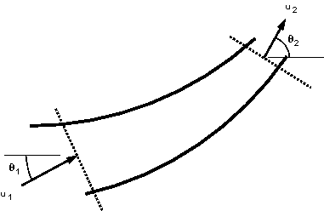
This analysis assumed that the inlet and outlet velocities were in the same direction. Consider the two dimensional system in the figure below:

Slide 11
In this case we consider the forces by resolving in the directions of the co-ordinate axes.
The force in the x-direction
F_{x} = Rate of change of momentum in X direction
= ρ Q ( u_{2x} – u_{1x} )
F_{y} = ρ Q ( u_{2y} – u_{1y} )
The resultant and direction of the force,

Slide 12
Remember that we are working with vectors so F is in the direction of the velocity.
In summary,

