Slide 1
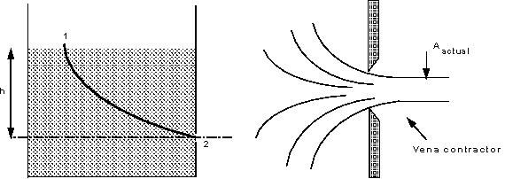
Flow Through A Small Orifice

Slide 2
Velocity can be predicted at the orifice using the Bernoulli equation between points 1 & 2. Notice that u₁ at the surface is zero and the pressure at both points is also zero ?, therefore,
This is the theoretical value of velocity because friction losses have not been taken into account. To incorporate friction we use the coefficient of
velocity to correct the theoretical velocity,
u _{actual} = C _{v} u ₂
Each orifice has its own coefficient of velocity, they usually lie in the range( 0.97 - 0.99)

Slide 3
Looking at the streamlines you can see how they contract after the orifice to a minimum value when they all become parallel, at this point, the velocity and pressure are uniform across the jet. This convergence is
called the vena contracta. One may obtain this area by using a coefficient of contraction for the orifice

Slide 4
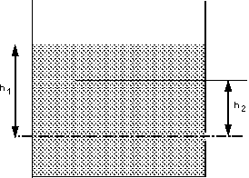
Tank Empting Time
The tank has a cross sectional area of A. In a time dt the level falls by dh or the flow out of the tank is

Slide 5
(-ve sign as dh is falling)
Rearranging and substituting for Q
This can be integrated between the initial level, h1, and final level, h2, to give an expression for the time it takes to fall this distance

Slide 7
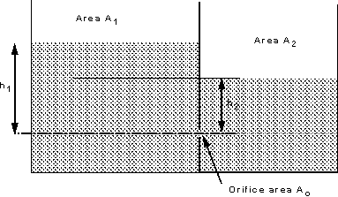
Submerged Orifice

Slide 8
Two tanks are next to each other and fluid is to flow
between them through a submerged orifice. Although difficult to see, careful measurement of the flow
indicates that the submerged jet flow behaves in a similar way to the jet in air in that it forms a vena
contracta below the surface. To determine the velocity at the jet we first use the Bernoulli equation to give
us the ideal velocity.

Slide 9
i.e. the ideal velocity of the jet through the submerged orifice depends on the difference in head across the
orifice. And the discharge is given by
In a similar way, The time for the water surface to drop between initial and final values can be given by:

Slide 10
Remember that h in this expression is the difference in height between the two levels (h₂ - h₁) to get the
time for the levels to equal use h_{initial} = h₁ and h_{final} = 0.
Thus we have an expression giving the time it will take for the two levels to equal.

