Slide 1
Fluid Statics

Slide 2
Pressure
Pressure is the force per unit volume.
Units: Newton. s per square meter, N m⁻² ,
kgm⁻¹ s⁻² .
(The same unit is also known as a Pascal, Pa, i.e.
1Pa = 1 N m⁻² )
(Also frequently used is the alternative SI unit the
bar, where 1bar = 10⁵ N m⁻² )
( Also frequently used is a Atmosphere, where 1 atm
= 101325 N m⁻²
Dimensions: ML⁻¹T ⁻² .

Slide 3
Pascal’s Law for Pressure
Pressure acts equally in all directions. i.e. Pressure at any point is the same in all directions.
h
P = ρ g h

Slide 4
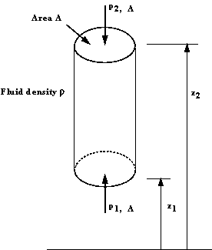
Variation Of Pressure Vertically In A Fluid Under Gravity

Slide 5
Force at point 1 = P₁ A
Force at point 2 = P₂ A
Force due to weight of water Column = ρ g a (z₂ – z₁)
As the column is in equilibrium, the sum of the vertical forces is zero.
P₁ A – P₂ A - ρ g A (z₂ – z₁) = 0
P ₁ – P₂ = ρ g (z₂ – z₁)
The pressure increases due to gravity with the increase of height.

Slide 6
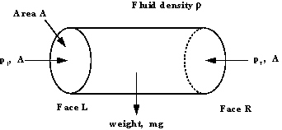
Equality Of Pressure At The Same Level In A Static Fluid

Slide 7
Horizontal elemental cylinder of fluid
The fluid is at equilibrium so the sum of the forces acting in the x direction is zero.
p₁ A = p_{r} A
Pressure in the horizontal direction is constant.
P₁ = P_{r}

Slide 8
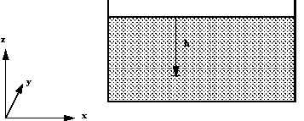
Pressure and Head

Slide 9
p = ρ g h + constant
At the surface of fluids we are normally concerned with, the pressure is the atmospheric pressure,
p _{atmospheric} . So
p = ρ g h + p _{atmospheric}
Notice that velocity is constant.
As we live constantly under the pressure of the atmosphere, it is convenient (and often done) to take atmospheric pressure as the datum. So we quote pressure as above or below atmospheric.

Slide 10
Pressure quoted in this way is known as gauge pressure
P _{gauge} = ρ g h
The lower limit of any pressure is zero - that is the pressure in a perfect vacuum. Pressure measured above this datum is known as absolute pressure i.e.
P _{absolute} = ρ g h + P _{atmosphere}

Slide 11
As g is constant, the gauge pressure can be given by stating the vertical height of any fluid of density ρ which is equal to this pressure.
p = ρ g h
This vertical height is known as head of fluid.

Slide 12
Example:
We can quote a pressure of 500K N m⁻² in terms of the height of a column of water of density,
ρ = 1000 kg m⁻³ .
And in terms of Mercury with density, ρ = 13.6x10³ kg/m³
of water
of mercury

