Slide 1
Fluid Dynamics

Slide 2
Introduce concepts necessary to analyze fluids in motion.
Identify differences between Steady/unsteady uniform/non-uniform flow.
Introduce the Continuity principle through conservation of mass and control volumes.
Derive the Bernoulli (energy) equation.
Demonstrate practical uses of the Bernoulli and continuity equation in the analysis of flow.
Introduce the momentum equation for a fluid.
Demonstrate how the momentum equation and principle of conservation of momentum is used to
predict forces induced by flowing fluids

Slide 3
It is possible - and useful - to classify the type of flow which is being examined into small number of groups.
uniform flow: If the flow velocity is the same magnitude and direction at every point in the fluid it is said to be uniform.
non-uniform: If at a given instant, the velocity is not the same at every point the flow is non-uniform. (In practice, by this definition, every fluid that flows near a solid boundary will be non-uniform - as
the fluid at the boundary must take the speed of the boundary, usually zero. However if the size and shape of the of the cross-section of the stream of fluid is constant the flow is considered uniform.)
steady: A steady flow is one in which the conditions (velocity, pressure and cross-section) may differ from point to point but DO NOT change with time.
unsteady: If at any point in the fluid, the conditions change with time, the flow is described as unsteady. (In practise there is always slight variations in velocity and pressure, but if the average values are constant, the flow is considered steady.

Slide 4
Combining the above we can classify any flow in to one of four type:
1. Steady uniform flow. Conditions do not change with position in the stream or with time. An example is the flow of water in a pipe of constant diameter at constant velocity.
2. Steady non-uniform flow. Conditions change from point to point in the stream but do not change with time. An example is flow in a tapering pipe with constant velocity at the inlet - velocity will change as you move along the length of the pipe toward the exit.
3. Unsteady uniform flow. At a given instant in time the conditions at every point are the same, but will change with time. An example is a pipe of constant diameter connected to a pump pumping at a constant rate which is then switched off.
4. Unsteady non-uniform flow. Every condition of the flow may change from point to point and with time at every point. For example waves in a channel.

Slide 5
Flow Rate:
Mass Flow Rate:
By collecting water from a pipe within a certain time and weighting it
mass flow rate = water weight / time
Volume Flow Rate
By collecting water from a pipe within a certain time and measuring the volume
volume flow rate = water volume / time

Slide 6
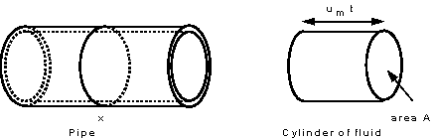
Discharge and mean velocity
If the area of cross section of the pipe at point X is A, and the mean velocity here is um . During a time t, a
cylinder of fluid will pass point X

Slide 7
The volume flow rate or the discharge
Where A is the area of the cross section, u_{m} is the mean velocity and t is the time.

Slide 8
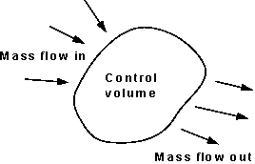
Continuity
Matter cannot be created or destroyed. This principle is know as the conservation of mass and we use it in the analysis of flowing fluids. The principle is applied to fixed volumes, known as control volumes (or surfaces), like that in the figure:

Slide 9
For any control volume the principle of conservation of mass says
mass enter = mass exit + change in the mass
For steady flow
mass per unit time enter = mass per unit time exit
ρ₁ A₁ u_{m1} = ρ₂ A₂ u_{m2} = constant
For steady liquids ρ is constant then:
A₁ u_{m1} = A₂ u_{m2} = Q
This is the continuity equation

Slide 10
Some Example Application
Section 2
Section 1
A liquid is flowing from left to right and the pipe is narrowing in the same direction. By the continuity principle.
A₁ u₁ = A₂ u₂ = Q

Slide 11
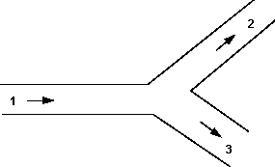
Q₁ = Q₂ +Q₃
A₁ u₁ = A₂ u₂ + A₃ u₃

