Slide 1
Resultant force on a submerged curved surface
It is most straightforward to calculate the horizontal and vertical components and combine these to obtain
the resultant force and its direction.
In the diagram below the liquid is resting on top of a curved base.

Slide 2
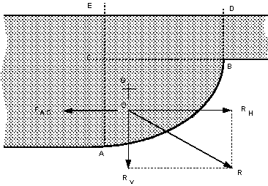

Slide 3
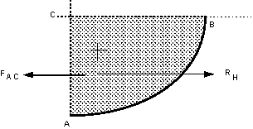
Horizontal forces
Considering the horizontal forces, none can act on CB as there are no shear forces in a static fluid so the forces would act on the faces AC and AB as shown below.

Slide 4
The resultant horizontal force of a fluid above a curved surface is:
RH = Resultant force on the projection of the curved surface onto a vertical plane.
It is calculated as before.
Vertical forces
The diagram below shows the vertical forces which act on the element of fluid above the curved surface.

Slide 5
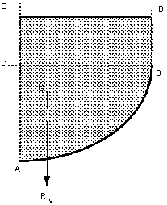
The resultant vertical force of a fluid above a curved surface is:
RV = Weight of fluid directly above the curved surface.
and it will act vertically downward through the centre of gravity of the mass of fluid.

Slide 6
Resultant force
The overall resultant force is found by combining the vertical and horizontal components vectorialy,
Resultant force
The angle the resultant force makes to the horizontal is

Slide 7
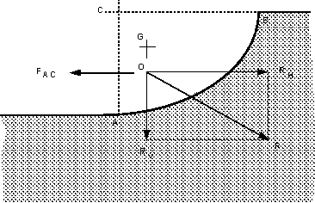
The figure below shows a situation where there is a curved surface which is experiencing fluid pressure from below.

Slide 8
Horizontal force
The resultant horizontal force, RH acts as shown in the diagram. The resultant horizontal force of a fluid below a curved surface is:

Slide 9
RH = Resultant force on the projection of the curved
surface on a vertical plane.
That is it cab be calculated as before.
Vertical force
The vertical force are acting are as shown on the figure below. If the curved surface were removed and the
area it were replaced by the fluid.
The resultant vertical force of a fluid below a curved surface is:
Rv =Weight of the imaginary volume of fluid vertically
above the curved surface.

Slide 10
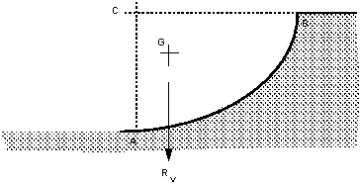
Resultant force
The overall resultant force is found by combining the vertical and horizontal components vectorialy,
Resultant force
The angle the resultant force makes to the horizontal is

Slide 11
Example:
Determine the total hydrostatic pressure and center of pressure on a 3 m long and 2 m height quadrant gate.
R_{H}
1.33
R_{V}
0.85

Slide 12
Solution:
The horizontal component is equal to the hydrostatic pressure on vertical projection of the gate
R_{H} = γ ŷ A = 9810 x (0.5 x 2) x (2x3) = 58860 N
The pressure center of the horizontal component is at (2/3) of the height i.e. 1.33 m
The vertical component equal the weight over the gate
RV = γ V = 9810 (0.25 x π 2²) 3 = 92460 N
The pressure center of the vertical component is at (4r/3π) = 0.85 m
The resultant and the direction

