Slide 1
Pressure Measurement By Manometer
The Piezometer Tube Manometer
The simplest manometer is a tube, open at the top, which is attached to the top of a vessel containing
liquid at a pressure (higher than atmospheric) to be measured. An example can be seen in the figure
below. This simple device is known as a Piezometer tube. As the tube is open to the atmosphere the
pressure measured is relative to atmospheric so is gauge pressure.

Slide 2
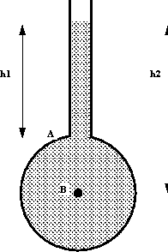

Slide 3
P _{A} = ρ g h₁
P _{B} = ρ g h₂
The ‘U’-Tube Manometer
Using a ‘U’-Tube enables the pressure of both liquids
and gases to be measured with the same instrument.
The ‘U’ is connected as in the figure below and filled
with a fluid called the manometric fluid. The fluid
whose pressure is being measured should have a mass
density less than that of the manometric fluid and the
two fluids should not be able to mix readily - that is,
they must be immiscible.

Slide 4
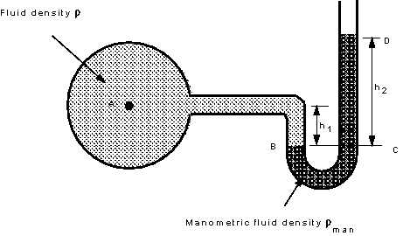

Slide 5
Pressure in a continuous static fluid is the same at any horizontal level so,
pressure at B = pressure at C
P _{B} = P _{C}
But,
P_{B} = P_{A} + ρ g h
P_{C} = ρ_{man} g h₂
P_{A} = ρ_{man} g h₂ – ρ g h₁

Slide 6
Measurement Of Pressure Difference Using a ‘U’-Tube Manometer
If the ‘U’-tube manometer is connected to a pressurized vessel at two points the pressure difference between these two points can be measured.
P_{C} = P_{D}
P_{C} = P_{A} + ρ g h_{a}
P_{D} = P_{B} + ρ g (h_{b} – h) + ρ_{man} g h
P_{A} – P_{B} = ρ g (h_{b} – h_{a}) – (ρ_{man} – ρ) g h

Slide 7
