Slide 1
Neuro-Ophthalmology for GP

Slide 2
Neuro-Ophthalmology for GP

Slide 3
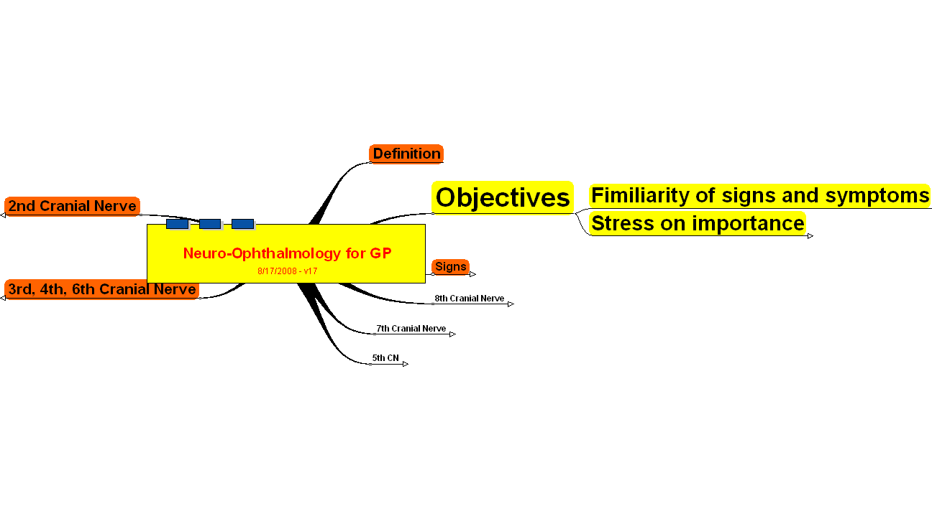
Objectives

Slide 4
Stress on importance
Visual pathway
Pupil pathway
Clinical Entities

Slide 5
Clinical Entities
ON Swelling
Anisocoria
CN Palsy
3rd N Palsy
Aneurysm
4th N Palsy
Congenital
6th Nerve Palsy
Increased ICP
Ptosis
Congenital
Aquired
Neurogenic
Muscular
N-Muscular
Aponeurotic

Slide 6
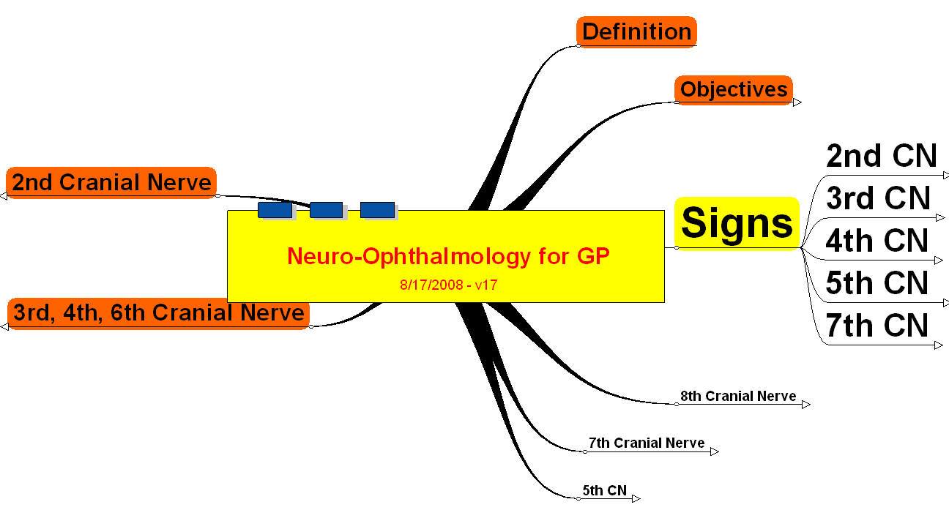
Signs

Slide 7
2nd CN
Optic Nerve Swelling
Optic Nerve Atrophy
Optic Nerve Cupping
RAPD
VA& VF Changes

Slide 8
3rd CN
Anisocoria
Hypotropia
Ptosis
Exotropia
Limitation of EOM

Slide 9
4th CN
Hypertropia

Slide 10
5th CN
Hyperasthesia
Hypoasthesia
Change in Appearance

Slide 11
7th CN
Lagophthlmos

Slide 12
8th Cranial Nerve

Slide 13
7th Cranial Nerve

Slide 14
5th CN

Slide 15
3rd, 4th, 6th Cranial Nerve

Slide 16
2nd Cranial Nerve

Slide 17
Neuro-Ophthalmology for GP

Slide 18
Neuro-Ophthalmology
Samir Jamal M.D, FRCSC

Slide 19
Neuro-Ophthalmology

Slide 20
Cupping

Slide 21
AHD

Slide 22
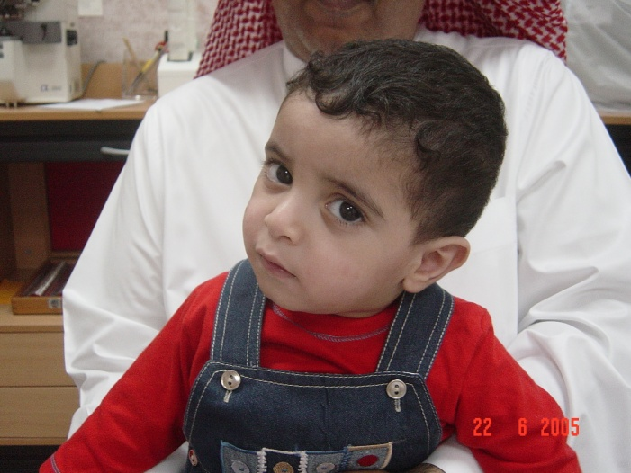
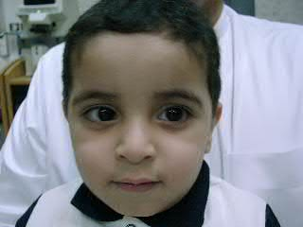
AHD

Slide 23
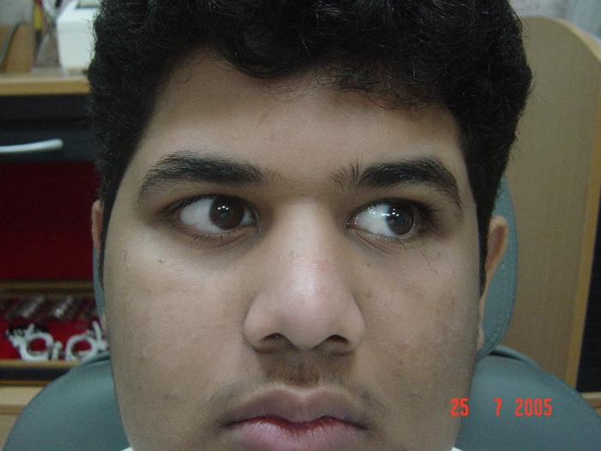
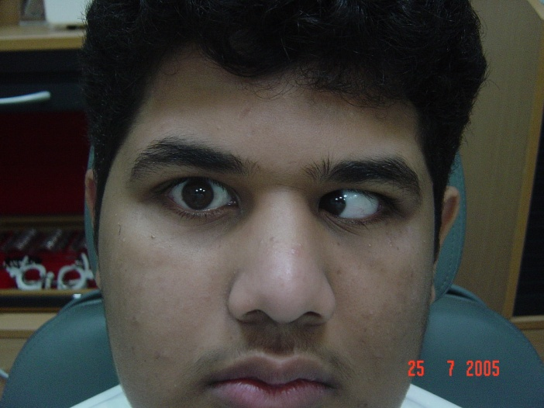

Slide 24
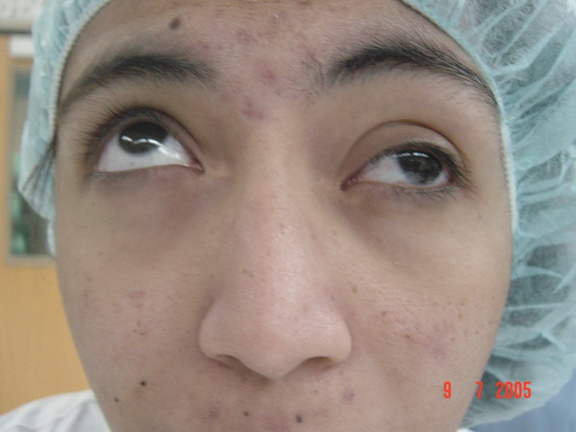
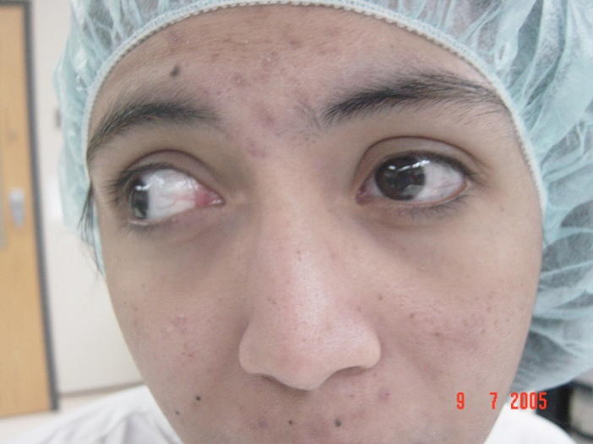
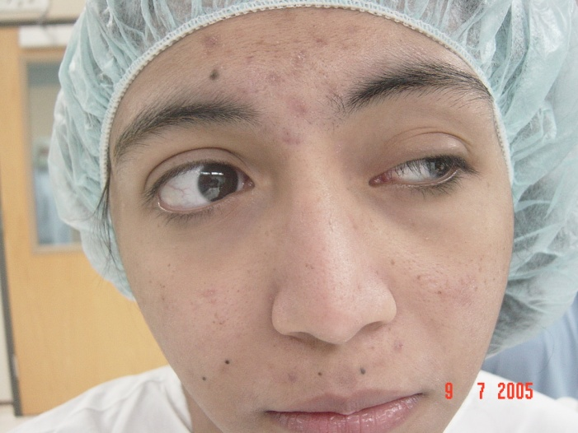
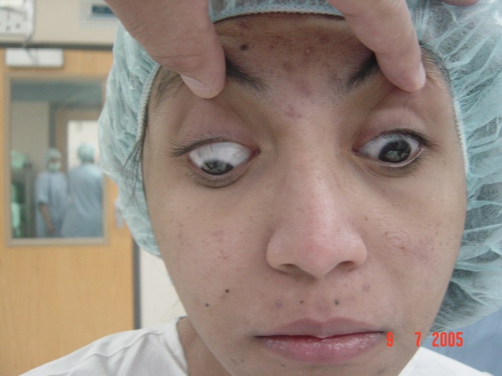
Describe the abnormal signs you can see in this slide
What is the differential diagnosis?
How do you manage?
Notes:
Third nerve palsy

