Slide 1
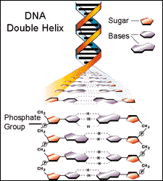
Introduction - DNA and DNA Extraction

Slide 2
Introduction - DNA and DNA Extraction
Every gene has a promoter, a coding region, and a termination sequence.
Genetic engineering is the directed addition of new DNA to an organism's genetic makeup, its genome. DNA is the material that makes up genes. Once scientists understood the properties of DNA and how it functions as genetic material, they could envision and invent techniques for genetic engineering. DNA is the instruction manual for living things. Within the relatively simple double helix structure, DNA holds the coded information for how to make every protein a living organism might need throughout its entire l

Slide 3
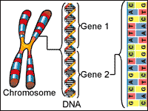
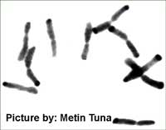
Chromosomes
DNA is packaged in the cell into structures called chromosomes. Chromosomes are the form by which genetic information is passed from old cells to new cells, one generation to the next, resulting in the successful and reliable inheritance of traits. Every cell in an organism contains two copies of every chromosome present in that organism. For example, humans have 46 chromosomes in their body, 23 were inherited from the father and 23 from the mother. Gametes, the reproductive cells of an organism, (egg or sperm), have only one set of chromosomes. When the two gametes unite, they form a living embryo with two sets of genetic information. Therefore, we actually have two copies of the genetic information for each trait. Sometimes one copy controls trait expression, and other times both copies influence a trait. As a result, the offspring will have characteristics of both the mother and the father
Nucleotides make up DNA. DNA makes up genes, and genes are small segments of chromosomes
Chromosomes from brome grass (Bromus inermis). Photograph taken through a light microscope at 1000X magnification.

Slide 4
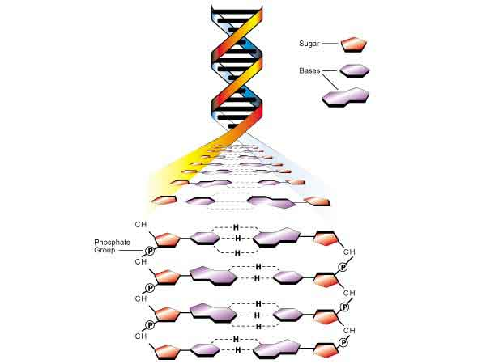
DNA Structure
DNA is a macro molecule that consists of many subunits connected together. The subunits are called nucleotides. Each nucleotide has three parts; a sugar, a phosphate, and a base. The sugar and phosphate molecules are linked together in two long chains. The bases are linked to the sugar-phosphates. Bases of one strand are bound to those of the other strand by hydrogen bonds making what is called a base pair. The structure of DNA is a double helix which allows it to perform the functions of replication and information storage. Base pairs look similar to rungs on a ladder. In fact, the DNA structure could be described as a long ladder twisted into a spiral.

Slide 5
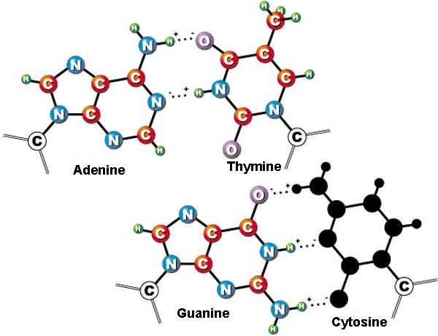
Nucleotides
There are only 4 nucleotides in DNA, Adenine (A), Guanine (G), Thymine (T), and Cystosine (C). The chemical structures of Thymine and Cytosine are smaller, while those of Adenine and Guanine are larger. Size and structure of the specific nucleotides cause Adenine and Thymine to always pair together while Cytosine and Guanine always pair together. Therefore the two strands of DNA are considered complimentary.
The nucleotides are like letters in the ’genetic language’. Just as we use letters to make words with meaning, the order of the nucleotides on a DNA strand codes information. They make ’words’ that tell the cell how to make each protein. Furthermore, the genetic language is a universal language. Every living organism uses the same nucleotide combinations to code for its genetic information. This characteristic is important in genetic engineering. It allows the transfer of genetic information from one species to another while maintaining its meaning.
The four nucleotide structures.

Slide 6
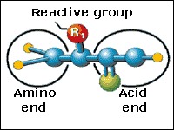
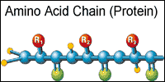
Genes Encode Proteins
The information for making a specific protein is encoded in a single gene. Genes are usually several thousand nucleotides long. There are thousands of genes on a chromosome. Nucleotides make up DNA, DNA makes up genes, and genes make up chromosomes.
A single amino acid has two ends and a reactive group. The reactive group is different for each amino acid.
Amino acids link together in a chain to form proteins.

Slide 7
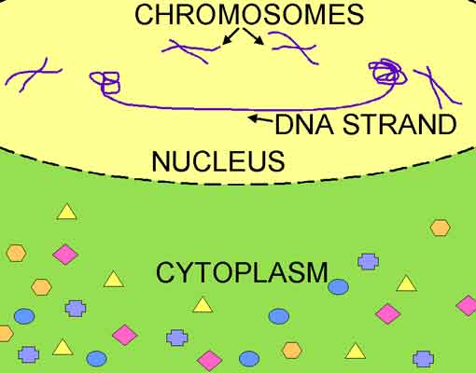
Genes Encode Proteins
Proteins are chains of amino acids. The amino acid sequence in a protein determines how it will fold up into a specific structure. The shape or structure determines the function of a protein in the cell. A single amino acid has two ends and a reactive group. The reactive group is different for each amino acid. Amino acids link together in a chain to form proteins. There are several roles proteins can play in the life of a cell. They can be enzymes and catalyze reactions, structural proteins and influence the shapes of cells and tissues, or regulatory proteins and regulate the expression of other genes. Amino acids are found in the cytoplasm of the cell where protein production takes place. However, DNA is located in the nucleus stored as large chromosomes and cannot leave. In order, to get the genetic code from the nucleus to the cytoplasm, the cell reads the DNA and makes a message molecule called RNA. Making RNA begins when the two DNA strands for a gene unwind and separate. A protein present in the nucleus, called RNA polymerase, binds to one DNA strand and builds a complementary mRNA strand. When it does this, it places a Uracil (U) nucleotide instead of a Thymine nucleotide in the mRNA strand. This process is called ’ transcription’. When transcription begins, the DNA code is in the nucleus while the amino acids, which will compose the protein to be produced, are in the cytoplasm. A molecule called RNA polymerase reads the gene to be produced and makes a copy of the DNA sequence called RNA. The RNA strand is able to travel outside of the nucleus into the cytoplasm with the amino acids.
When transcription begins, the DNA code is in the nucleus while the amino acids, which will compose the protein to be produced, are in the cytoplasm

Slide 8
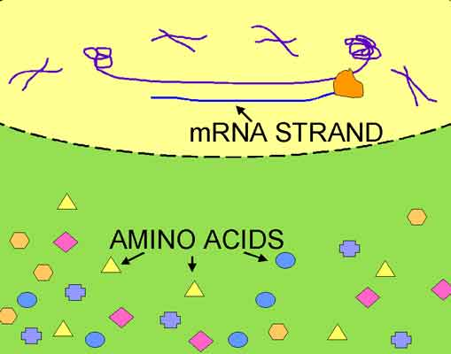
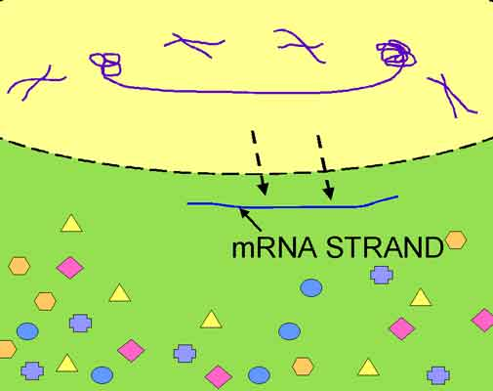
Genes Encode Proteins
When transcription begins, the DNA code is in the nucleus while the amino acids, which will compose the protein to be produced, are in the cytoplasm
A molecule called RNA polymerase reads the gene to be produced and makes a copy of the DNA sequence called RNA.
The RNA strand is able to travel outside of the nucleus into the cytoplasm with the amino acids.

Slide 9
Genes Encode Proteins
After transcription, the mRNA molecule travels outside of the nucleus into the cytoplasm. There, a protein building macromolecule called a ribosome binds to the RNA and reads the gene’s code three nucleotides at a time. Each group of three nucleotides is called a codon, and each codon codes for a specific amino acid. As you can see in the table, there are 20 different amino acids. Their abbreviations are listed in the right half of each column. The codons coding that particular amino acid are listed on the left half. There is usually more than one codon that codes each amino acid. For example, the amino acid serine, (’SER’ on the codon table) is coded by the codons UCU, UCC, UCA, and UCG. In this codon table, each possible codon is listed along with the abbreviation for the amino acid it codes for.

Slide 10
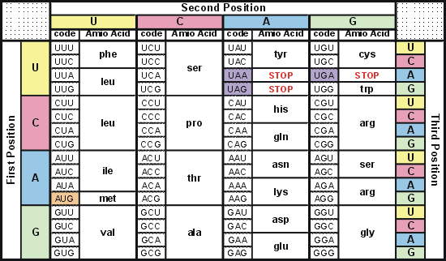
Genes Encode Proteins
AMINO ACID TABLE

Slide 11
Genes Encode Proteins
The ribosome travels down the mRNA, reading the codons and linking the appropriate amino acids together into a chain. This process is called ’ translation’. A complete protein has hundreds of amino acids in its chain and may have more than one chain. Once assembly is complete, the ribosome falls off of the mRNA message and the completed chain of amino acids folds up into its functional protein structure. The protein is now able to perform its job in the plant. A molecule called a ribosome is present in the cytoplasm and reads the RNA strand three nucleotides at a time. Each group of three nucleotides (codon) codes for a specific amino acid. As the ribosome reads the RNA strand it places the proper amino acids together in the order encoded in the strand. Once all of the amino acids have been linked together, the protein folds up into the shape dictated by the order of the amino acids. This shape gives the protein its function and allows it to do its work in the cell.

Slide 12
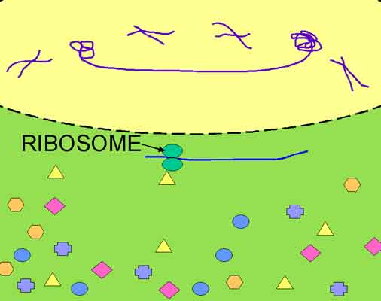
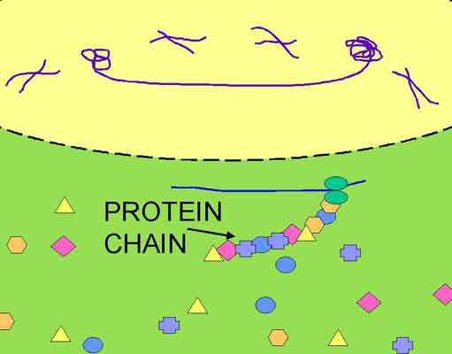
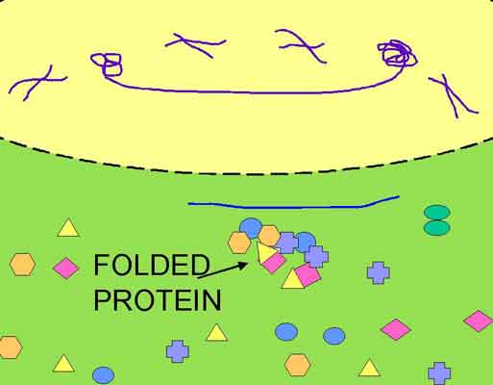
Genes Encode Proteins
A molecule called a ribosome is present in the cytoplasm and reads the RNA strand three nucleotides at a time.
Each group of three nucleotides (codon) codes for a specific amino acid. As the ribosome reads the RNA strand it places the proper amino acids together in the order encoded in the strand.
Once all of the amino acids have been linked together, the protein folds up into the shape dictated by the order of the amino acids. This shape gives the protein its function and allows it to do its work in the cell.

Slide 13
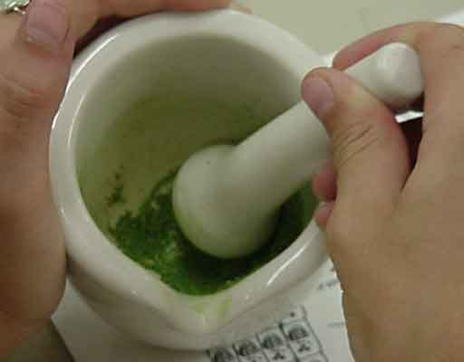
DNA Extraction
Why is it necessary to extract the DNA out of a cell in genetic engineering? As mentioned above, DNA is found in the nucleus of a cell. In order for genetic engineers to be able to work with and transfer DNA into another organism, it must be first taken out of the cell. Fortunately, a DNA molecule remains somewhat stable outside of a living cell allowing scientists the opportunity to work with and study it without destroying it. To extract DNA, tissue samples are taken from plants, and crushed to break open the cells.

Slide 14
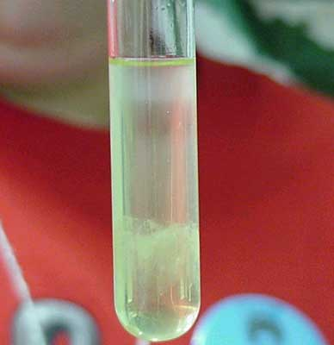
DNA Extraction
Next, a buffered salt water solution is added into which DNA dissolves easily. The DNA is purified by adding an organic solution into which other molecules, such as fats and proteins dissolve. The purified DNA solution is separated off and the DNA is precipitated out of the solution by adding alcohol. The DNA is now a solid string that can be spooled out with a hook. The extracted DNA is placed into test tubes with a weak buffer solution and can be stored almost indefinitely. During DNA extractions, the entire cells' DNA is extracted at the same time. Extracted DNA has usually been sheared into smaller pieces due to the leaf tissue grinding process. This makes it difficult to isolate an entire chromosome in once continuous strand. However, large pieces that contain several to dozens of genes can be extracted intact with this method. After isolating the DNA, researchers can use it for further laboratory studies including genetic engineering.

Slide 15
Summary - DNA and DNA Extraction
DNA is a non-living stable molecule. The DNA code is universal allowing it to work the same in all living things. This is a critical fact that makes genetic engineering possible.
DNA
DNA is composed of nucleotides bonded to a sugar-phosphate backbone. Double stranded DNA forms a double helix structure.
The DNA double helix coils up into compact structures called chromosomes. Small segments of the chromosome that encode a single protein are called genes.
Chromosomes are microscopic. There are thousands of genes on each chromosome and hundreds of nucleotides in the DNA sequence of each gene.
The role of DNA is to store and pass on genetic information.
Proteins
Proteins are chains of amino acids bonded together and folded into a 3-dimensional structure.
Proteins do the ’work’ in a cell and function in 3 ways:
Enzyme=catalyze reactions
Structure=influence cell shape and tissues
Regulate=regulate the expression of other genes
Protein Production
DNA in the nucleus is copied by RNA polymerase which reads the code and makes a complimentary copy called RNA. (transcription)
RNA travels from the nucleus to the cytoplasm where amino acids are located.
The RNA code is read by a ribosome 3 nucleotides (1 codon) at a time linking the appropriate amino acids together into a chain. (translation)
The amino acid chain (protein) folds up into a 3-dimensional structure able to perform its function in the cell.
DNA extraction is necessary because genetic engineers need to be able to work with the DNA, cut it, locate and clone a single gene, and modify the gene before they insert it into another organism. The steps in DNA extraction are:
Plant tissue is crushed to break open the cells and release the DNA.
Buffered salt solution is added into which the DNA easily dissolves.
Organic solution is added into which other molecules, such as proteins and fats, easily dissolve purifying the DNA solution.
The purified DNA solution is separated from the organic waste solution.
Alcohol is added to the DNA solution causing the DNA to precipitate out into a solid string that can be spooled out with a glass hook and stored indefinitely.

