Slide 1
Database Design
Mohammad Yamin
Lecturer Information Systems
Faculty of Information Science & Engineering
University of Canberra
Office: 11A13
Phone: 62012436
Email: mohammad.yamin@canberra.edu.au

Slide 2
Today
Databases and the Business Organizations

Slide 3
Database Design: Databases and the Business Organisations
Have you worked with a database?
Have you seen a database in action?
What can you do with the help of a database?

Slide 4
Database Design
Can databases be useful in
Crisis Management:
Fires (e.g. Victorian Bush Fires), Earthquakes, Tsunami, Terror Attack, Drought, Floods,
Matching:
Passports Management, Criminal Investigation, Visitor Identification
Businesses:
University, Library, Super Market, Financial Institution (e.g. Banks), Travel, Holiday, Factories, Sports, Expo,, Census, Personal Finance, Small Business, Household Matters etc?

Slide 5
Database
A database system or in short a database is a shared collection of logically related data (and a description of this data), designed to meet the information needs of an organisation

Slide 6
Database Management System (DBMS)
A software system that enables users to define, create, and maintain the database and which provides controlled access to the database.

Slide 7
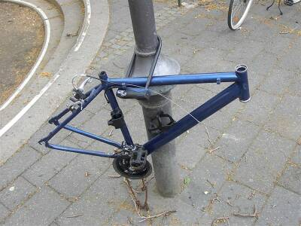

Slide 8
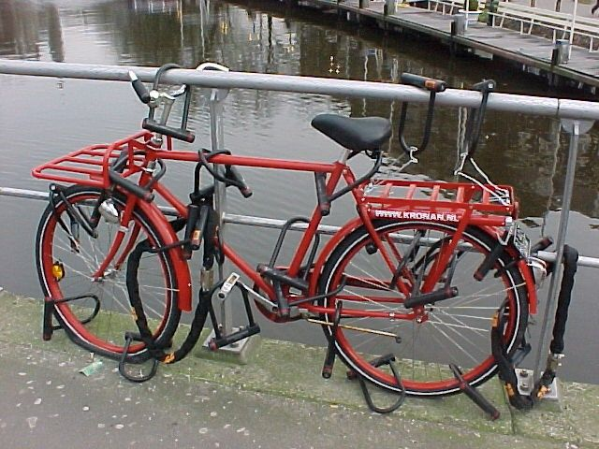

Slide 9
DBMS Environment
Hardware
Can range from a PC to a network of computers.
Software
DBMS, operating system, network software (if necessary) and also the application programs.
Data
Used by the organization (e.g. data dictionary) and a description of this data called the schema.
Procedures
Instructions and rules that should be applied to the design and use of the database and DBMS.
People
Data Administrator (DA)
Database Administrator (DBA)
Database Designers (Logical and Physical)
Application Programmers
End Users (naive and sophisticated)

Slide 10
Benefits of Databases
Control of data redundancy
Sharing of data
Data consistency
Data integrity
Concurrency
Improved security
Who provides these facilities for databases?

Slide 11
DBMS - functions
Data Storage, Retrieval, and Update.
Transaction Support.
Concurrency Control Services.
Recovery Services.
Authorization Services.
Services to Promote Data Independence.
A User-Accessible Catalog

Slide 12
DBMS: Constraints
Complexity and Size
Cost of DBMS
Additional hardware costs
Cost of conversion when changing to new DBMS
Performance
Higher impact of a failure

Slide 13
Views
Do all people have the same view about a database?

Slide 14
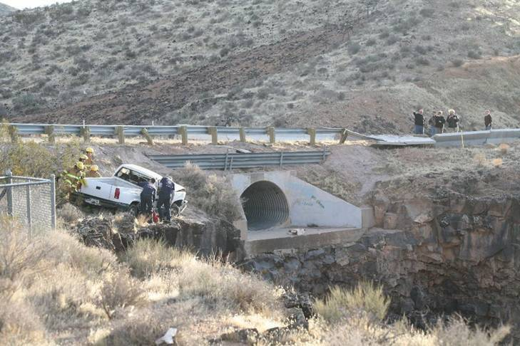
View

Slide 15
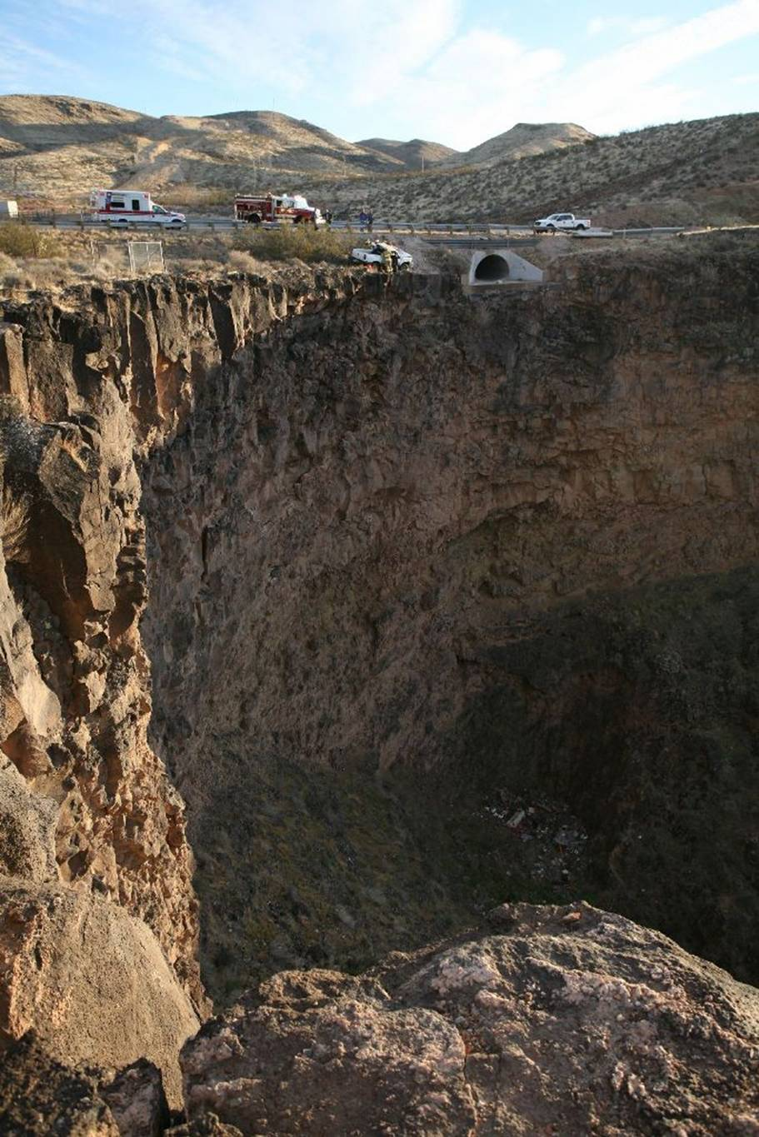
View

Slide 16
Three-Level Architecture
View
Should all users be able to access same data?
Should a user's view be immune to changes made in other views?

Slide 17
Three-Level Architecture
Should DBA be able to change database storage structures without affecting the users' views?
Do the users need to know physical database storage details?

Slide 18
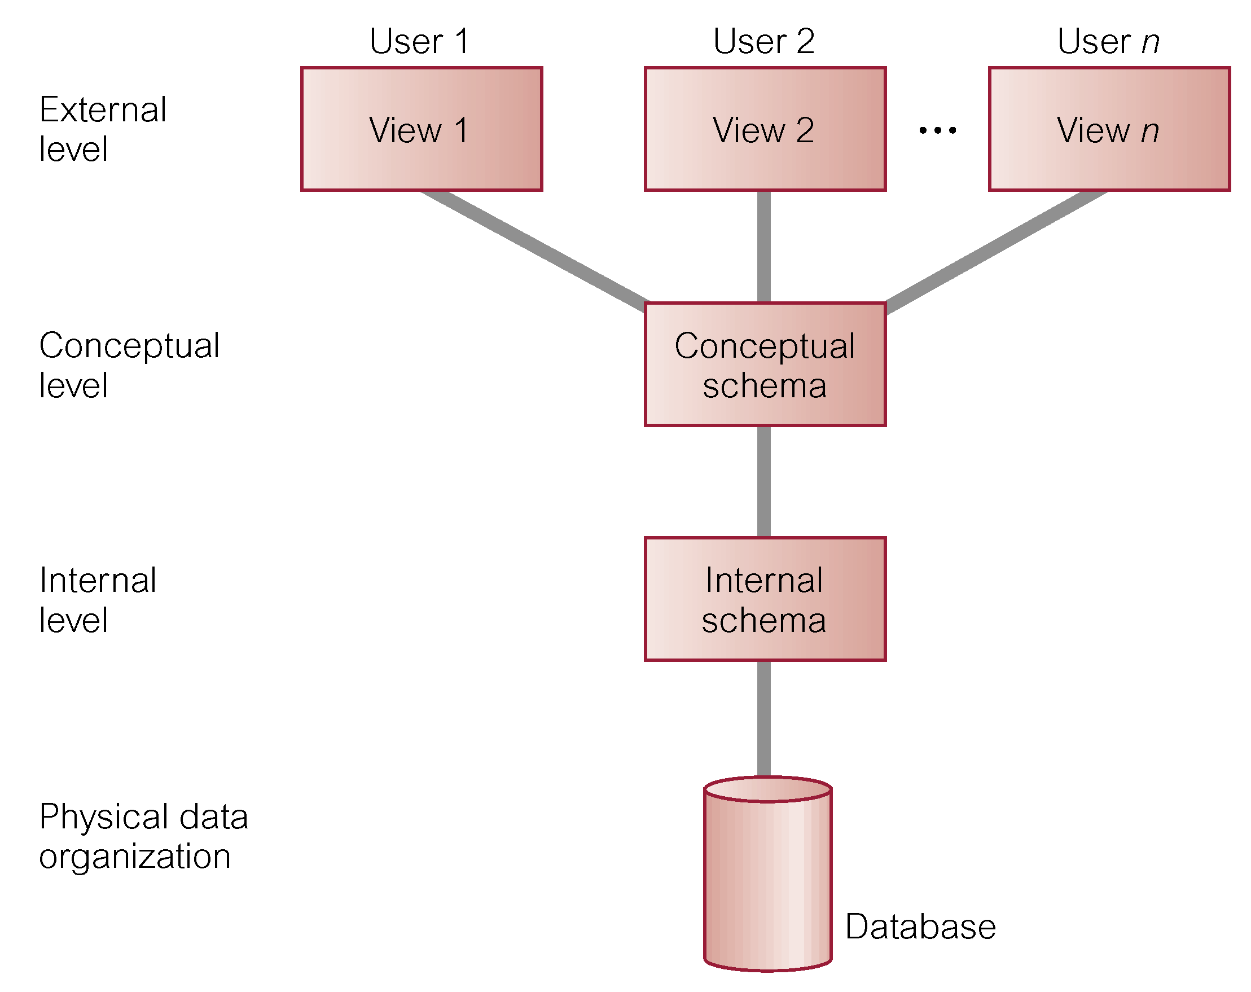
Three-level Architecture (ANSI-SPARC)

Slide 19
Three-level Architecture
External Level
Users' view of the database.
Describes that part of database that is relevant to a particular user.
Conceptual Level
Community view of the database.
Describes what data is stored in database and relationships among the data. Internal Level
Internal Level
Physical representation of the database on the computer.
Describes how the data is stored in the database.

Slide 20
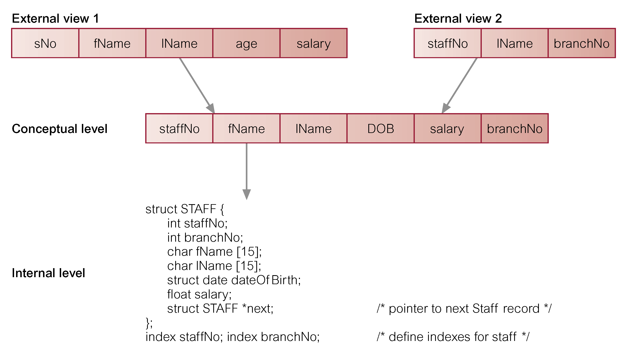
Differences between Three Levels

Slide 21
Data Independence
Logical Data Independence
Refers to immunity of external schemas to changes in conceptual schema. Conceptual schema changes means addition or removal of entities.
Should not require changes to external schema
Should not require rewriting of application programs.

Slide 22
Data Independence
Physical Data Independence
Refers to immunity of conceptual schema to changes in the internal schema. Internal schema changes means using different file organizations, storage structures/devices.
Should not require change to conceptual or external schemas.

Slide 23
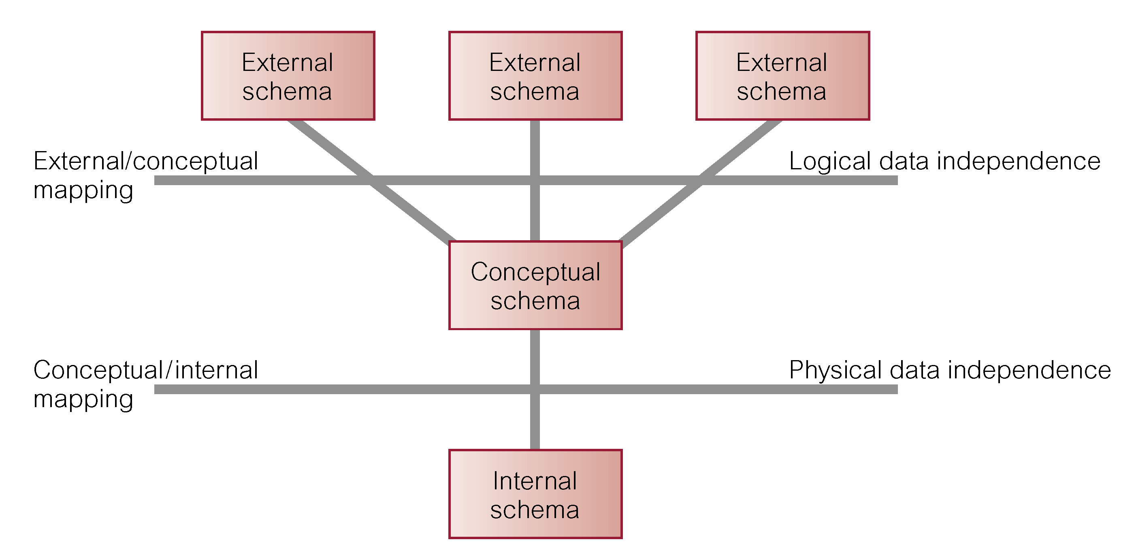
Data Independence and the Three-level Architecture

Slide 24
Three-level Architecture & DBMS
A DBMS does the following:
Data Storage, Retrieval, and Update.
Transaction Support.
Concurrency Control Services.
Recovery Services.
Authorization Services.
Services to Promote Data Independence
A User-Accessible Catalog

Slide 25
Multi-User DBMS Architectures
File-server
Client-server

Slide 26
File-Server
File-server is connected to several workstations across a network.
Database resides on file-server.
DBMS and applications run on each workstation.
Disadvantages include:
Significant network traffic.
Copy of DBMS on each workstation.
Concurrency, recovery and integrity control more complex.

Slide 27
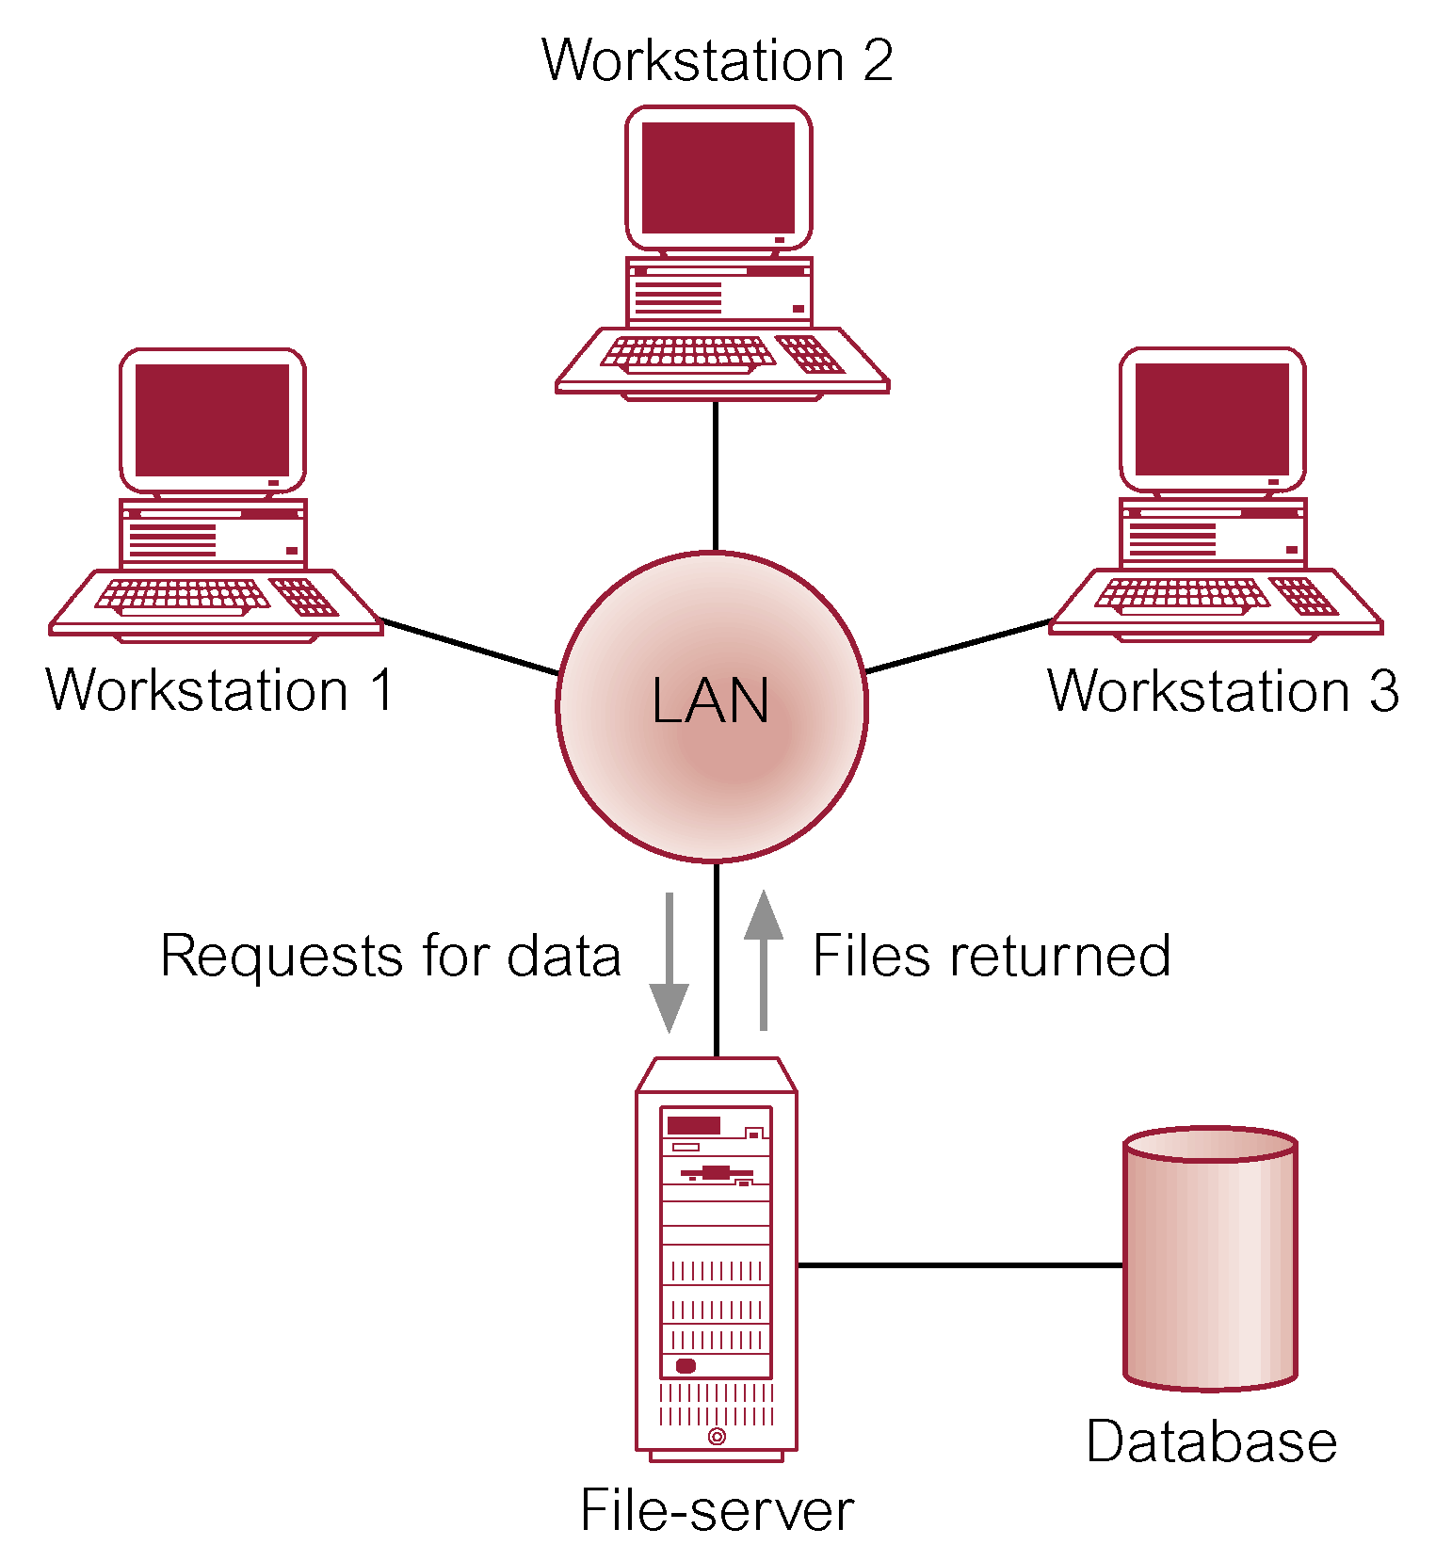
File-server Architecture

Slide 28
Client-server
Server holds the database and the DBMS.
Client manages user interface and runs applications.
Advantages include:
wider access to existing databases
increased performance
possible reduction in hardware costs
reduction in communication costs
increased consistency.

Slide 29
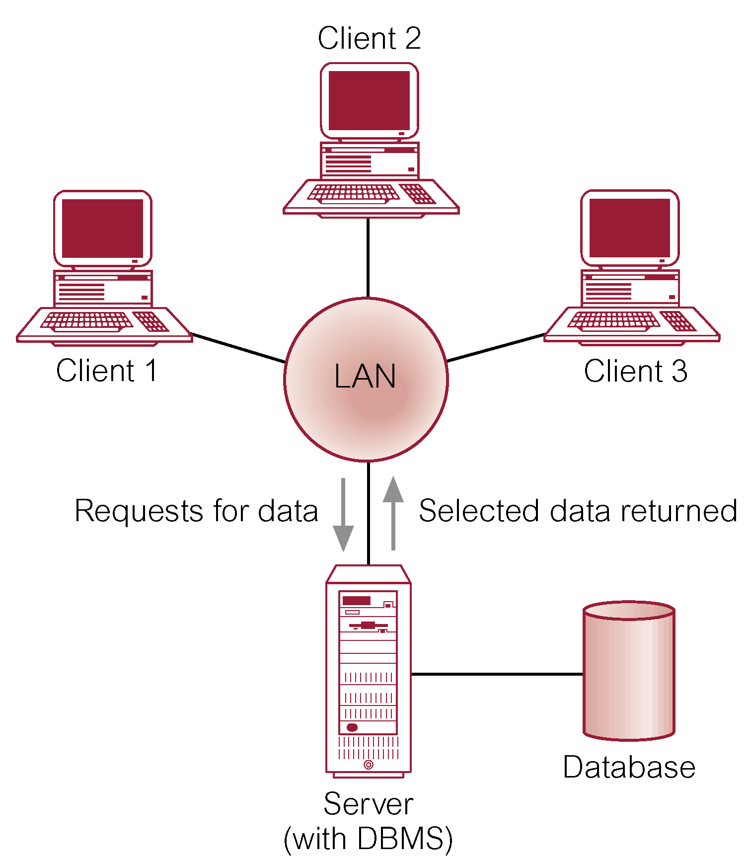
Client-server Architecture

