Slide 1
حوسبة التجارة
e-Commerce
- An Introduction -
أ.د. حسنين محمد البرهمتوشي
Hassanin M. Al-Barhamtoshy
hassanin@kau.ed.sa

Slide 2


Notes:
introduction

Slide 3


The Evolution of E-Commerce
History Repeats Itself (again)
Daniel V. Klein
dan@klein.com

Slide 4
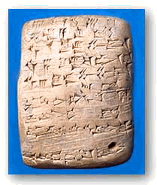

In the beginning…
…the Earth was without form, and void; and darkness was on the face of the deep.
Notes:
The original currencies were property – sheep, oxen, grain, and textiles, because they were valuable. Once life was no longer strictly hand-to mouth, currencies abstracted in different ways – ornamental textiles, ochre, precious metals and jewels, rare shells, rounded rocks (Yap island). Wealth was having a lot of what other people wanted. Commerce was trading what you had for what you wanted.
Transactions based on promises - Venice: flags seen from towers as ships approached
Space shuttle more than worth it’s weight in gold

Slide 5
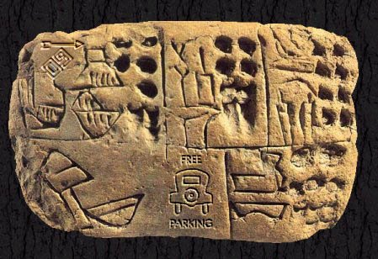
Notes:
This is not a talk about facts alone. It is about history: observation, inference, prediction, guesswork and ratiocination (Sherlock Holmes: detective work)

Slide 6
Where E-commerce began
Telegraph (demonstrated in 1844) spread with the railroads in the mid 1800’s
  Coast-to-coast by 1861
  Ordering goods and services remotely
  Wire transfer of funds (backed by physical transit later on by Express)
  The promise of goods and of payment
Transatlantic Cables – 1857-1866
Notes:
Cables transmitting at 50 baud
Online Newspapers being read in 1939
OED, on a railroad line: http://dictionary.oed.com/public/news/0109.htm

Slide 7
Electronic Genesis
Until very recently, only computer people had computers
Started to change in the 1980’s
Paradigm shift in 1995 – the World Wide Web
Notes:
Computer people used regular commerce – reverse alchemy, they turned gold into sand (silicon)
In 1980’s, “normal” people started getting computers, and in 1995, the web started to take off. Suddenly, critical mass was reached.
In 6 years, the world has changed – completely and irreversibly

Slide 8
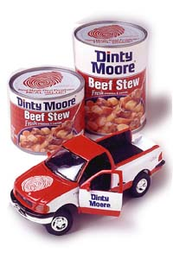
Checks & Credit Cards
In the early 19th Century, there were cheques
Credit cards only started to
become widely accepted in
the 1950’s
Notes:
Early e-commerce – you manufacture a marker for your account
Limited acceptance, based on trust or membership
Diner’s club, Dinty Moore as a restaurant reviewer

Slide 9
Evolution & Natural Selection
Natural selection works in nature
It also works in computers & business
  Digital Equipment Corporation
  Microsoft
  Linux
It also works in politics and e-commerce
Notes:
DEC – extincted by politics
Microsoft – big dinosaur, the comet is coming
Linux – Little furry rodents will fill ecological niches
Politics you know much better than I do!

Slide 10
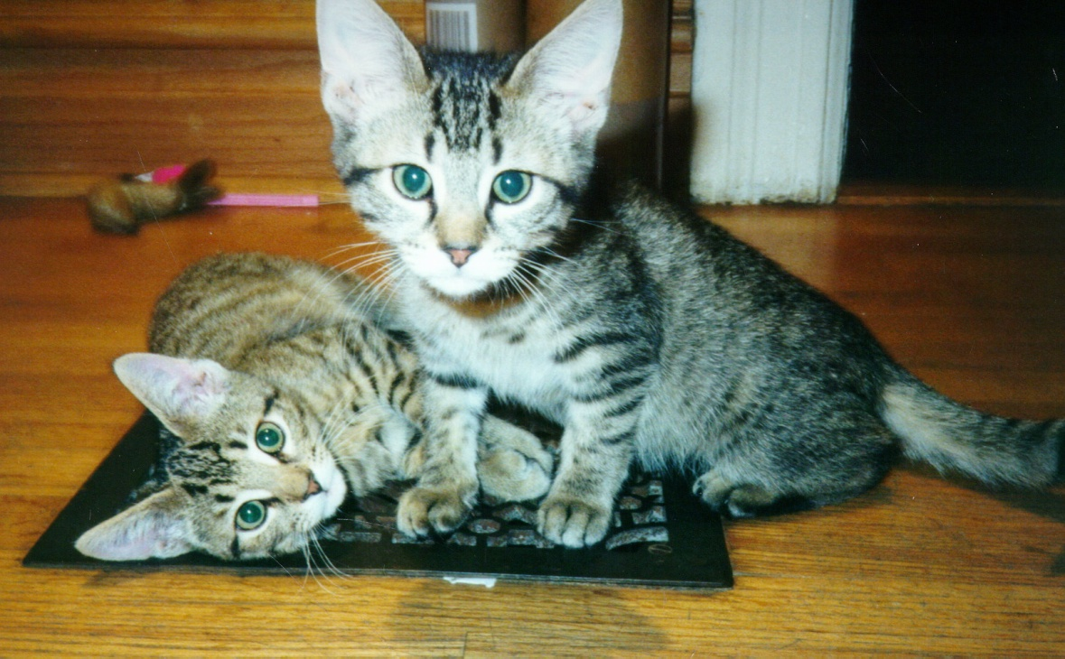
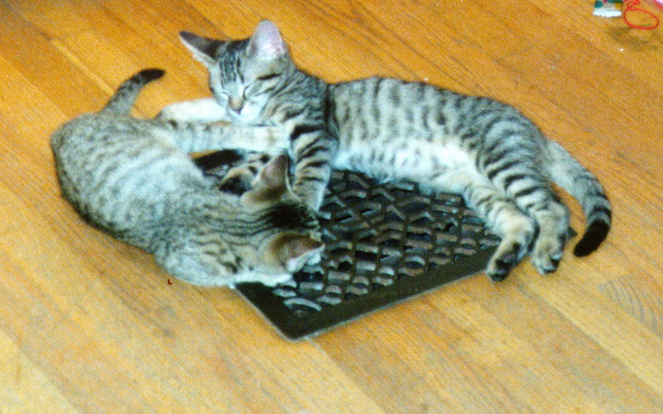

Slide 11

Church and State
Taxation is okay
  You have to pay for armies
Killing is okay
  They are infidels
Theft is okay
  Spoils of war
Lending money at interest is bad
  A venial sin!
Notes:
Other bright ideas
Carrying charges - interest that isn’t interest (see also tax refund checks and check advance)
Gregory VI, whores in the Vatican
Jakob Fugger, 6M guilders in 1425 (7' x 8' x 8' … 6 of those!)
private armies in the 14-15th century, roving mercenaries
Can't fight 'em, they can burn you at the stake

Slide 12
You’ll do it my way
Big companies try to set rules
Need special accounts with special banks, everyone uses my bank (or pay extra)
Special hardware attached to your computer
Place order online, call company with credit card information, exchange PIN numbers
Notes:
Anyone can do it - New Age religions

Slide 13
Company Store, Company Scrip
People work, are paid in company scrip
Can use scrip to shop at company store
Scrip has theoretical cash value
  Cannot readily exchange for dollars
  Company store engages in price gouging
  Employees are slaves
Notes:
There were exceptions to the slavery rule, and companies gave employees a better deal (viz. The army’s PX, although the currency is usually dollars)

Slide 14
Cybercash / Cyberwallet
You buy cyberdollars with real dollars
Clients buy services with cyberdollars
Companies accept cyberdollars as payment
Companies sell cyberdollars to get real dollars
Transaction fees when you exchange
Notes:
Last item – sounds like the Euro :-)

Slide 15
Private Banks
In 17th – 19th centuries, banks were private
Uninsured
  If your bank was robbed, you lost your money
  If your bank folded or absconded, you lost
Largely unrelated
  No ATMs, elaborately coded letters of credit
Notes:
Bank of England was originally the Bank of the Crown, not the English People.
Mention S&L crisis – new rules, new banks, new thieves, new losses
Who suffers? Little guy!
Exceptions: credit unions, rare national banks (Scotland)

Slide 16
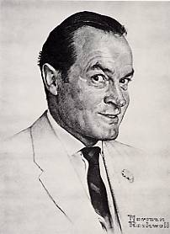
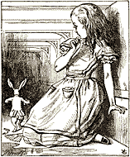
Cryptography
Secure communication is the key
Security is keeping a secret
  Can you hear it?
  Can you understand it?
  Can you reproduce it?
Notes:
Ciphers, steganography, and cryptography have been around for a long time
Caesar used ROT-3, Enigma, Purple, etc., private codes used by agents.
Crypto was used for expensive things (tactics, big movements, big monetary transactions, because crypto was expensive). Only recently, when it becomes cheaper/easier, is it endemic in use.

Slide 17
Purchasing Agents
You hire agent, give letter of credit
Agent goes on road
  Sees goodies
  Sends samples
  You send okay
  Buys on credit, ships goodies
  Credit cleared later
Notes:
Based on long history of trust, obscurity of secrets, and personal(often familial) relationships between banking houses
NOTE: complicated transactions work just fine for: RSA, AFS, Web Certificates… - that’s because the work transparently.

Slide 18
First Virtual
Client signs up with credit card
  By telephone
When buying, submits form
  Server sends email to FV
  FV sends email to client
  Client sends email to FV
  FV sends email to server
  (Can view product before paying!)
Notes:
Same day service in a nanosecond world
Exception to the rule – PayPal - more elaborate than just paying cash, but easy enough for almost any fool to use.

Slide 19
Industrial Revolution
You make stuff, you want to sell it
Unless you are big, you get robbed
  Hire thugs
  Cost of doing business
Unless you are big, transactions are small
  and local or highly specialized
Wholesalers / retailers
Notes:
Merchant class has been around a while (Belgium 15th century), but rarely on a big scale. Controlled by warriors or politics; rise of the guilds.
Hiring thugs was a cost of doing business; losing money was a cost, too
Small transactions are also local and/or highly specialized
Industrial revolution was much more than a revolution of industry. Involved class structure, sales structure, communication, finance, etc. Introduced the middle class, allowed class shifting by brains and not just brawn. Andrew Carnegie, William Randolph Hearst. Earlier examples in Europe.

Slide 20
E-Commerce Revolution
If you want to sell, you need a merchant account
  Have to be big, need credit history, nope - sell on trust, send me a check, get screwed
  Don’t have to be big, just pay a lot, hard to interface to banks
Wholesalers
  Have merchant account, take 15%, take risks
  Enable lower class to sell to world
Notes:
Selling specialized widget, hoping the tourist comes by to buy the matrioshka (vs. selling it to a wholesaler) - the whole concept of blat
Paypal, exception again, makes money on the float

Slide 21
Same Problems, Different People
Large number of credit card wholesalers
  Requires lots of work
  Requires lots of security
Mergers and acquisitions
Survival of the fittest, fattest, fastest
Notes:
Fittest == best
Beta/VHS
Fattest == pay a lot to market your bad idea
Windoze
Fastest == first to market
Not necessarily the best
Not necessarily the ultimate winner
Mergers: Amtrak & ConRail; AT&SF, P&LE, C&N;
Metro; BMT, IRT, IND
Privatization and Nationalization

Slide 22
What’s Next?
Microtransactions
  Pay as you go (or use)
  Utility service analogy
  Rent with utilities included
Currently not cost effective
  Credit card transactions too expensive
  Tracking and reporting issues
Notes:
Accumulation of transactions by Google bill every month, or bill per transaction
Maybe yes, maybe no
Why did AOL go to unlimited use?

Slide 23
So, nu?
There is no difference between commerce and e-commerce
Electronic transactions are just a different type of payment
Protocols have to fit human needs and human models – not the other way around
Your customers are not geniuses
Notes:
E-commerce is just selling stuff electronically, it is not (necessarily) selling electronic things.
So if you have a digital wallet, you need a way to look into it, or have mom lend her son $10, or give kids an allowance
Losing your wallet does not mean you lose your savings – just your portable cash. Losing your Java-ring should mean the same thing – it should not mean losing your identity!

Slide 24


Slide 25
Okay, what is for sale?
Physical media
  Books, parts, cars, music, antiques, junque, etc.
Virtual media
  Programs, memberships, searches, greeting cards, money, etc.
Advertising
  Anyone can be a publisher!

Slide 26
Physical
Barnes & Noble, L.L.Bean, LandsEnd, Clinique, Camera World
Books.com, buy.com, pets.com, groceries.com, wine.com, sparks.com
Amazon.com, PayPal.com
Notes:
1st set: Started selling physical, moved into electronic commerce
2nd set: Started business as a new physical mover of things
3rd set: the lucky one, and move money - no investment in merchandise or warehouse space
Note: first item in each bullet are books

Slide 27
Virtual Media
Sell once
  Buy a program (or picture, or license)
Sell repeatedly (monthly/annually)
  Buy a membership in a site
  Mainly adult-site memberships, others exist
Sell sporadically (access/use)
  Buy information per search
  Moving money (PayPal, IBill)
Notes:
Pictures on a CD, buy right to use them in your work (stock photos)
Memberships - non-adult, to buy in a market place
Prothonotary’s office

Slide 28
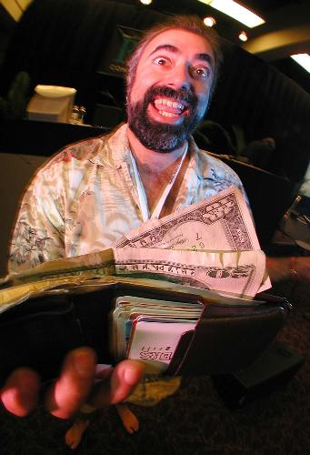
Advertising
Anyone can advertise!
  Selling ads is main motivation
  of free sites
  Not all ads are banners!
Different payment schemes
  Per-impression
  Per-click
  Per-sale
Notes:
Free sites:
Adult site ads (us) $14,000/month
Exit traffic
Buy a keyword: sex 330,300 impressions/day $4954.50/day
fuck 23,500 impressions, $352.50/day
Lycos: Nude Pictures of Pamela Anderson and Monkey
Voyeur.com
Selling lists of searched words to ad companies

Slide 29
Paying for Ads
Per-impression
  Fairest to advertiser (bandwidth costs), but advertiser must trust publisher
Per-click
  Fairest to both (both can track traffic, publisher can pull unsuccessful ads), but susceptible to abuse by both sides (click-bots and trimming by “uniques”)
Per-conversion
  Fairest to advertiser (pay only for results), but publisher must trust advertiser
Notes:
Click-bot, simple 6-line script

Slide 30
Two Distinct Marketplaces
“Adult”
  5–15% click-through rate
  0.1–1% conversion rate
  Lots of traffic from little advertisers
“Mainstream”
  0.25–1% click-through rate
  2–10% conversion rate
  Most traffic through big advertisers
Notes:
What could PlasticFantastic advertise?
A camera site could advertise cameras (not much traffic, though)
A search engine will advertise cameras (lots of potential traffic, easily directed)

Slide 31
Payment Schemes
Per Impression
  Only way on big mainstream advertisers
Per Click
  Few adult sites use it any more – lots of abuse
  Many mainstream sites use it
Per Conversion
  Mainstream and adult
Notes:
Per click still paid with sliding scale based on conversions
Per conversion – pay more than one month’s income for signup
signup vs. retained income (don’t mention yet - 2 slides from now)

Slide 32
Simple Click-bot
#!/usr/bin/perl
use HTTP::Request;
use LWP::UserAgent;
$ua = new LWP::UserAgent;
$ua->agent("Mozilla/4.76");
$req = new HTTP::Request(GET =>
"http://tracker.loser.com/count?id=1a47cb3");
while (1) {
$ua->request($req);
sleep int rand 16;
}
Notes:
About 10,000 clicks/day

Slide 33
Per-Conversion Payment
Different pay-out schemes (depending on business being advertised)
  Per-referral fee
  Per-signup fee
    A fraction of sales
      One-time
      Recurring
    A fraction of anticipated sales
Notes:
Per referral: what does it cost to get a qualified person? Financial companies...
Payout of more than signup as commission:
Web
Insurance companies

Slide 34
Not the end…
Information super-highwayman
  New kinds of sales
  New kinds of commerce
  New kinds of theft
  Different kinds of insurance
  Adaptive restrictions
Back to the Wild West!
Notes:
Brinks, Wells Fargo, riding shotgun
1852 - from the beginning: signs on the first office in San Francisco proclaimed it an “Express and Banking House.” The first ads in 1852 listed the banking services: buying and transporting gold; cashing checks; selling bank drafts payable in other states and overseas [known as exchanges]; accepting deposits and making loans. In the 19th Century, Wells Fargo maintained large banking offices in the major cities of the West, as well as in New York. Wells Fargo's Express network brought its banking services virtually anywhere.
In 1918, the federal government assumed operations of the nation's railroads and express as a wartime measure. Wells Fargo, American Express, Southern Express, and all other express companies' offices, equipment and employees were merged into one vast American Railway Express. The Wells Fargo name disappeared from express wagons and offices at 10,000 locations worldwide, ending an era in American transportation history. At the end of the First World War, there was\ mutual agreement to continue with a unified express company, and the Railway Express Agency continued until 1972. American Express built on its financial services for travelers.
From the wild west arose the biggest, most powerful nation… of narrow minded, egocentric, idots. See that it doesn't happen to e-commerce.

Slide 35
It was the best of times, it was the worst of times.
Instant gratification
  Assessing customer feedback
  Assessing ad effectiveness
Loss of privacy
  Voluntary loss
  Involuntary loss
Loss of anonymity
Big Brother is already watching you!
Notes:
What is your privacy worth?
Fingerprints
Mother’s maiden name
SSN
Some folks are willing to sell their own secrets
Giant Eagle advantage card
Amazon wish list

Slide 36
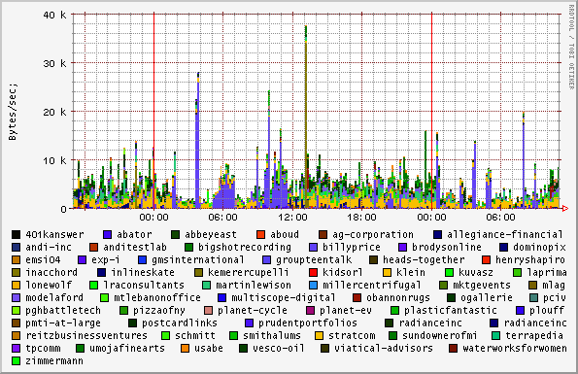
Mainstream Sites - 1 day use

Slide 37
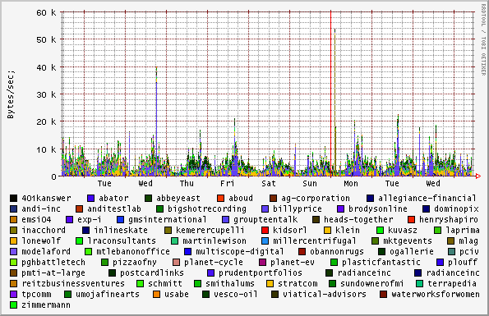
Mainstream Sites - 1 week use

Slide 38
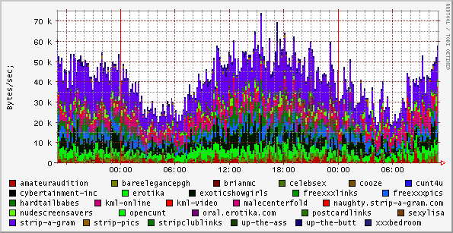
Adult Sites - 1 day use

Slide 39
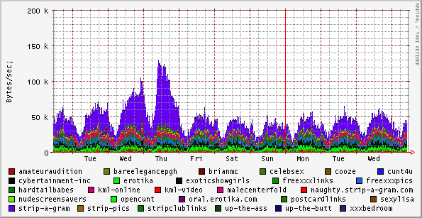
Adult Sites - 1 week use

Slide 40
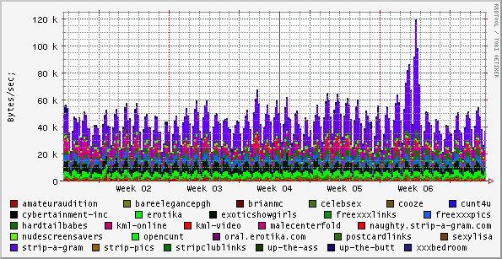
Adult Sites - 1 month use

Slide 41
So… what’s next?
Read science fiction!
  Chester Gould (<1935) – wrist radio
  Frederick Pohl (1965) – joymaker
  John Brunner (1974) – information society
  Robert Heinlein (1959) – computer immersion
  implanted computers, crypto, global networks, intelligent agents, nanobots…
Notes:
Pohl – Age of the Pussyfoot
Vinge – True Names
Brunner – The Shockwave Rider
Toffler – Future Shock
Walter John Williams, Gibson, Heinlein, Rudy Rucker, Niven, Pournell…
Pay for vending machines through cel phone (Australia, Finland) - microtransactions built in!
Started @ Stanford (early 1970’s) using your computer login (beer or not depending on age)

Slide 42
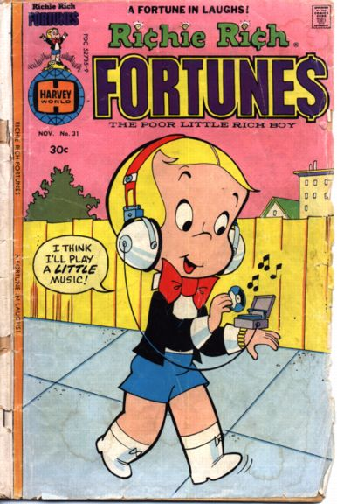
Notes:
1976
In 1964(ish), Danish inventor Karl Krøyer came up with the idea to raise a sunken ship using styrofoam balls. He was denied a patent because the idea (w/ping pong balls) had appeared in Donald Duck in 1949 (http://stp.ling.uu.se/~starback/dcml/story/W+WDC+104-02)

Slide 43
The Evolution of E-Commerce
History Repeats Itself (again)
Daniel V. Klein
dan@klein.com

Slide 45
Electronic Commerce (E-Commerce)
Commerce refers to all the activities the purchase and sales of goods or services.
  Marketing, sales, payment, fulfillment, customer service
Electronic commerce is doing commerce with the use of computers, networks and commerce-enabled software (more than just online shopping)

Slide 46
Brief History
1970s: Electronic Funds Transfer (EFT)
  Used by the banking industry to exchange account information over secured networks
Late 1970s and early 1980s: Electronic Data Interchange (EDI) for e-commerce within companies
  Used by businesses to transmit data from one business to another
1990s: the World Wide Web on the Internet provides easy-to-use technology for information publishing and dissemination
  Cheaper to do business (economies of scale)
  Enable diverse business activities (economies of scope)

Slide 47
E-commerce applications
Supply chain management
Video on demand
Remote banking
Procurement and purchasing
Online marketing and advertisement
Home shopping
Auctions

Slide 48
Ecommerce infrastructure
Information superhighway infrastructure
  Internet, LAN, WAN, routers, etc.
  telecom, cable TV, wireless, etc.
Messaging and information distribution infrastructure
  HTML, XML, e-mail, HTTP, etc.
Common business infrastructure
  Security, authentication, electronic payment, directories, catalogs, etc.

Slide 49
The Main Elements of E-commerce
Consumer shopping on the Web, called B2C (business to consumer)
Transactions conducted between businesses on the Web, call B2B (business to business)
Transactions and business processes that support selling and purchasing activities on the Web
  Supplier, inventory, distribution, payment management
  Financial management, purchasing products and information

Slide 50
Advantages of Electronic Commerce
Increased sales
  Reach narrow market segments in geographically dispersed locations
  Create virtual communities
Decreased costs
  Handling of sales inquiries
  Providing price quotes
  Determining product availability
Being in the space

Slide 51
Disadvantages of Electronic Commerce
Loss of ability to inspect products from remote locations
Rapid developing pace of underlying technologies
Difficult to calculate return on investment
Cultural and legal impediments

Slide 52
The process of e-commerce
Attract customers
  Advertising, marketing
Interact with customers
  Catalog, negotiation
Handle and manage orders
  Order capture
  Payment
  Transaction
  Fulfillment (physical good, service good, digital good)
React to customer inquiries
  Customer service
  Order tracking

Slide 53
Web-based E-commerce Architecture
Tier 1
Tier 2
Tier 3
Tier N
DMS
Client
Web Server
Application Server
Database Server

Slide 54
E-commerce Technologies
Internet
Mobile technologies
Web architecture
Component programming
Data exchange
Multimedia
Search engines
Data mining
Intelligent agents
Access security
Cryptographic security
Watermarking
Payment systems

Slide 55
Infrastructure for E-commerce
The Internet
  system of interconnected networks that spans the globe
  routers, TCP/IP, firewalls, network infrastructure, network protocols
The World Wide Web (WWW)
  part of the Internet and allows users to share information with an easy-to-use interface
  Web browsers, web servers, HTTP, HTML
Web architecture
  Client/server model
  N-tier architecture; e.g., web servers, application servers, database servers, scalability

Slide 56
E-Commerce Software
Content Transport
  pull, push, web-caching, MIME
Server Components
  CGI, server-side scripting
Programming Clients
Sessions and Cookies
Object Technology
  CORBA, COM, Java Beans/RMI
Technology of Fulfillment of Digital Goods
  Secure and fail-safe delivery, rights management

Slide 57
System Design Issues
Good architectural properties
  Functional separation
  Performance (load balancing, web caching)
  Secure
  Reliable
  Available
  Scalable

Slide 58
Creating and Managing Content
What the customer see
Static vs. dynamic content
Different faces for different users
Tools for creating content
Multimedia presentation
Integration with other media
Data interchange
HTML, XML (Extensible Markup Language)

Slide 59
Cryptography
Keeping secrets
  Privacy: interceptor cannot use information
  Authentication: sender’s identity cannot be forged
  Integrity: data cannot be altered
  Non-repudiation: sender cannot deny sending
How to evaluate cryptography
Secret key (symmetric) cryptography; e.g., DES
Public key (asymmetric) cryptosystems; e.g, RSA
Digital signatures, digital certificates
Key management; e.g., PKI

Slide 60
Security
Concerns about security
Client security issues
Server security issues
Security policy, risk assessment
Authentication methods
  Something you know: passwords
  Something you have: smart card
  Something you are: biometrics
Firewalls, proxy servers, intrusion detection
Denial of service (DOS) attacks, viruses, worms

Slide 61
Payment Systems
Role of payment
Cash
  properties: wide accept, convenient, anonymity, untraceability, no buyer transaction cost
Online credit card payment, Smart Cards
  Secure protocols: SSL, SET
Internet payment systems
  Electronic cash, digital wallets
Micro-payments
Wireless devices

Slide 62
Transactions Processing
Transactions and e-commerce
Overview of transaction processing
Transaction processing in e-commerce
Keeping business records, audit, backup
High-availability systems
Replication and scaling
Implementation

Slide 63
Other System Components
Taxes
Shipping and handling
Search engines
Data mining
Intelligent agents
Inventory management, enterprise resource planning (ERP)
Customer relation management (CRM)

Slide 64
Course Outline
Overview of e-commerce
The Internet and the WWW
E-commerce software building blocks and tools
Scalability, high-performance servers, web caching
Basic cryptography
Security, watermarking, firewalls
Payment systems
Current and future directions

Slide 66
Introduction
Why websites don’t work
    Strategy
    Marketing
    Design
    Technology
Traffic Generation
    Search Engines
    E-mail marketing
Notes:
Explain previous seminars

Slide 67
ECommerce
Profit from selling online
Reach customers previously unattainable
Professional Approach
24hr shop
Cheapest sales channel
Notes:
What is ecommerce

Slide 68
ECommerce
What is eCommerce
Our Definition for today
  Selling online
  B2B
  B2C
  Payments online
Notes:
Narrow focus for today

Slide 69
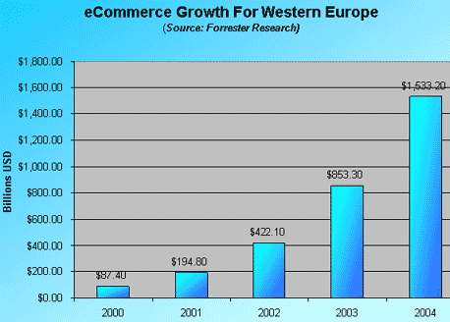

Notes:
Script:
Earlier I stated that the Internet was the greatest revolution. Look at this graph. Back in 1995, $436 million dollars was generated in e-commerce. That number is predicted to grow to the trillions by the year 2006.
Even Forrester Research, one of the leading researchers on the net today, says that whatever they predict, it is not going to be high enough. Every optimistic projection has been surpassed by the actual facts of this rapid growth of e-business. The point of the matter is we are talking about something big here! And what got me most interested in this business, and of course helping my clients, is the ability to get in before it happens, not after it happens. That is what is important in any business strategy.
These are real figures not projections
Key Points:
discuss growth in e-business
emphasize the importance of getting online now

Slide 70
Examples
Ryanair.com – flights and other products
Ireland.com – membership
Amazon.com - Books and other products
eBay.com – Auction
Cbg.ie - Advertising

Slide 71
Growth
Different Reasons
B2B
B2C
Dot-Bomb
Solid reasoning
ROI
Clicks and Mortar
Notes:
Some terms

Slide 72
Myth vs Reality
Easy
Build it and they will come
It can run itself
Online is the same as offline
Its immediate
Requires Work
Needs traffic
Needs Conversion rates
Online is different
It takes time to build and develop

Slide 73
Reality
Targeted Visitors
Conversion Rates
Sales
Profitability
ROI
Research needs
Be Different
Test, Test, Test
Trust
Ask for the order
Make it simple

Slide 74
Targeted traffic
Research online
Keywords
Competition
Links
What’s the problem?
What’s the solution?

Slide 75
Three Categories
Replenishment – B2B
Researched goods – Cars, Computers, Cameras
Convenience goods – Toys, CDs

Slide 76
Three Categories - Opportunities
Replenishment – upsell, complimentary products, e-mail marketing, coupons
Researched goods – Offline sales, product testing, specials, self service.
Convenience goods – New markets, gift registry, Wish list, new products

Slide 77
Return on Investment
Off-line Sales
On-line Sales
Life Time Value
Cost savings
Branding

Slide 78
Advanced Systems
Integrate with EPOS system
Integrate with computer system

Slide 79
Issues with selling online
Products
  What sells
  Presentation
  Information
  Vareities of products
Stock Control
  Can’t sell what you don’t have

Slide 80
Issues with selling online
Pricing
  Retail
  Wholesale
  Members
  Bulk
  VAT
  Currencies

Slide 81
Issues with selling online
Payments
  Cheques
  Credit Cards
  3rd party processing
  Security
  Fraud

Slide 82
Issues with selling online
Delivery
  Post and Packaging
  Legalities
  Safety
  Resources
  Costs

Slide 83
Issues with selling online
Promotion
  SEO/SEM/PPC/PPI
  Links
  Email Marketing
  Online/Offline Promotions
  Gift Certificates
  Coupons
  Custom Catalogue
  Wish Lists/ Gift Registry

Slide 84
Issues with selling online
Process
  Layout
  Shopping experience
  Search facility
  Specials
  Categories
  Quality of Information/images
  Checkout process
  Paperwork

Slide 85
Issues with selling online
Administration Process
  Layout
  Adding products
  Flexibility on layouts/process
  Content Management
  Reporting
  Global Changes

Slide 86
Issues with selling online
Miscellanous
  Automate
  Deliver ontime
  Security
  Communicate
  Other pages
  Trust

Slide 87
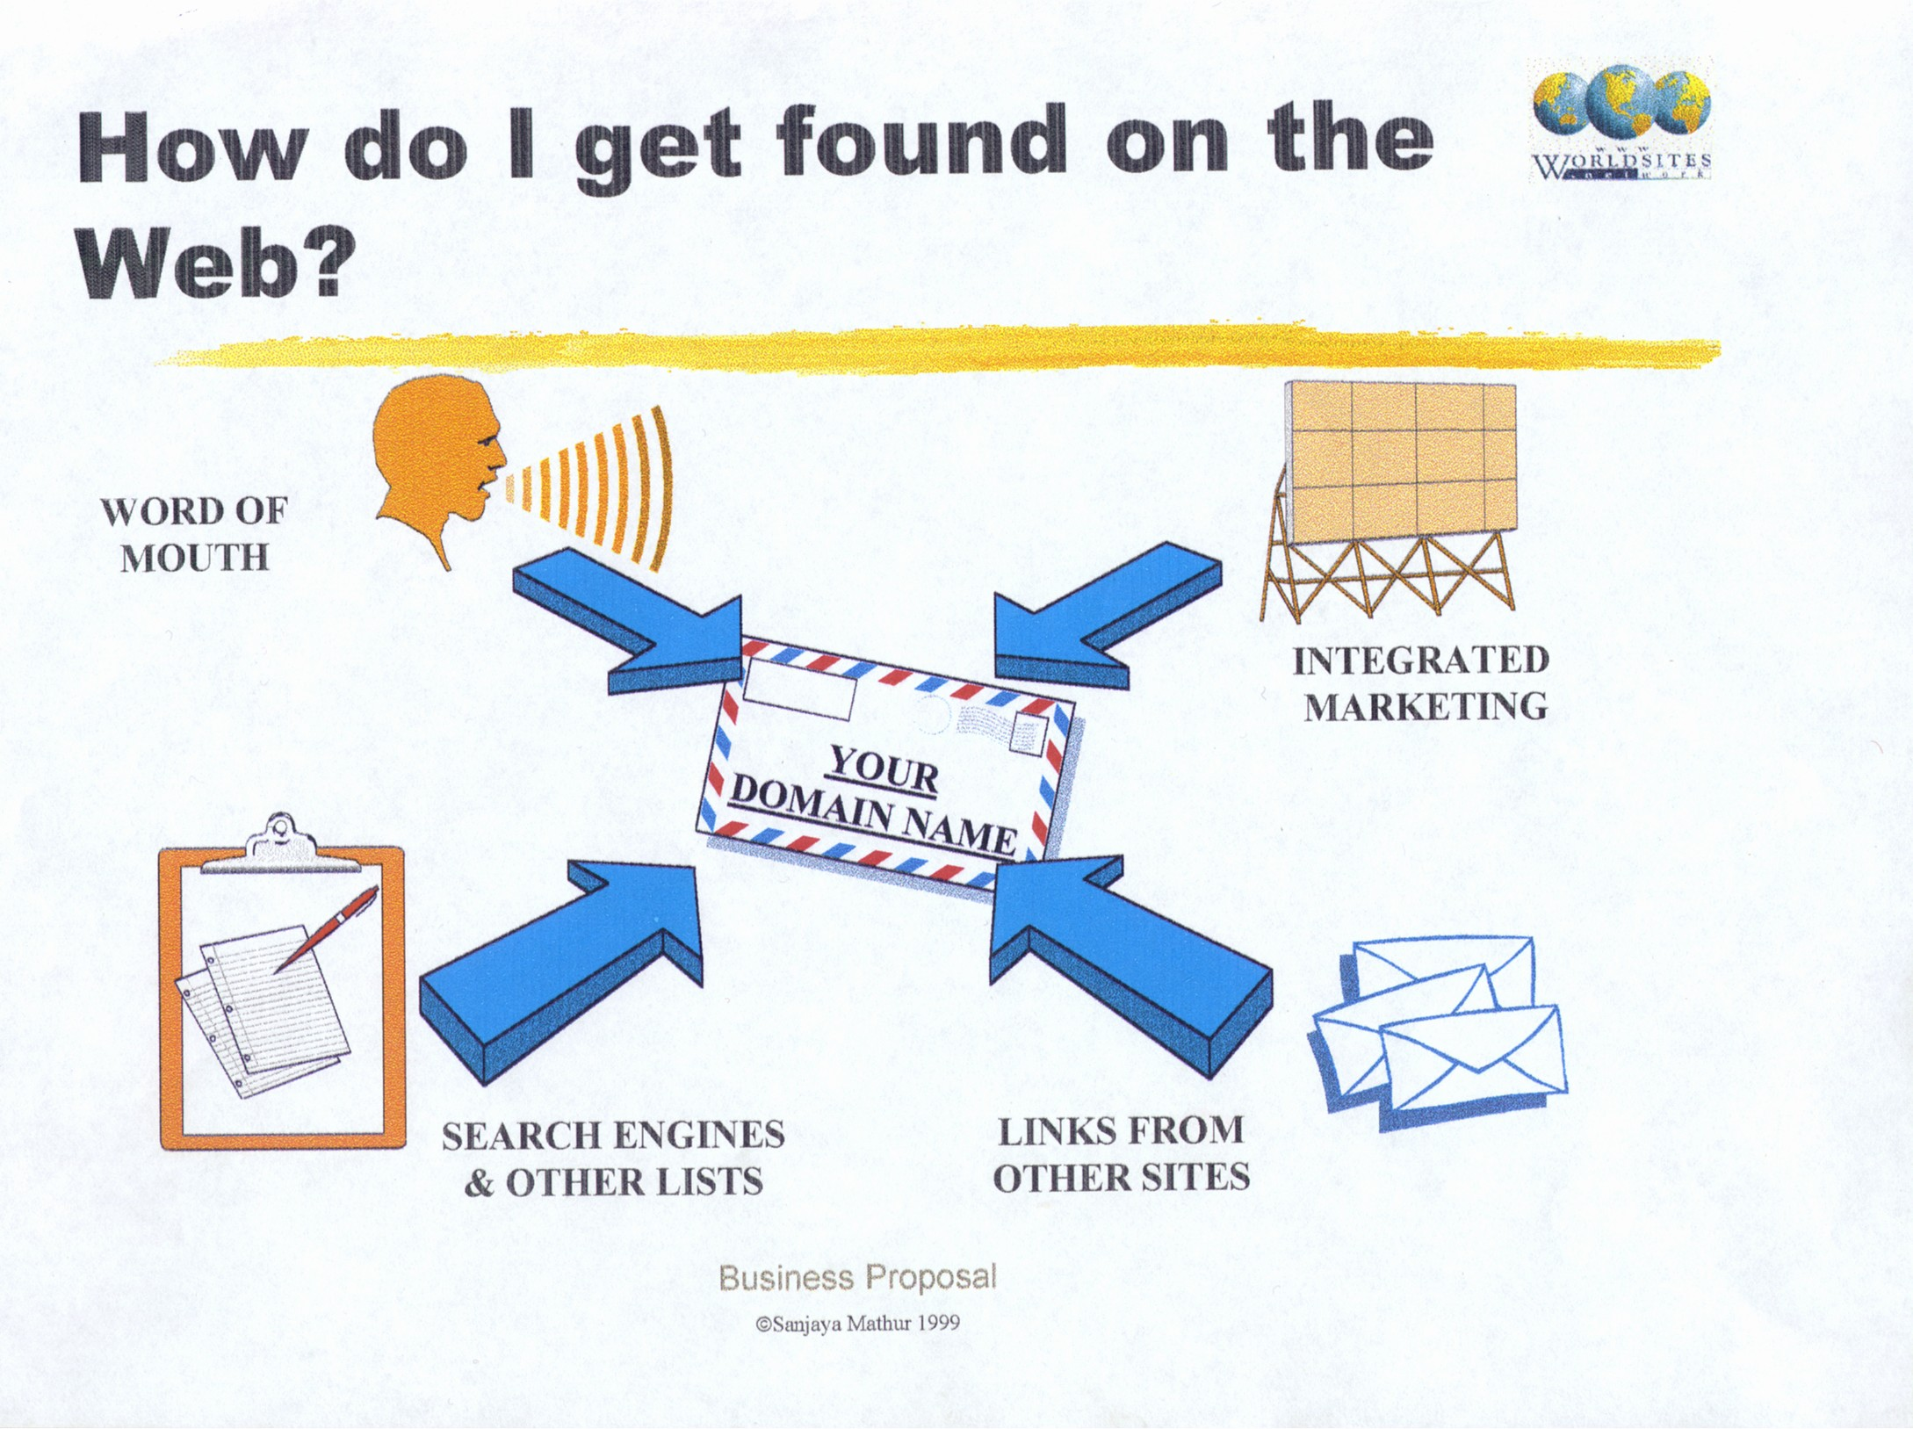
Notes:
Script:
Most websites are unable to generate traffic. So let me explain, by looking at this slide, how traffic is generated to a website. In the center, here is the domain name. That is your website address. We can set up your domain name for you. The objective is we want to drive traffic to your site. How do we do that? One of the ways is with search engine marketing.
Search Engines -- Most websites are like grains of sand, lost on the beaches of the world. Most people just can’t find them. Worldsites has an integrated strategy to help generate traffic to your site. One of the ways we do that is with search engine registration. Not only do we register your site in literally hundreds of search engines and directories around the world, what we do is develop your site in such a way that it is optimized within those search engines -- in other words, so that you site is viewed favorably by search engines. You don’t want to be at the bottom of a list of 50,000 sites. 98% of viewers go to the top 100.
Another way we generate traffic is with integrated marketing. We look at your whole business model and determine how can we get your customers, your suppliers, your employees and anyone who is already associated with your business to leverage off of your Internet presence, so it will improve the service and in many ways reduce costs.
The third way is through a link, and specifically to something we call the Global Gateway; it is unique to Worldsites and has the ability to generate global and regional traffic to your website.

Slide 88
Virtual Global Merchant
What will it do for YOU?
The VGM is your complete website utility for setting up your shop on the Internet. It provides you with the tools necessary in order to successfully market and sell products online.
With the built-in tracking features of the VGM system you can not only generate timely sales and traffic reports but also gauge the effectiveness of your sales strategies.
Notes:
Flagship Product

Slide 89
The (IBA) is an advanced
business analysis tool designed
to help your business:
Internet Business
Analysis (IBA)
Increase Revenue
Reduce Costs
Improve Efficiencies
Notes:
Script:
What I’d like to do now is go through the Internet Business Analysis. Our objective is to find ways we can pay for your website through increased efficiencies, improved revenues or reduced cost. We believe a website should not be an expense but an investment that results in measurable returns on investment. We can only do that if we take the time to analyze your business. There are a lot of hidden opportunities within many businesses that are not capitalized on. So I want to make sure that I understand your business well enough in order to put together a Specialized Internet Business Strategy that is appropriate. So let’s go through it now. I will be taking notes as we work together.

Slide 90
Virtual Global merchant
Developed in C#, Java, C++, XML, XSL and utilising an ISPI Interface (XML and XSL are financial and Insurance standards)
Hosted anywhere
Automatically updated
Modular approach

Slide 91
Virtual Global merchant
128 bit security
Secure Admin area
Encrypted vital Customer information

Slide 92
Virtual Global merchant
Multi currency
Multi Language
Regional shipping
Regional Taxes
Shopping cart
Ecommerce on/off
Checkout process
Third Party credit card/ echeque or not

Slide 93
Virtual Global merchant
Unlimited number of categories/products and styles
Feature products
Product Reviews
Related Products
Product Write-ins
Product Summary
Product description/SCE

Slide 94
Virtual Global merchant
Order without registering
Running tally
Gift Certs
Instore promotions
Gift Wrapping
Discounts
Member pricing
Pick up options
Integration with Fedex, UPS

Slide 95
Virtual Global merchant
Customer access to orders
Member pricing
Wholesale pricing
Supplier support
Wish List
Gift registry
Favourite product
Custom catalogue

Slide 96
Virtual Global merchant
Manage online
All SCE
Store/amend messages
E-mail autoresponders
Dynamic Reporting

Slide 97
Virtual Global merchant
Add-on modules
Auction
Classified Ads
Download on demand
Quickbooks Integration
CRM
Microsoft Quicksell POS system

Slide 98
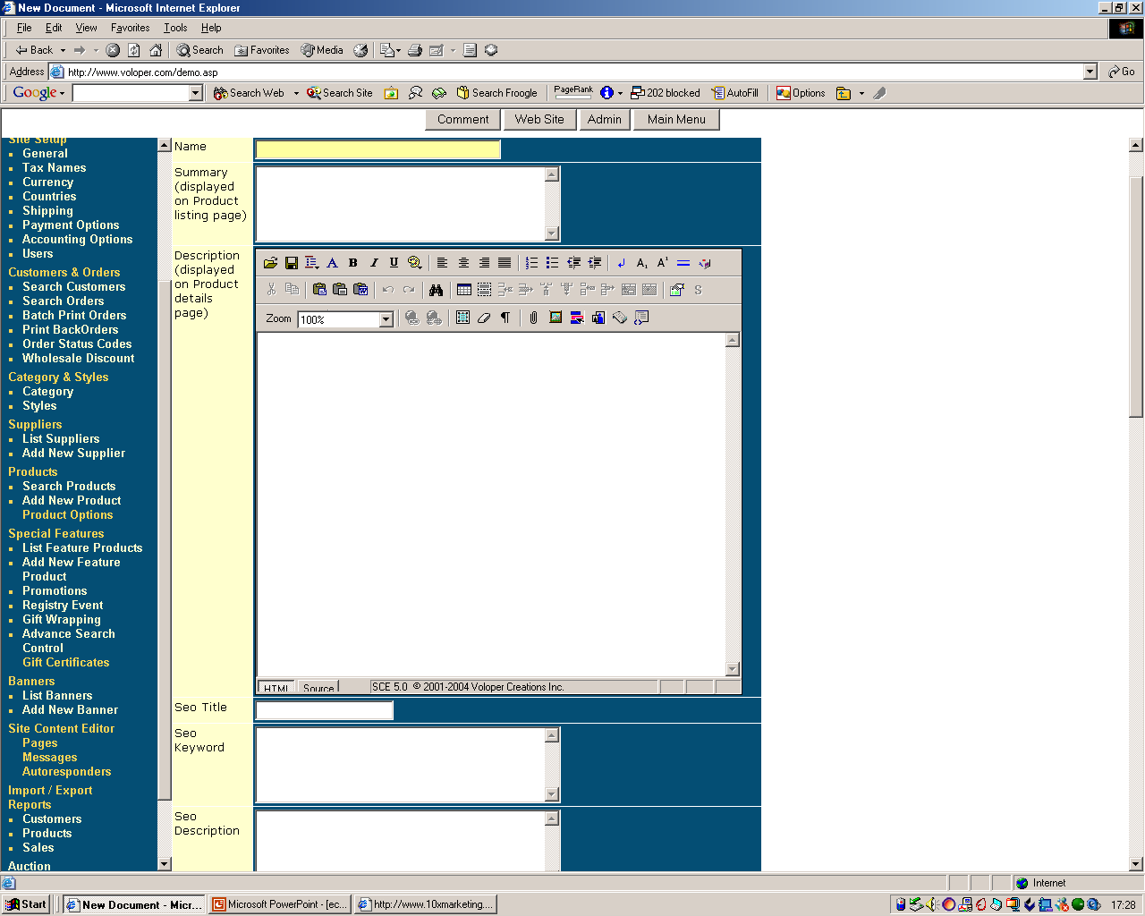
Notes:
Example of Admin area – adding a new product and the extensive list of functions and options

Slide 99
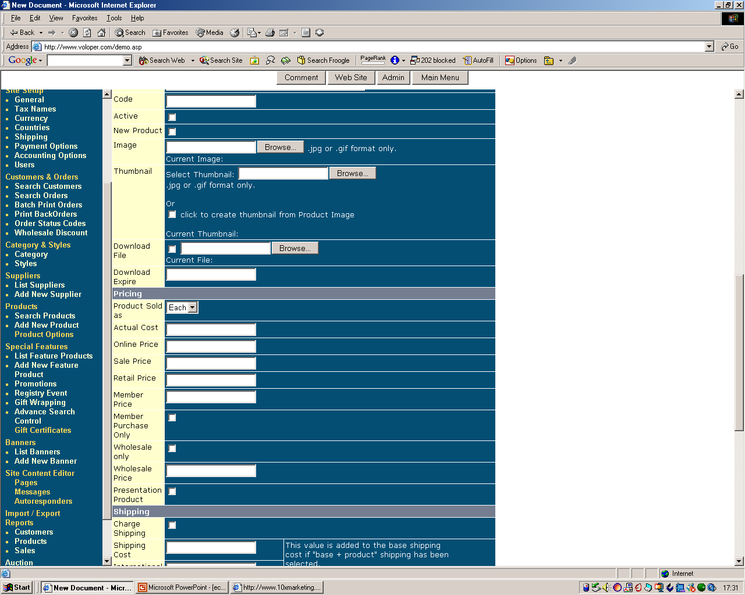

Slide 100
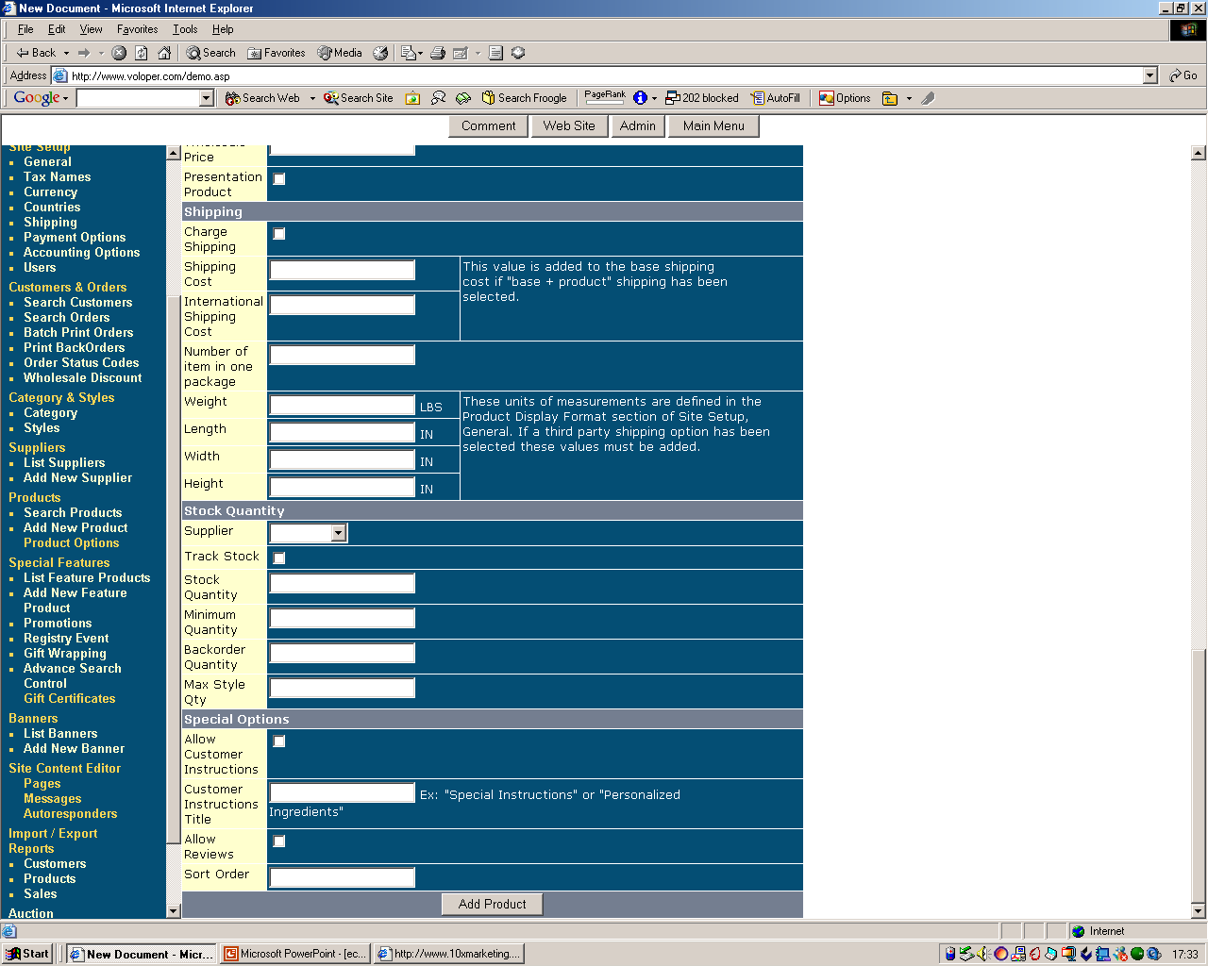

Slide 102
Thanks
Q & A

