Slide 1
Applications of the Bernoulli Equation

Slide 2
The Bernoulli equation can be applied to a great many
situations not just the pipe flow we have been
considering up to now. In the following sections we
will see some examples of its application to flow
measurement from tanks, within pipes as well as in
open channels.

Slide 3
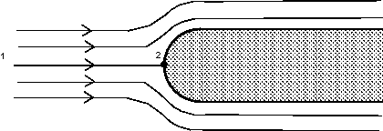
Pitot Tube
From the Bernoulli equation we can calculate the pressure at point 2. Apply Bernoulli along the central
streamline from a point upstream where the velocity is u₁ and the pressure p₁ to the stagnation point of the
blunt body where the velocity is zero, u₂ = 0. Also z₁ = z₂.

Slide 4
Converting pressure into pressure head, we get

Slide 5
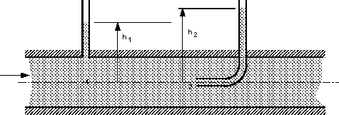
The blunt body stopping the fluid does not have to be a solid. It could be a static column of fluid. Two piezometers, one as normal and one as a Pitot tube within the pipe can be used in an arrangement shown below to measure velocity of flow.

Slide 6
Using the above theory, we have the equation for p₂

Slide 7
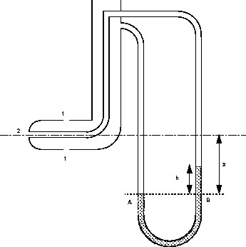
Pitot Static Tube

Slide 8
The Pitot static tube combines the two tubes and they can then be easily connected to a manometer.
The holes on the side of the tube connect to one side of a manometer and register the static head, (h₁), while the central hole is connected to the other side of the manometer to register, as before, the stagnation head (h₂).
      P_{A} = P₂ + ρ g X
      P_{B} = P1 + ρ g (X-h) + ρ_{man} g h
      P_{A} = P_{B}

Slide 9
The Pitot/Pitot-static tubes give velocities at points in the flow. It does not give the overall discharge of the stream, which is often what is wanted.

Slide 10
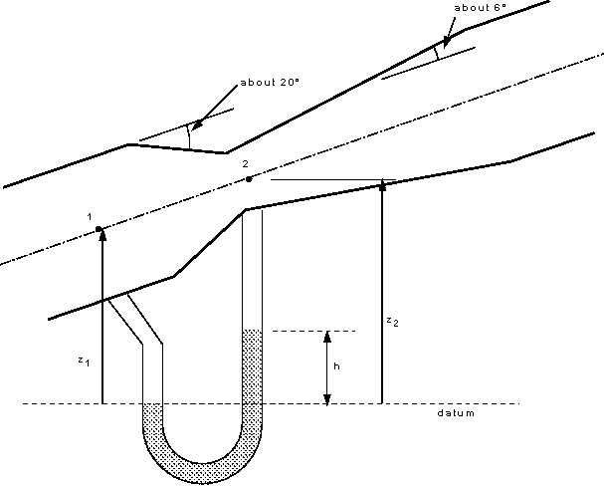
Venturi Meter

Slide 11
Applying Bernoulli’s between point 1 & 2 get
By applying the continuity equation
Q = A₁u₁ =A₂u₂
Substituting in Bernoulli’s equation and rearranging

Slide 12
To get the theoretical discharge this is multiplied by the area. To get the actual discharge taking in to account the losses due to friction, we include a coefficient of discharge

Slide 13
After substitution and rearranging
Notice how this expression does not include any terms for the elevation or orientation (z₁ or z₂) of the Venturimeter. This means that the meter can be at any convenient angle to function.

