Slide 1
The Bernoulli Equation - Work and Energy
Conservation of Energy
Sum of kinetic energy and gravitational potential energy is constant.
Kinetic energy =
Gravitational potential energy = mg h
To apply this to a falling droplet we have an initial velocity of zero, and it falls through a height of h

Slide 2
Initial kinetic energy = 0
Initial potential energy = mg h
Final kinetic energy =
Final potential energy = 0
Notice that the pressure is constant.
Initial kinetic energy + Initial potential energy = Final kinetic energy + Final potential energy

Slide 3
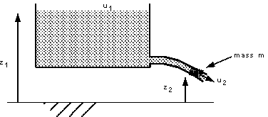
In this way , the velocity of a drop of water can calculated in theory. It is also applied to any case. For example to calculate the velocity of water exiting an orifice:
Initial kinetic energy = 0
Initial potential energy = mg z₁
Final kinetic energy = 0.5 mu²
Final potential energy = mgz₂

Slide 4
We know that
kinetic energy + potential energy = constant
Compare these equations

Slide 5
Bernoulli’s Equation
Bernoulli’s equation is one of the most important and useful equations in fluid mechanics. It may be written,
We see that from applying equal pressure or zero velocities we get the two equations from the section above. They are both just special cases of Bernoulli’s equation.

Slide 6
Bernoulli’s equation has some restrictions in its applicability, they are:
- Flow is steady;
- Density is constant (which also means the fluid is incompressible);
- Friction losses are negligible.
All these conditions are impossible to satisfy at any instant in time! Fortunately for many real situations
where the conditions are approximately satisfied, the equation gives very good results.

Slide 7
By the principle of conservation of energy the total energy in the system does not change, Thus the total
head does not change. So the Bernoulli equation can be written,

Slide 8
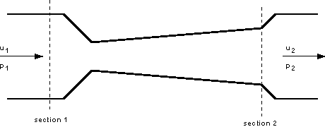
An example of the use of the Bernoulli equation.
When the Bernoulli equation is combined with the continuity equation the two can be used to find velocities and pressures at points in the flow

Slide 9
A fluid of constant density ρ = 960 kg / m³ is flowing steadily through the above tube. The diameters at
the sections are d₁ = 100 mm and d₂ = 80 mm. The gauge pressure at 1 is p₁ = 200 kN/ m² and the velocity
here is u₁ = 5 m/ s. We want to know the gauge pressure at section 2.
The tube is horizontal, with z₁ = z₂ so Bernoulli gives us the following equation for pressure at section 2:

Slide 10
But we do not know the value of u₂ . We can calculate this from the continuity equation: Discharge into
the tube is equal to the discharge out i.e.
A₁u₁ = A₂u₂
u₂ = 7.8125 m/s
p2 = 217.3 kN/m²

Slide 11
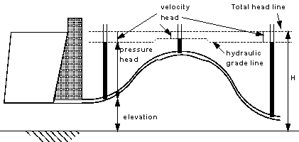
Notice the figure and relate with Bernoulli’s equation

Slide 12
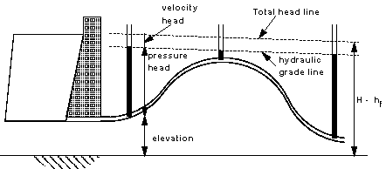
Energy losses due to friction

Slide 13
In a real pipe line there are energy losses due to friction - these must be taken into account as they can be very significant.
The total head - or total energy per unit weight – is
constant. We are considering energy conservation, so if we allow for an amount of energy to be lost due to friction the total head will change.

