Slide 1

HUMAN RESOURCE MANAGEMENT
Global Edition 12e
Chapter 6
Managing Global Human Resources
Part 5 Employee Relations
Copyright © 2011 Pearson Education
GARY DESSLER
PowerPoint Presentation by Charlie Cook
The University of West Alabama
Notes:
Human Resources Management 12e
Gary Dessler
Copyright © 2011 Pearson Education
1–1

Slide 2

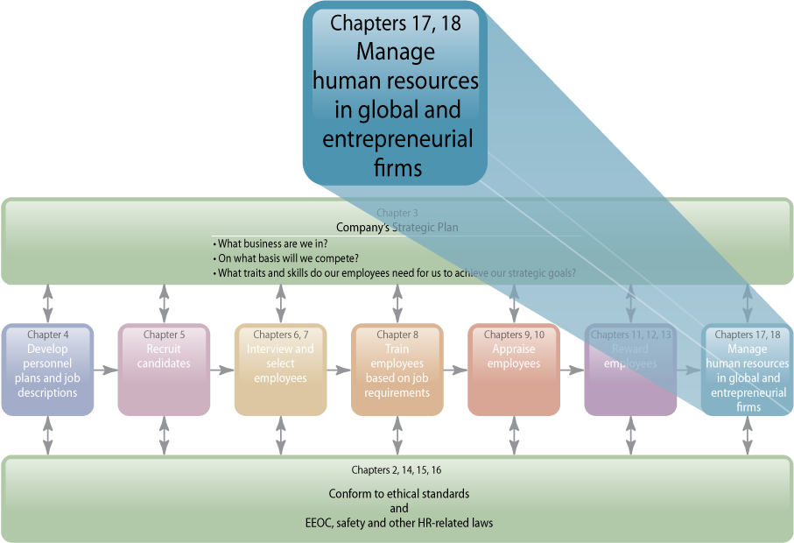
WHERE WE ARE NOW…
Notes:
More managers and employers today find themselves managing people internationally. The purpose of this chapter is to improve your effectiveness at applying your human resource knowledge and skills when global issues are involved. The topics we’ll discuss include the internationalization of business, inter-country differences affecting HR, improving international assignments through selection, and training and maintaining international employees.

Slide 3
LEARNING OUTCOMES
List the HR challenges of international business.
Illustrate with examples how intercountry differences affect HRM.
List and briefly describe the main methods for staffing global organizations.
Discuss some important issues to keep in mind in training, appraising, and compensating international employees.
Explain with examples how to implement a global human resource management program.

Slide 4
HR and the Internationalization of Business
The Global Challenges
  Coordinating market, product, and production plans on a worldwide basis
  Creating organization structures capable of balancing centralized home-office control with adequate local autonomy
  Extending HR policies and systems
  to service staffing needs abroad
Notes:
Taking the company global triggers various management challenges. The employer has to install all those management systems it needs to manage its overseas activities. These management systems include organization structures, managerial controls, worldwide banking relationships, and, of course, human resource management systems for recruiting, selecting, training, and appraising and compensating its workers abroad.

Slide 5
Challenges of International HRM
Deployment
  Getting the right skills to where they are needed, regardless of geographic location
Knowledge and Innovation Dissemination
  Spreading state-of-the-art knowledge and
  practices throughout the organization regardless
  of their origin
Identifying and Developing Talent
on a Global Basis
  Identifying those who can function effectively in a global organization and developing their abilities
Notes:
Taking the company global triggers various management challenges. The employer has to install all those management systems it needs to manage its overseas activities. These management systems include organization structures, managerial controls, worldwide banking relationships, and, of course, human resource management systems for recruiting, selecting, training, and appraising and compensating its workers abroad.

Slide 6
Intercountry Differences Affecting HRM
Cultural factors and ethics issues
International
Human Resource Management
Political/Legal
systems
Economic
systems
Labor
relations
Notes:
Companies operating only within the United States generally have the luxury of dealing with a relatively limited set of economic, cultural, and legal variables. A company operating multiple units abroad doesn’t face such homogeneity. Managers have to be cognizant of and generally adapt their human resource policies and practices to cope with the cultural, political, legal, and economic differences among countries.

Slide 7
Global Differences and Similarities in HR Practices
Personnel
selection
procedures
Use of pay and
other incentives
International
HRM
Purpose of performance appraisal
Training and development practices
Notes:
The wide variations in human resource management practices among companies around the world impact on and create complexity in the development of international HRM practices. A practice that works in one country may not work at all in another country and may even be illegal.

Slide 8
Staffing the Global Organization
International staffing: Home or local?
  Expatriates (expats)
  Home-country nationals
  Third-country nationals
Offshoring
  Having local employees abroad do jobs that the firm’s domestic employees previously did in-house
Offshoring Issues
  Effective local supervisory/management structure
  Screening and required training for locals
  Local compensation policies and working conditions
Notes:
Filling a company’s jobs abroad has traditionally been the heart of international human resource management. The process involves identifying and selecting the people who will fill the positions, and then placing them in those positions.
Offshoring and its increasing popularity raises important international staffing issues.

Slide 9
Management Values and
International Staffing Policy
Top Management Values
Ethnocentric
Polycentric
Geocentric
Notes:
Experts classify top executives’ values related to how international operations are staffed as ethnocentric, polycentric, or geocentric.

Slide 10
Selecting Expatriate Managers
Adaptability Screening
  Assessing the assignee’s (and spouse’s)
  probable success in handling the foreign transfer.
  Overseas Assignment Inventory
    A test that identifies the characteristics and attitudes international assignment candidates should have.
Realistic Previews
  Cover problems to expect in the new job, as well as the cultural benefits, problems, and idiosyncrasies
  of the country.
Notes:
Adaptability screening aims to assess the expatriate assignees’ (and spouses’) probable success in handling the foreign transfer, and to alert the firm to issues (such as the impact on children) the move may involve and which may affect the assignee’s success in completing the international assignment.

Slide 11
FIGURE 17–2 Five Factors Important in International Assignee Success and Their Components
I. Job Knowledge and Motivation
Managerial ability
Organizational ability
Imagination
Creativity
Administrative skills
Alertness
Responsibility
Industriousness
Initiative and energy
High motivation
Frankness
Belief in mission and job
Perseverance
II. Relational Skills
Respect
Courtesy
Display of respect
Kindness
Empathy
Nonjudgmental
Integrity
Confidence
III. Flexibility/Adaptability
Resourcefulness
Ability to deal with stress
Flexibility
Emotional stability
Willingness to change
Tolerance for ambiguity
Adaptability
Independence
Dependability
Political sensitivity
Positive self-image
IV. Extracultural Openness
Variety of outside interests
Interest in foreign cultures
Openness
Knowledge of local language(s)
Outgoingness and extraversion
Overseas experience
V. Family Situation
Adaptability of spouse and family
Spouse’s positive opinion
Willingness of spouse to live abroad
Stable marriage
Notes:
Figure 17-2 shows the five items identified in one study that asked international assignees from various countries to specify which traits were important for success in a foreign assignment.

Slide 12

FIGURE 17–3
Overseas Assignment
Inventory
Notes:
Many firms also use tests such as the Overseas Assignment Inventory (OAI). This identifies the characteristics and attitudes international assignment candidates should have. Its publisher establishes local norms and conducts ongoing validation studies. Figure 17-3 illustrates the OAI.

Slide 13
Personality of expatriate
Inability of spouse
to adjust
Why Expatriate
Assignments Fail
Personal
intentions
Inability to cope
with overseas responsibilities
Family
pressures
Lack of cultural
skills
Notes:
Several factors can impact on the likelihood that an expatriate assignment will be successful.

Slide 14
Making Expatriate Assignments Successful
Realistic previews
Careful screening
Helping
Expatriate Assignments Succeed
Improved orientation
Cultural and language training
Improved benefits package
Notes:
Many employers post expatriates abroad, but often assignments fail. Understanding the main potential problems and what actions to take to make a successful assignment are important management skills.

Slide 15
Orienting and Training Employees on International Assignment
Predeparture training is needed on:
  The impact of cultural differences on
  business outcomes
  How attitudes (both negative and positive)
  are formed and how they influence behavior
  Factual knowledge about the target country
  Language and adjustment and adaptation skills
Notes:
When it comes to the orientation and training required for success overseas, the practices of most U.S. employers reflect more talk than substance. Executives tend to agree that international assignees do best when they receive the special training (in things like language and culture) that they require. However, few companies actually provide such training.

Slide 16
Trends in Expatriate Training
Use of returning managers as resources to cultivate
the “global mind-sets” of their home-office staff.
Use of software and the Internet for cross-cultural training.
Rotating assignments that permit professional growth.
Management development centers where executives hone their overseas skills.
Classroom programs provide overseas executives with educational opportunities similar to stateside programs.
Continuing, in-country cross-cultural training.
Notes:
This slide lists some of the methods that firms use to provide continuing, in-country cross-cultural training during the early stages of an overseas assignment.

Slide 17
Compensating Expatriates
The “Balance Sheet Approach”
  Home-country groups of expenses—income taxes, housing, goods and services, and discretionary expenses—are the focus of attention.
  The employer estimates what each of these four expenses is in the expatriate’s home country,
  and what each will be in the host country.
  The employer then pays any differences such
  as additional income taxes or housing expenses.
Notes:
The most common approach to formulating expatriate pay is to equalize purchasing power across countries, a technique known as the balance sheet approach.
Table 17-1 in the textbook illustrates the balance sheet approach for someone transferring from the U.S. to Belgium.

Slide 18

TABLE 17–1 The Balance Sheet Approach (Assumes U.S. Base Salary of $80,000)
Annual Expense | Chicago, U.S. | Brussels, Belgium (US$ Equivalent) | Allowance
Housing & utilities | $35,000 | $67,600 | $32,600
Goods & services | 6,000 | 9,500 | 3,500
Taxes | 22,400 | 56,000 | 33,600
Discretionary income | 10,000 | 10,000 | 0
Total | $73,400 | $143,100 | $69,700

Slide 19
Incentives for International Assignments
Foreign Service Premiums
  Financial payments over and above regular base pay, and typically range between 10% and 30% of base pay
Hardship Allowances
  Payments to compensate expatriates
  for exceptionally hard living and working conditions at certain foreign locations
Mobility Premiums
  Lump-sum payments to reward employees for moving from one assignment to another
Notes:
Employers use incentives to encourage participation in international assignments. Foreign service premiums are financial payments over and above regular base pay. Hardship allowances compensate expatriates for hard living and working conditions at certain foreign locations. Mobility premiums are lump-sum payments to reward employees for moving from one assignment to another.

Slide 20
Steps in Establishing a Global Pay System
1
Develop a global compensation philosophy framework.
2
Identify any gaps in existing rewards systems.
3
Systematize pay systems worldwide.
4
Adapt global pay policies to local conditions.
5
Conduct an ongoing pay policies program assessment.
Notes:
Balancing global consistency in compensation with local considerations starts with establishing a rewards program that supports the employer’s strategic needs. In practice, doing so involves five steps (probably over several years).

Slide 21
Appraising Expatriate Managers
Challenges
  Determining who should appraise the manager.
  Deciding on which factors to base the appraisal.
Improving the Expatriate Appraisal Process
  Stipulate the assignment’s difficulty level, and
  adapt the performance criteria to the situation.
  Weigh evaluation more toward on-site manager’s appraisal than toward that of the home-site manager.
  If home-office manager does appraisal, use a former expatriate from same overseas location for advice.
Notes:
Several things complicate the task of appraising an expatriate’s performance. The questions of who will appraise the expatriate and which performance measures to use are crucial.

Slide 22
International Labor Relations
Characteristics of European Labor Relations
Industry-wide centralization
Employer organization
Multiple union recognition
Content and scope of bargaining
Notes:
Firms opening subsidiaries abroad will find substantial differences in labor relations practices among countries and regions. This is important, because, while union membership is dropping in the United States, it is still relatively high abroad, and unions abroad therefore tend to be more influential. Union-employer relations vary markedly across different European countries.

Slide 23
Terrorism, Safety, and Global HR
Taking Protective Measures
  Crisis management teams
  Intelligence services
Kidnapping and Ransom (K&R) Insurance
  Crisis situations
    Kidnapping: employee is a hostage
    until employer pays a ransom
    Extortion: threatening bodily harm
    Detention: holding employee without
    any ransom demand
    Threats to property or products unless
    employer makes a payment
Notes:
The increased threat of terrorism is affecting human resource activities in many ways. Prospective expatriates are increasingly reluctant to take their families abroad, and those who do are demanding more compensation. Travel between countries is becoming more difficult. And for employees and facilities abroad, employers have had to institute more comprehensive safety plans, as well as other measures.

Slide 24
Repatriation: Problems and Solutions
Problem
  Making sure that the expatriate and his or her family don’t feel that the company has left them adrift.
Solutions
  Match the expat and his or her family with
  a psychologist trained in repatriation issues.
  Make sure the expat always feels “in the loop”
  with what’s happening back at the home office.
  Provide formal repatriation services when
  the expat returns home.
Notes:
A worrisome fact about sending employees abroad is that 40% to 60% of them will probably quit within 3 years of returning home. Given the investment in training and sending these high-potential people abroad, it makes sense to do everything possible to make sure they stay with the firm. For this, formal repatriation programs can be quite useful.

Slide 25
How to Implement a Global HR System
Best practices in developing worldwide human resource policies and practices:
  Form global HR networks that make local HR managers a part of global teams.
  Remember that it’s more important to standardize ends and competencies than specific methods.
Notes:
With employers increasingly relying on local rather than expatriate employees, transferring one’s selection, training, appraisal, pay, and other human resource management practices abroad is a top priority.
Employers who successfully implement global HR systems do so by applying several best practices. This enables them to install uniform global human resource policies and practices around the world. The basic idea is to develop systems that are acceptable to employees in units around the world, and ones that the employers can implement more effectively.

Slide 26
Making the Global HR System
More Acceptable
Best practices for making a global HR system
more acceptable to local managers:
  Remember that global systems are more accepted in
  truly global organizations.
  Investigate pressures to differentiate and determine
  their legitimacy.
  Try to work within the context of a strong corporate culture.
Implementing the global HR system:
  Constant contact: “You can’t communicate enough.”
  Dedicate adequate resources for a global HR effort.
Notes:
Employers engage in three best practices so that the global human resource systems they develop will be acceptable to local managers around the world.

Slide 27
TABLE 17–2 Summary of Best Global HR Practices
Do . . .
Don’t . . .
Work within existing local systems—integrate global tools into local systems
Create a strong corporate culture
Create a global network for system development— global input is critical
Treat local people as equal partners in system development
Assess common elements across geographies
Focus on what to measure and allow flexibility in how to measure
Allow for local additions beyond core elements
Differentiate when necessary
Train local people to make good decisions about which tools to use and how to do so
Communicate, communicate, communicate!
Dedicate resources for global HR efforts
Know, or have access to someone who knows, the legal requirements in each country
Try to do everything the same way everywhere
Yield to every claim that “we’re different”—make them prove it
Force a global system on local people
Use local people just for implementation
Use the same tools globally, unless you can show that they really work and are culturally appropriate
Ignore cultural differences
Let technology drive your system design—you can’t assume every location has the same level of technology investment and access
Assume that “if we build it they will come”—you need to market your tools
or system and put change management strategies in place
Notes:
Table 17-2 below summarizes best practices for instituting global HR systems.

Slide 28
K E Y T E R M S
codetermination
expatriates (expats)
home-country nationals
third-country nationals
ethnocentric
polycentric
geocentric
adaptability screening
foreign service
premiums
hardship allowances
mobility premiums

Slide 29

All rights reserved. No part of this publication may be reproduced, stored in a retrieval system, or transmitted, in any form or by any means, electronic, mechanical, photocopying, recording, or otherwise, without the prior written permission of the publisher. Printed in the United States of America.

