Slide 1

HUMAN RESOURCE MANAGEMENT
Global Edition 12e
Chapter3
Benefits and Services
Part 4 Compensation
Copyright © 2011 Pearson Education
GARY DESSLER
PowerPoint Presentation by Charlie Cook
The University of West Alabama
Notes:
Human Resources Management 12e
Gary Dessler
Copyright © 2011 Pearson Education
1–1

Slide 2

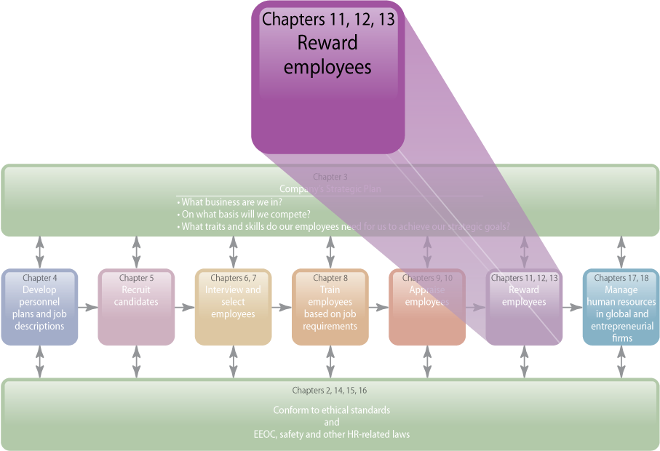
WHERE WE ARE NOW…
Notes:
The main purpose of Chapter 13 is to discuss employee benefits. We discuss four main types of plans: supplemental pay benefits (such as sick leave and vacation pay); insurance benefits (such as workers’ compensation); retirement benefits (such as pensions); and employee services (such as child-care facilities). Because legal considerations loom large in any benefits decision, we cover applicable federal laws and their implications for managers. This chapter completes our discussion of employee compensation.

Slide 3
LEARNING OUTCOMES
Name and define each of the main pay for time not worked benefits.
Describe each of the main insurance benefits.
Discuss the main retirement benefits.
Outline the main employees’ services benefits.
Explain the main flexible benefit programs.

Slide 4
Benefits
Types of Employee Benefits
Supplemental
pay
Insurance benefits
Retirement benefits
Executive services
Notes:
There are many benefits and various ways to classify them. We will classify them as (1) pay for time not worked, (2) insurance benefits, (3) retirement benefits, and (4) services.

Slide 5
FIGURE 13–1 U.S. Health Care Cost Increases*
Total Spending on Health Care | 2004 | 2009 | 2015
Dollars | $1.9 trillion | $2.9 trillion | $4 trillion
% of GNP | 16% | 18% | 20%
*Note: Figures for 2009 and 2015 estimated. Health care costs rose 7.9% in 2004, about twice the rate of inflation, and are expected to rise at that rate through 2015.
Notes:
Figure 13-1 confirms what employers are well aware of: health care costs are rising. Since 2001, health care premiums have risen about 78%, while inflation rose only 17%. However, in 2009, employee costs rose only 6.4% compared with an average 15% since 2002, largely because of the employer cost containment efforts we’ll discuss shortly.

Slide 6
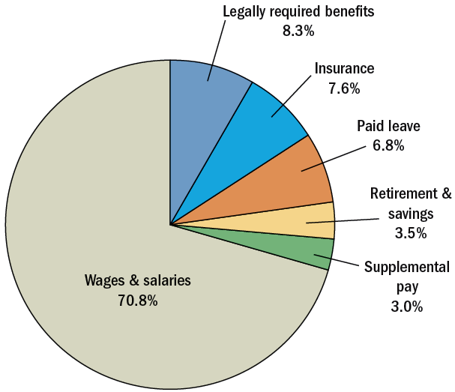
FIGURE 13–2 Private-Sector Employer Benefits Costs by Category, March 2009
Notes:
Figure 13-2 summarizes the breakdown of benefits as a percentage of wages and salaries.

Slide 7

TABLE 13–1 Some Required and Discretionary Benefits
Benefits Required by Federal or Most State Law | Benefits Discretionary on Part of Employer*
Social Security Unemployment Insurance Workers’ Compensation Leaves under the Family Medical Leave Act | Disability, Health, and Life Insurance Pensions Paid Time Off for Vacations, Holidays, Sick Leave, Personal Leave, Jury Duty, etc. Employee Assistance and Counseling Programs “Family Friendly” benefits for Child Care, Elder Care, Flexible Work Schedules, etc. Executive Perquisites
* While not required under federal law, all these benefits are regulated in some way by federal law, as explained in this chapter.
Notes:
Table 13-1 lists benefits mandated by federal laws while other benefits are at the employer’s discretion.

Slide 8
Policy Issues in Designing Benefit Packages
Which benefits to offer
Who will be covered
Whether to include retirees
Coverage during probation
Policy Issues
How to finance benefits
Degree of employee choice
Cost containment procedures
Communicating
benefits options
Notes:
A short list of policy issues that firms confront when designing benefit packages include what benefits to offer, who receives coverage, whether to include retirees in the plan, whether to deny benefits to employees during initial “probationary” periods, how to finance benefits, the degree of employee choice in determining benefits, cost-containment procedures, and how to communicate benefits options to employees.

Slide 9
Pay For Time Not Worked
Unemployment insurance
Vacations and holidays
Supplemental Pay Benefits
Sick leave
Parental leave
Severance pay
Supplemental unemployment benefits
Notes:
Pay for time not worked—also called supplemental pay benefits—is the most costly benefit, because of the large amount of time off that most employees receive.
Common time-off-with-pay periods include holidays, vacations, jury duty, funeral leave, military duty, personal days, sick leave, sabbatical leave, maternity leave, and unemployment insurance payments for laid-off or terminated employees.

Slide 10
Pay for Time Not Worked
Unemployment Insurance
  Provides for benefits if a person is unable to work through
  no fault of his or her own.
  Is an employer payroll tax that is determined by an employer’s rate of personnel terminations.
  Tax is collected and administered by the state.
Vacations and Holidays
  Number of paid leave days and holidays varies by employer.
  Qualification for and calculation of holiday and leave pay varies by employer.
  Premium pay for those who work on holidays.
Notes:
All states have unemployment insurance or compensation laws. These provide benefits if a person is unable to work through no fault of his or her own. The benefits derive from a tax on employers that can range from 0.1% to 5% of taxable payroll in most states. An employer’s unemployment tax rate reflects its rate of employee terminations. States have their own unemployment laws, but they all follow federal guidelines.
Firms have to address several holiday- and vacation-related policy issues. They must decide, of course, how many days off employees will get, and which days (if any) will be the paid holidays, and how much employees will be paid for vacations and holidays.

Slide 11
TABLE 13–2 An Unemployment Insurance Cost-Control Checklist
Do You:
Keep documented history of lateness, absence, and warning notices
Warn chronically late employees before discharging them
Have rule that 3 days’ absence without calling in is reason for automatic discharge
Request doctor’s note on return to work after absence
Make written approval for personal leave mandatory
Stipulate date for return to work from leave
Obtain a signed resignation statement
Mail job abandonment letter if employee fails to return on time
Document all instances of poor performance
Require supervisors to document the steps taken to remedy the situation
Document employee’s refusal of advice and direction
Require all employees to sign a statement acknowledging acceptance of firm’s policies and rules
File the protest against a former employee’s unemployment claim on time (usually within 10 days)
Use proper terminology on claim form and attach documented evidence regarding separation
Attend hearings and appeal unwarranted claims
Check every claim against the individual’s personnel file
Routinely conduct exit interviews to produce information for protesting unemployment claims
Notes:
Employers spend thousands of dollars on unemployment taxes that would not be necessary if they protected themselves. The main rule is to keep a list of written warnings. Beyond that, the checklist in Table 13-2 can help protect employers.

Slide 12
Pay for Time Not Worked (cont’d)
Sick Leave
  Provides pay to an employee when he or she is out of work because of illness.
    Costs for misuse of sick leave
    Pooled paid leave plans
Parental Leave
  The Family Medical Leave Act of 1993 (FMLA)
    Up to 12 weeks of unpaid leave within a one-year period.
    Employees must take unused paid leave first.
    Employees on leave retain their health benefits.
    Employees have right to return to job or equivalent position.
Notes:
Sick leave provides pay to employees when they’re out of work due to illness. Most sick leave policies grant full pay for a specified number of sick days—usually up to about 12 per year. The sick days usually accumulate at the rate of, say, 1 day per month of service.
The problem is that while many employees use their sick days only when they are sick, others use it for personal leave. To reduce the cost of absences and give employees more discretionary leave time, many employers now use pooled paid leave plans that lump together sick leave, vacation, and personal days into a single leave pool.
FMLA leaves are usually unpaid, but they’re not costless. The costs associated with hiring temporary replacements, training them, and compensating for their lower productivity can be considerable.

Slide 13

FIGURE 13–3
Your Rights Under
the Family and
Medical Leave Act
of 1993
Notes:
Figure 13-3 shows the Family and Medical Leave Act of 1993 (FMLA) poster that informs employees of their rights under the FMLA.

Slide 14

FIGURE 13–4
Online Request
for Leave Form
Notes:
Figure 13-4 shows a standard form that employers can use to place on record both the employee’s expected return date and the fact that, without an authorized extension, the firm may terminate his or her employment.

Slide 15
Pay for Time Not Worked (cont’d)
Severance Pay
  A one-time payment when terminating an employee.
Reasons for granting severance pay:
  Acts as a humanitarian gesture and good public relations.
  Mirrors employee’s two-week quit notice.
  Avoids litigation from disgruntled former employees.
  Reassures employees who stay on after the employer downsizes its workforce of employer’s good intentions.
Notes:
Many employers provide severance pay, a one-time separation payment when terminating an employee.

Slide 16
Pay for Time Not Worked (cont’d)
Supplemental Unemployment Benefits (SUB)
  Payments that supplement the laid-off or furloughed employee’s unemployment compensation.
    The employer makes contributions to a SUB reserve fund.
    SUB payments are made to employees for the time the employee is out of work due to layoffs, reduced workweeks, or relocations.
    SUB payments are considered previously earned compensation for unemployment calculation purposes.
Notes:
SUB benefits are cash payments that supplement the employee’s unemployment compensation to help the person maintain his or her standard of living while out of work. They generally cover three contingencies: layoffs, reduced workweeks, and facility relocations.

Slide 17
Insurance Benefits
Workers’ Compensation
  Provides income and medical benefits to work-related accident victims or their dependents, regardless of fault.
    Death or disability: a cash benefit based on earnings per week of employment.
    Specific loss injuries: statutory list of losses.
    Injured workers are protected by ADA provisions.
  Controlling workers’ compensation costs
    Screen out accident-prone workers.
    Make the workplace safer.
    Thoroughly investigate accident claims.
    Use case management to return injured employees to work as soon as possible.
Notes:
Workers’ compensation laws aim to provide sure, prompt income and medical benefits to work-related accident victims or their dependents, regardless of fault. Every state has its own workers’ compensation law and commission, and some run their own insurance programs.
It is important to control workers’ compensation claims (and therefore costs). The employer’s insurance company usually pays the claim. However, the costs of the employer’s premiums reflect the amount of claims. Workers’ comp claims also tend to correlate with injuries, so fewer claims is usually a good sign of fewer accidents.

Slide 18
Insurance Benefits (cont’d)
Hospitalization, Health, and Disability Insurance
  Provide for loss of income protection and group-rate coverage of basic and major medical expenses for off-the-job accidents and illnesses.
    Accidental death and dismemberment
    Disability insurance
    Mental health benefits
Notes:
Hospitalization, health, and disability insurance helps protect employees against hospitalization costs and the loss of income arising from off-the-job accidents or illness. Many employers purchase insurance from life insurance companies, casualty insurance companies, or Blue Cross (for hospital expenses) and Blue Shield (for physician expenses) organizations. Others contract with health maintenance organizations or preferred provider organizations.
Disability insurance provides income protection for salary loss due to illness or accident.

Slide 19
TABLE 13–3 Percentage of Employers Offering Popular Health Benefits—
Change Over Time
 | Yes (%) 2005 | Yes (%) 2009
Prescription drug program coverage | 97 | 96
Dental insurance | 95 | 96
Mail order prescription program | 90 | 91
PPO (preferred provider organization) | 87 | 81
Chiropractic coverage | 56 | 80
Mental health insurance | 72 | 80
Vision insurance | 80 | 76
Employee assistance program | 73 | 75
Medical spending account | 80 | 71
Life insurance for dependents | 67 | 58
HMO (health maintenance organization) | 53 | 35
Notes:
Table 13-3 illustrates the prevalence of health-related benefits. Most employer health plans provide at least basic hospitalization and surgical and medical insurance for all eligible employees at group rates.
Insurance is generally available to all employees—including new nonprobationary ones—regardless of health or physical condition. Most basic plans pay for hospital room and board, surgery charges, and medical expenses (such as doctors’ visits to the hospital). Some also provide “major medical” coverage to meet the medical expenses resulting from serious illnesses.

Slide 20
Insurance Benefits (cont’d)
Health Maintenance Organization (HMO)
  A medical organization consisting of specialists operating out of a health care center.
    Provides routine medical services to employees who pay a nominal fee.
    Receives a fixed annual contract fee per employee from the employer (or employer and employee), regardless of whether it provides that person with service.
Notes:
Many employers offer membership in a health maintenance organization (HMO) as a hospital/medical insurance option. Employees often have general practitioner “gatekeeper” doctors who need to approve appointments with specialist doctors.

Slide 21
Insurance Benefits (cont’d)
Preferred Provider Organizations (PPOs)
  Groups of health care providers that contract to provide services at reduced fees.
    Employees can select from a list of preferred individual health providers.
    Providers agree to discount services and to submit to utilization controls.
    Employees using non-PPO-listed providers may pay
    all costs or only costs above the reduced fee structure for services.
Notes:
Preferred provider organizations (PPOs) are a cross between HMOs and the traditional doctor-patient arrangement: They are “groups of health care providers that contract with employers, insurance companies, or third-party payers to provide medical care services at a reduced fee. PPOs let employees select providers (such as doctors) from a list, and see them in their offices, often without gatekeeper doctor approval.

Slide 22
Laws Influencing Health Care Benefits
Health Services and Insurance
  COBRA notification and insurance continuance requirements
  Health Insurance Portability and Accountability Act of 1996 (HIPAA)
Retirement and Pension Plans
  Employee Retirement Income Security Act of 1974 (ERISA)
Mental Health Benefits
  Mental Health Parity Act of 1996
Family Leave
  Pregnancy Discrimination Act
  Family Medical Leave Act
  The Newborn Mother’s Protection Act of 1996
Notes:
With the U.S. introducing new laws governing health insurance plans, federal influence over health benefits will increase substantially in the next few years. But even before 2009, federal laws already had a big influence.

Slide 23

FIGURE 13–5
COBRA Record-Keeping
Compliance Checklist
Notes:
Figure 13-5 provides a COBRA checklist. As the U.S. slid into recession, Congress changed COBRA to support unemployed persons’ insurance needs.

Slide 24
Trends in Health Care Cost Controls
Premiums and co-pays
Communication and empowerment
Cost-Control Trends
Wellness programs
Health savings accounts
Claim audits
Notes:
Employers are trying hard to rein in spiraling health care costs. Many retain cost-containment specialists who help employers reduce their health care costs. And most now negotiate more aggressively with their health care insurance providers, and require employees to pay higher premiums or deductibles and co-payments.

Slide 25
Other Cost-Control Options
Mandatory online plan enrollment
Defined contribution health care plans
Controlling Health Care Costs
Outsourced health care plan administration
Reduced retiree
health care coverage
Benefits purchasing alliances

Slide 26
Other Benefits Issues
Long-Term Care
  Insurance for older workers is a growing issue.
Life Insurance
  Types
    Group life insurance
    Accidental death and dismemberment
  Personnel policy considerations
    Benefits-paid schedule
    Supplemental benefits
    Financing (employee contribution)
Benefits for Part-Time and Contingent Workers
  Leave and health benefits available to part-time workers.
  Benefits for long-term independent contractors.
Notes:
In addition to hospitalization and medical benefits, most employers provide group life insurance plans. Employees can usually obtain lower rates in a group plan. And group plans usually accept all employees—including new, non-probationary ones— regardless of health or physical condition.
Most firms now provide holiday, sick leave, and vacation benefits to part-timers, and more than 70% offer some form of health care benefits to them.

Slide 27
Retirement Benefits
Social Security
(Federal Old Age and Survivor’s Insurance)
  A federal payroll tax (7.65%) paid by both the employee and the employer on the employee’s wages
    Retirement benefits at the age of 62
    Survivor’s or death benefits paid
    to the employee’s dependents
    Disability payments to disabled employees
    and their dependents
  The Medicare program
    Health services to people age 65 or older
Notes:
Most people assume that Social Security provides income only when they are older than 62, but it actually provides three types of benefits. The Social Security system also administers the Medicare program, which provides health services to people age 65 or older.

Slide 28
Retirement Benefits (cont’d)
Types of Pension Plans
Defined
benefit
plans
Defined contribution plans
Qualified
plans
Nonqualified plans
Notes:
Pension plans are financial programs that provide income to individuals in their retirement. We can classify pension plans in three ways: contributory versus noncontributory plans, qualified versus nonqualified plans, and defined contribution versus defined benefit plans.

Slide 29
Retirement Benefits (cont’d)
401(k) plans
Savings and thrift plans
Types of Defined Contribution Plans
Deferred profit-sharing plans
Employee stock
ownership plans
Cash balance pension plans
Notes:
Defined contribution pension plans specify what contribution the employee and/or employer will make to the employee’s retirement or savings fund. With a defined benefit plan, the employee knows what his or her retirement benefits will be upon retirement. With a defined contribution plan, the person’s pension will depend on the amounts contributed to the fund and on the retirement fund’s investment earnings.
Portability—making it easier for employees who leave the firm prior to retirement to take their accumulated pension funds with them—is enhanced by switching from defined benefit to defined contribution plans such as cash balance plans.

Slide 30
Retirement Benefits (cont’d)
Employee Retirement Income Security Act (ERISA) of 1974
  Established guidelines for “qualified” pension plans.
  Requires fiduciary responsibility.
Pension Benefits Guarantee Corporation (PBGC)
  Insures plans that terminate without sufficient funds
  to meet obligations.
  Guarantees only defined benefit plans.
  Pays individual pensions up to $54,000 per year.
Notes:
The Employee Retirement Income Security Act of 1975 (ERISA) requires that employers have written pension plan documents and adhere to certain guidelines. ERISA protects the employer’s pension or health plans’ assets by requiring that those who control the plans act responsibly. The Department of Labor says that the primary responsibility of fiduciaries is to run the plan solely in the interest of participants and beneficiaries.
ERISA established the Pension Benefits Guarantee Corporation (PBGC) to oversee and insure a pension if a plan terminates without sufficient funds. The PBGC guarantees only defined benefit plans, not defined contribution plans.

Slide 31
Pension Plans
Policy Issues in
Pension Planning
Membership requirements
Benefit formula
Plan
funding
Vesting schedule
Notes:
In developing pension plans, employers must address several key policy issues:
When does an employee become eligible to participate in the plan?
What is the formula for calculating the level of plan benefits due an employee at retirement?
How will the plan be funded?
Which vesting schedule will be used?

Slide 32
Employees’ Vesting Rights under ERISA
Cliff Vesting
  Gives participants full right to the employer’s matching contribution after three years of service.
Graded Vesting
  Gives participants an increasing right to the employer’s matching contribution over a six-year schedule of 20% after two years of service and 20% for each succeeding year thereafter.
Notes:
With cliff vesting, the period for acquiring a nonforfeitable right to employer matching contributions (if any) is 3 years.
With the second (graded vesting) option, pension plan participants must receive nonforfeitable rights to the matching contributions as follows: 20% after 2 years, and then 20% for each succeeding year, with a 100% nonforfeitable right by the end of 6 years.

Slide 33
Pensions and Early Retirement
Early Retirement Windows
  Offer specific employees (often age 50-plus) an incentive
  to voluntarily retire earlier than usual.
  Offer a combination of improved or liberalized pension benefits plus a cash payment.
  Require careful program construction to avoid oversubscription and timely delivery to avoid potential age discrimination claims.
Older Workers’ Benefit Protection Act (OWBPA)
  Imposes limitations on waivers that purport to release a terminating employee’s potential claims against the employer based on age discrimination.
Notes:
To trim their workforces or for other reasons, employers are encouraging employees to retire early. Many of these plans take the form of early retirement window arrangements for specific employees (often age 50-plus).
Discrimination is the other potential problem. Unless structured properly, older employees can challenge early retirement programs as de facto ways for forcing them to retire against their will. Although it is generally legal to use incentives to encourage individuals to choose early retirement, the employee’s decision must be voluntary under OWBPA.

Slide 34
Personal Services
Credit Unions
  Separate businesses established with the employer’s assistance to help employees with their borrowing and saving needs.
Employee Assistance Programs (EAPs)
  Provide counseling and advisory services:
    Personal legal and financial services
    Child and elder care referrals
    Adoption assistance
    Mental health counseling
    Life event planning
Notes:
Many employers provide the sorts of personal services that employees need at one time or another. These include credit unions, legal services, counseling, and social and recreational opportunities.

Slide 35
Employee Assistance Programs
Steps for Launching an EAP Program
1
Develop a policy statement.
2
Ensure professional staffing.
3
Maintain confidential record-keeping systems.
4
Be aware of legal issues.

Slide 36
Family-Friendly (Work–Life) Benefits
Subsidized child care
Sick child benefits
Elder care
Time off
Subsidized employee transportation
Food services
Educational subsidies
Fitness and medical facilities
Flexible work scheduling
Notes:
Several trends are changing the benefits landscape. There are more households where both adults work, more one-parent households, more women in the workforce, and more workers older than age 55.
Then, there’s the “time bind”—people working more, without the time to do all they’d like to do. The issues involve working men, as well as women. These pressures have led many employers to bolster their family-friendly (or work–life) benefits.

Slide 37
Flexible Benefits Programs
Cafeteria (Flexible Benefits) Approach
  Each employee is given a limited benefits fund budget
  to spend on preferred benefits.
  Types of plans
    Flexible spending accounts
    Core plus option plans
Employee Leasing
  Professional employer organizations or staff leasing firms
  Handle human resources functions for leased employees of small firms
  Can provide benefits by aggregating employees into larger insurable groups
  Can raise worker commitment, co-employment, and workers’ compensation issues
Notes:
Employees prefer choice in their benefits plans. A cafeteria plan is one in which the employer gives each employee a benefits fund budget, and lets the person spend it on the benefits he or she prefers, subject to two constraints. First, the employer must of course limit the total cost for each employee’s benefits package. Second, each employee’s benefits plan must include certain required items—for example, Social Security, workers’ compensation, and unemployment insurance.
Employee leasing firms (also called professional employer organizations or staff leasing firms) assume all or most of the employer’s human resources chores. In doing so, they also become the employer of record for the employer’s employees, by transferring them all to the employee leasing firm’s payroll.

Slide 38
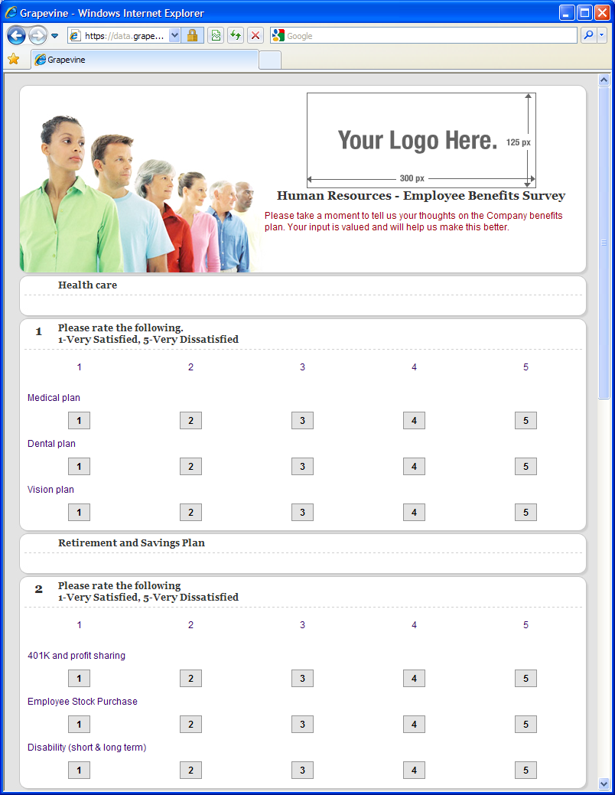
FIGURE 13–6
Online Survey of
Employees’ Benefits
Preferences
Notes:
It is prudent to survey employees’ benefits preferences, perhaps using a form like that in Figure 13-6. In any case, employers should provide for choice when designing benefits plans.

Slide 39
Flexible Work Schedules
Flextime
Compressed workweek schedules
Workplace flexibility
Job sharing
Work sharing
Notes:
Flexible work schedules are increasingly popular. Single parents often find them crucial for balancing work and family responsibilities. And for many millennial employees, flexible work schedules provide a way for them to pursue their careers without surrendering the quality of work life they desire.

Slide 40
K E Y T E R M S
benefits
supplemental pay benefits
unemployment insurance
sick leave
severance pay
supplemental unemployment benefits
workers’ compensation
health maintenance organization (HMO)
preferred provider organizations (PPOs)
group life insurance
Social Security
pension plans
defined benefit pension plan
defined contribution pension plan
portability
401(k) plan
savings and thrift plan
deferred profit-sharing plan
employee stock ownership plan (ESOP)
cash balance plans
Employee Retirement Income Security Act (ERISA)
Pension Benefits Guarantee Corporation (PBGC)
early retirement window
employee assistance program (EAP)
family-friendly (or work–life) benefits
flexible benefits plan/cafeteria benefits plan
flextime
compressed workweek
workplace flexibility
job sharing
work sharing

Slide 41

All rights reserved. No part of this publication may be reproduced, stored in a retrieval system, or transmitted, in any form or by any means, electronic, mechanical, photocopying, recording, or otherwise, without the prior written permission of the publisher. Printed in the United States of America.

