Slide 1
Rheumatic Fever
By Dr. Saud A. Bahaidarah
Pediatric cardiologist

Slide 2
Definition
Delayed autoimmune reaction to group A, B-hemolytic streptococcal pharyngitis in genetically susceptible individuals .
Involves : heart, joints, brain, skin, serous surfaces

Slide 3
Epidemiology
Prevalence
  developed countries , RF was decreasing science 1920’s and almost disappeared in 1980’s , and reappear again in 1985 due to reappearance of streptococcus with M-protein serotype.
  In developing countries , RF is a major problem affecting about 10-20 million per year, RHD is a primary cause of death below 50 years of age

Slide 4
Incidence:
  In developing countries : 150 per 100,000 with mortality rate up to 8.2 per 100,000 from cardiac involvement
  In developed countries : less than 1 per 100,000 with mortality rate of 1.8 per 100,000

Slide 5
Environment :
  overcrowding, poverty, poor nutrition, poor hygiene, and poor access to health care are common in developing countries and contribute to rapid spread (respiratory droplets) and increased virulence of GAS .
  With poor access to health care, GAS pharyngitis is less likely to be diagnosed and treated, precluding effective primary prevention of RF
  Both GAS pharyngitis and RF are more common during the winter and spring in temperate climates, but there is no consistent seasonal pattern in the tropics

Slide 6
Host :
  Age : 5-15 years of age with peak at 8 years
  Uncommon before 5 years and after 35 years of age
  Almost never before 2 years of life
  No gender predisposition except for chorea in girls
  Recurrence in adolescent and early adulthood
Family history indicates genetic factor which still under study

Slide 7
Pathogenesis
Organism : group A, B hemolytic streptococcus
Serotype : depends on M-protein :
  Class I : infect pharynx causing RF
  Class II : infect skin causing glomerulonephritis
Latent period : 10 days to 5 wk, average of 18 days
Infection lead to activation of T-cells and B-cell and release of cytokines and antibodies which will attack the myosin the heart .

Slide 8
Pathology
Aschoff nodules :
  perivascular aggregation characterized by a central area of fibrinoid change (altered collagen) surrounded by or infiltrated by large multinucleated cells
  Found in all affected organs i.e. heart, skin, brain, joint, serous surfaces.

Slide 9
Clinical picture
History of sore throat about 3wk back
History of fever with other major or minor manifestation

Slide 10
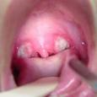


Slide 11
Arthritis
Common in 70% of RF cases
Migratory, non destructive arthritis
Involves large joints with all signs of inflammation mostly knees ,hips, ankles, elbows, wrist, shoulder
Duration not more than 2-3 days
Self limited
Respond dramatically to salisylate

Slide 12
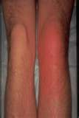

Slide 13
Carditis
About 50% of RF will be affected
Ranges from asymptomatic , heart murmur to sever heart failure
Usually it is pancarditis
Affecting mitral valve 95% , aortic valve 25% , tricuspid valve and rarely pulmonary valve
Pericarditis in 4-10%

Slide 14
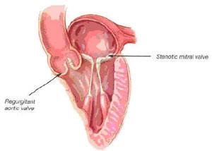

Slide 15
Sydenham's chorea
In 10-30 % of patient with RF
Due to inflammation in the basal ganglia, cerebral cortex, and the cerebellum
Involuntary, purposeless movements, muscular incoordination and/or weakness, and emotional lability
tongue movements described as resembling a bag of worms
Explosive speech
pronation of the hands when arms are extended above the head (pronator sign),
irregular contractions of the hands when asked to squeeze an object (milkmaid's grip)
hyperextension of the fingers when hands are extended forward with eyes closed, (spooning)

Slide 16
Patients often come to attention based on deterioration in school performance, and neurobehavioral symptoms seen along with the chorea including irritability, poor attention span, lack of cooperation, and obsessive-compulsive symptoms are not uncommon.
Sensory deficits do not occur.
The neurologic manifestations are usually bilateral but may be unilateral (hemichorea).
These symptoms, which decrease with rest and sedation and increase with effort or excitement
Resolve over a median of 15 weeks, and by 6 months in 75% of cases . Recurrent episodes of chorea are not uncommon

Slide 17
Latent period in chorea is about 1-6 month while in arthritis 10-18 days , this can explain that both don’t present together .
If chorea and cardiac involvement together most likely the cardiac involvement is mild with decreased acute phase reactant

Slide 18
Erythema Marginatum
occurs in less than 10% of patients with acute rheumatic fever.
The characteristic nonpruritic serpiginous or annular erythematous rashes are most prominent on the trunk and the inner proximal portions of the extremities; they are never seen on the face.
The rashes are evanescent, disappearing on exposure to cold and reappearing after a hot shower or when the patient is covered with a warm blanket.
They are seldom detected in air-conditioned rooms.

Slide 19
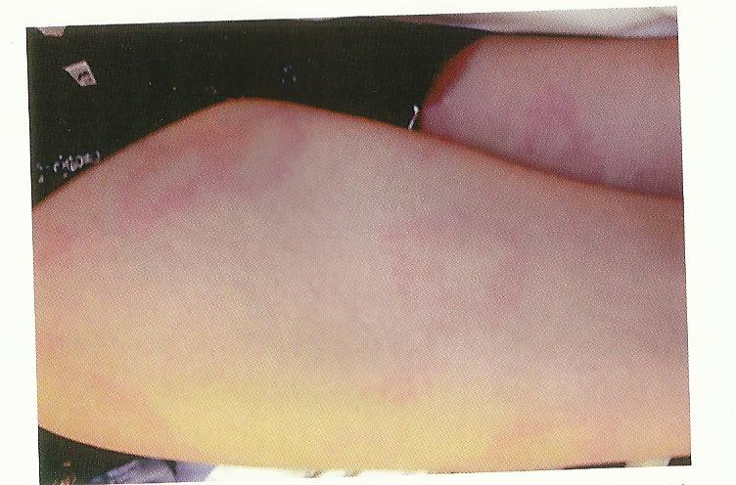

Slide 20
Subcutaneous nodules
Found in 2% to 10% of patients, particularly in cases with recurrences
They are hard, painless, nonpruritic, freely movable, swelling, and 0.2 to 2 cm in diameter.
They are usually found symmetrically, singly or in clusters, on the extensor surfaces of both large and small joints, over the scalp, or along the spine.
They are not transient, lasting for weeks
Have a significant association with carditis.

Slide 21

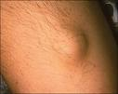

Slide 22
Laboratory :
  Increase in acute phase reactant
  Evidence of streptococcal infection :
    Positive throat swap
    Strep antibodies :
      Antistreptolysin O (ASO) titer is well standardized and therefore is the most widely used test. It is elevated in 80% of patients with acute rheumatic fever and in 20% of normal
      individuals. Only 67% of patients with isolated chorea have an elevated ASO.
      Antideoxyribonuclease B titer
      The Streptozyme test

Slide 23
ECG :
  Prolongation of PR interval
  Occasional 2:1 block, rarely complete heart block
  Nonspesific T wave and ST segment changes
CXR:
  Enlareged heart
  Evidence of increase PVM if CHF
Echocardiography :
  Evaluate the effect of carditis on the heart including MR, AR, MS, preicardial effusion, and function

Slide 24
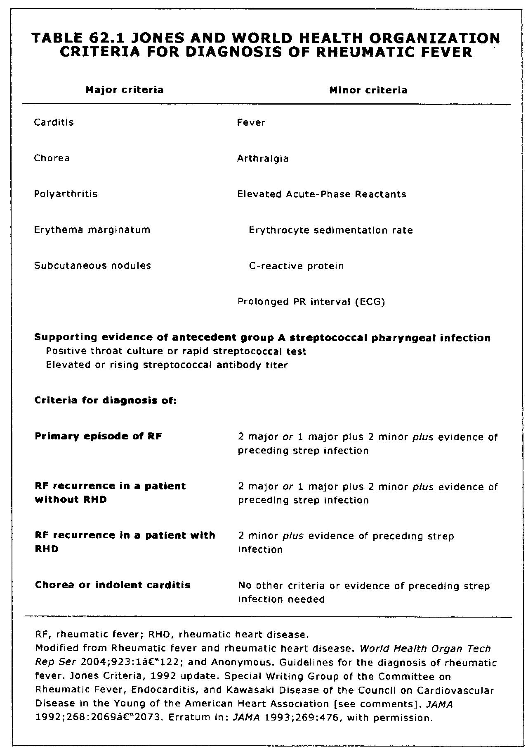
Diagnosis
Moss and Adam’s Heart Disease in Infant, Children, and Adolescents 7th edition

Slide 25
Treatment
Includes :
  Bed rest
  Anti-inflammatory
  Heart failure managements
  Antibiotics : primary and secondary prevention

Slide 26
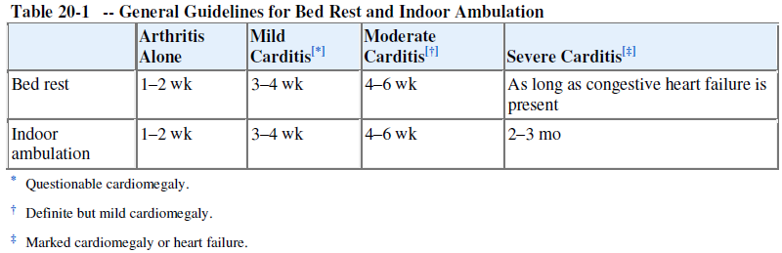
Bed rest
Pediatric Cardiology for practitioners 4th edition

Slide 27
  Anti-inflammatory
Mild to moderate carditis: aspirin
    80-100 mg/kg/day in 4 divided doses for children
    4-8 g/day in adolescents and adults
    Target salicylate levels 20-30 mg/dL
    Don't forget to protect the stomach
Severe carditis:
    Initial steroids (prednisone 2 mg/kg/day) for approximately 2 weeks, then taper
    Begin aspirin approximately 1 week prior to stopping steroids to prevent rebound
    Follow acute phase reactants (erythrocyte sedimentation rate, C-reactive protein)

Slide 28
  Heart failure managements
Depending on the severity
Salt and water restriction
Diuretics
Afterload reduction
Surgery in sever cases that needs intervention and refractory to medical management

Slide 29
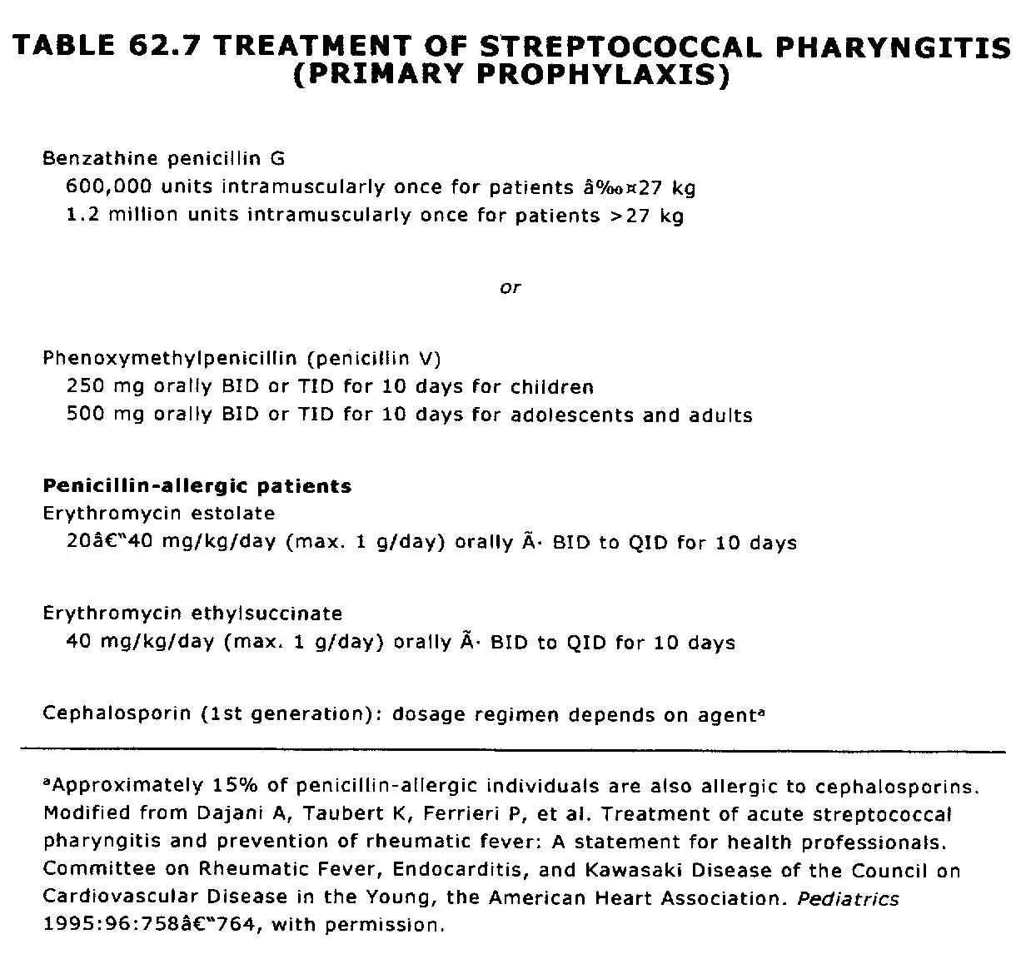
  Antibiotics : primary prevention
To eradicate the organism
Doesn't interfere with disease course
Moss and Adam’s Heart Disease in Infant, Children, and Adolescents 7th edition

Slide 30
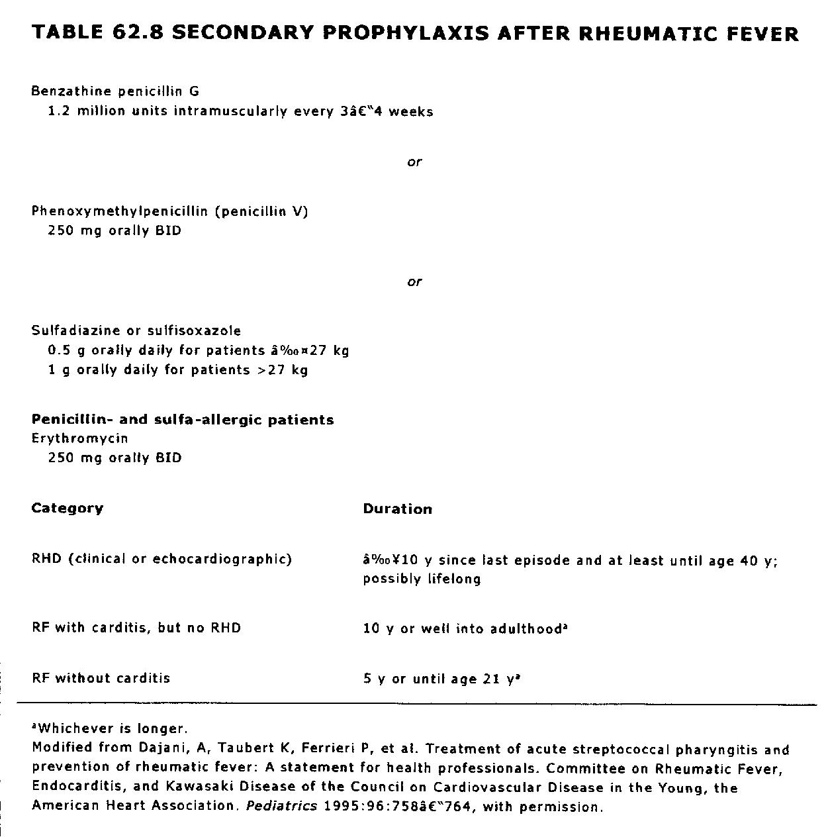
Antibiotics : secondary prevention
To prevent the recurrence and then worsening of the RHD
Recurrence rate 40-60 %
Higher in early years after 1st attack then decreases with time
Moss and Adam’s Heart Disease in Infant, Children, and Adolescents 7th edition

Slide 31
Thank You

