Slide 1
Entrepreneurship
ELIB 203

Slide 2
Product Planning

Slide 3
Product Planning is a Part of Business Plan…
Executive summary
Market analysis
Company description
Product Planning
Financial
Notes:
• Executive summary – provides an overview of the company and includes information from other elements. This is typically written last because the introduction is so important.
• Market analysis – provides information about the market that includes industry and pricing.
• Company description – provides information about the nature of the business and which factors will make it successful.
• Management and organization – provides a view of the company’s structure, leadership, and team.
• Sales and marketing – provides information about the sales and marketing that will be used.
• Product/service – explains the value, benefits, and uniqueness of the product.
• Funding/financial – outlines the amount of money the company needs in different scenarios and creates a five-year plan.

Slide 4
Product Management Interfaces
New product planning
& development
The product life cycle
3 Major
areas of
product
management
Strategic product
management

Slide 5
Considerations for the Acceptance of New Products
Determining Factors…
How the product will sell
Whether the product is easy to stock & display
Whether the product will be profitable

Slide 6
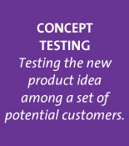
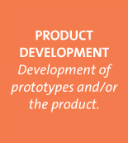
Steps in Developing New Products
1
2
3
4
5
6
Source: Marketing, 2nd Canadian Edition, by Grewal, Levy, Persaud, Lichti, McGraw-Hill, 2013.
Notes:
This slide is designed to introduce the new product development process and the steps to follow.
Group activity: Have each student group think of a new product. It need not be a “new-to-the-world” product. Then have them follow the steps in the New Product Development Process and describe what they would do at each step. This exercise might take an hour or so, so it may be used as an out of class assignment. Have students present their process to the rest of the group.

Slide 7
1- Idea Generation
Internal
R&D
Customer
Input
Licensing
Firms must constantly scan the environment looking for new product ideas. Depending on the company strategy, they use different sources.
Source
of Ideas
Competitor’s
Products
Brainstorming
Source: Marketing, 2nd Canadian Edition, by Grewal, Levy, Persaud, Lichti, McGraw-Hill, 2013.

Slide 8
Brainstorming
Groups work together to generate ideas
No idea can be immediately dismissed
Many firms, such as 3M, foster a culture of creativity and give employees both the time and the freedom to develop new products and new ideas.

Slide 9
Competitors’ Products
Reverse engineering
“Me Too” or copycat products
Products with patents or other proprietary protections cannot be copied, so reverse engineered products must be substantively different from their source product.

Slide 10
2. Concept Testing
Concept is a brief written description of the product
Customers’ reactions determine whether or not it goes forward
Triggers the marketing research process
Concepts are presented to potential buyers or users to gauge their reactions.

Slide 11
3. Product Development
Prototype
A prototype allows consumers to interact physically with the product. Some prototypes, such as the concept cars revealed at auto shows, never actually go into production.
Before it released Vista, Microsoft began beta testing in two years earlier to gather feedback from computer aficionados.

Slide 12
4. Market Testing
Premarket tests
Customers exposed
Customers surveyed
Firm makes decision
Test marketing
Mini product launch
More expensive than premarket tests
Market demand is estimated
Premarket test are conducted by research firms, such as ACNielsen (BASES II). Because test marketing reveals a new product to competitors, it might be inappropriate to expose some new products this way.
Notes:
Premarket test are conducted by research firms, such as ACNielsen (BASES II).
Because test marketing reveals a new product to competitors, it might be inappropriate to expose some new products this way.
Ask students: Think of some products that you think should not be subjected to test marketing. Why not?
Answer: incremental improvements on existing products (such as a new flavor of soda), small niche products because they only appeal to small market, products that could easily be copied by competition, etc.

Slide 13
5. Product Launch
Kellogg’s Drink’n Crunch Portable Cereals
An inner cup contains the cereal and the outer cup contains the milk
Minute Maid Premium Heart Wise Orange Juice
Each 8 oz. serving of the juice contains 1 gram of plan sterols that can reduce cholesterol levels
Aquafresh Floss ‘N’ Cap Fluoride Toothpaste
The cap of the toothpaste contains floss
Launching a new product is part art and part science. Each of these products offered unique benefits.
Notes:
Launching a new product is part art and part science. Each of these products offered unique benefits. Ask the students if they feel each would be successful? Minute Maid Heart Wise was introduced in 2003 and has been extremely successful. Aquafresh Floss N’Cap has been expanded to other Aquafresh lines including whitening. However, Kellogg’s Drink’n Crunch turned out to be a high-innovation, low-sales product. The innovative packaging allowed consumers to consume their cereal and milk while on the move but didn’t sell. Getting the right proportion of cereal with the right amount of milk without it being a choking hazard is difficult. (Source: http://www.kellogg.northwestern.edu/news/hits/060515usn.htm)
The Clorox Company of Canada gave consumers a way stay clean and green with the launch of the Green Works line of eco-friendly cleaners. An Ipsos-Reid survey, conducted on behalf of Clorox, found that Canadians were interested in “green” cleaning products but high prices, perceived efficacy and limited availability were preventing them from making the switch. The new line is 20% to 25% cheaper than other environmentally friendly cleaners currently in the marketplace and just as efficient as regular all-purpose cleaners. The product launched in the spring of 2008 and was a huge success.

Slide 14
New Product Marketing Mix
New
Product
Promotion
Place
Price
Timing
The right product must hit the market at the right time and for the right price. It matters little how good a product is if the launch lacks sufficient resources.
Source: Marketing, 2nd Canadian Edition, by Grewal, Levy, Persaud, Lichti, McGraw-Hill, 2013.
Notes:
The right product must hit the market at the right time and for the right price. It matters little how good a product is if the launch lacks sufficient resources.
Group activity: Continue with the same products the students have been working with. Design the marketing mix required to launch it. How will you communicate its benefits? What types of distribution will you use? How will you determine the price? When will you launch?

Slide 15
6. Evaluation of Results
Satisfaction of technical requirements
Customer acceptance
Satisfaction of the firm’s financial requirements
Marketers cannot only celebrate success but also must understand failure.
The question of why a product fails is just as important as why another succeeded.
An underperforming product may require further development.
Notes:
Marketers cannot only celebrate success but also must understand failure. The question of why a product fails is just as important as why another succeeded. An underperforming product may require further development.

Slide 16
Why do new products fail?
Too small target market
Poor design
Low product quality
Incorrect positioning
Wrong price strategy
Poor marketing communication
Competition
Forrester Research statistics show that: Four out of five new products fail within the first three years of introduction.
Notes:
5

Slide 17
Product Life Cycle
Source: Marketing, 2nd Canadian Edition, by Grewal, Levy, Persaud, Lichti, McGraw-Hill, 2013.
The PLC represents an important tool managers use to plan their marketing activities.
Notes:
Discuss the difficulties associated with the introduction stage, especially if the product is totally new to the world.
Ask students: What challenges do firms face in this stage?
Growth: Discuss the concept of the “tipping point”—the transition between introduction and growth when the product either gains market acceptance or must exit the market. The majority of new products fail at this point.
Maturity: Many consumer packaged goods products are in the maturity stage, which means companies must engage in defending their market share. Ask students: What marketing activities should firms engage in at this stage?
In the battle for soft drinks, a very mature market,, a 1% market share switch between Coke and Pepsi can account for millions of dollars in revenue.

Slide 18
Stages in the Product Life Cycle
 | Introduction | Growth | Maturity | Decline
Sales | Low | Rising | Peak | Declining
Profits | Negative or low | Rapidly rising | Peak to declining | Declining
Typical Consumers | Innovators | Early adopters and early majority | Late majority | Laggards
Competitors (number of firms and products) | One or few | Few but increasing | High number of competitors and competitive products | Low number of competitors and products
Source: Marketing, 2nd Canadian Edition, by Grewal, Levy, Persaud, Lichti, McGraw-Hill, 2013.
At each stage of the lifecycle, the marketing mix elements change in response to the marketplace.
Notes:
Group activity: List products that currently exist in each of the stages. What marketing mix would you design for each of these products?
Ask students: If your company’s product were in its decline stage, how would you determine whether to update the product, continue offering it for a small segment, or exit the market completely?

Slide 19
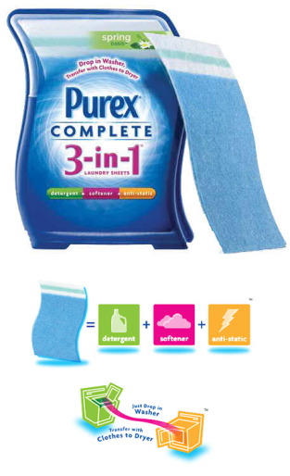
Strategies for Extending the PLC
Develop new uses
Modify product
Increase frequency of use
Increase # of users
Find new users
Reposition product
Tweak marketing strategy
Source: Marketing, 2nd Canadian Edition, by Grewal, Levy, Persaud, Lichti, McGraw-Hill, 2013.
Notes:
Develop new uses – Arm & Hammer (Click on the link to go to website) promotes its baking soda in many rooms in the house. Click on link to go to website.
Bounce fabric sheets are promoted as a way to keep closets, laundry hampers and gym bags smelling fresh (Procter & Gamble is pushing its Bounce fabric-softener with a contest that offers the chance for the winning entry to appear in an upcoming print ad.
Modify product - Change quality, performance, packaging, e.g. iPod is continually coming out with smaller models or offering more colours
Increase frequency of use – Campbells Soups (Click on the link to go to website) publishes recipes that use soup as an ingredient in an entrée. Click on link to go to website.
You can also show how P&G encourages users to share their stories about how to use Bounce dryer sheets beyond the laundry room. Visit http://www.bounceeverywhere.com/index.jsp
Increase # of users – Swiss Army Knife (Click on the link to go to website) now comes with an LED light, USB key. Click on link to go to website.
Find new users – as Roller Blade sales levelled off in the teen/young adult market, the company looked to market to elementary school children and older adults
Reposition product – Vitamin D is now being marketed as a way to ward off cancer
Tweak marketing strategy – may apply to all the 4Ps

Slide 20
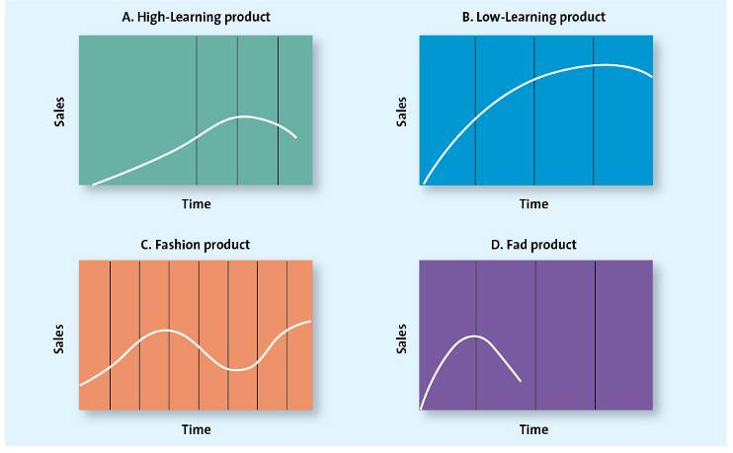
Variations on Product Life Cycle Curve
Source: Marketing, 2nd Canadian Edition, by Grewal, Levy, Persaud, Lichti, McGraw-Hill, 2013.
Theoretically the shape of the product life cycle curve is bell shaped. In reality, markets evolve in a variety of ways and the curve can take many shapes.
Notes:
Group activity: Propose different products whose PLCs might match those shown in this slide

Slide 21
Strategies Based on the Product Life Cycle: Some Caveats
Theoretically they are bell shaped but in reality they can take many shapes
Managers do not know exactly what the shape each product’s life cycle will take, so there is no way to know precisely what stage they are in.
Understanding where your product is on the PLC is difficult. If a firm misdiagnoses the stage, it can mean trouble for the firm
Notes:
Ask students: What happens to a product that is misdiagnosed as being in the decline stage? Answer: It will surely decline!

Slide 22
Strategic Product Management
Objective 5:
Successful product strategies depend on:
Product quality, innovativeness, or technological sophistication
Capabilities of managers overseeing product line
Firm’s financial capacity & willingness to provide promotional support
Channel members’ role in implementing product strategies

Slide 23
Product Strategies
Product differentiation
Product positioning
Product line expansion & contraction
Trading up & trading down
Product brand strategy

Slide 24
Product Differentiation
Creating a differential product involves getting
consumers to perceive a difference.
Implications for channel management:
Channel managers should try to select & help develop members who fit the product image when product differentiation strategy is affected by who will be selling the product.
Channel managers should provide retailers with the kind of support needed to properly present the product when this strategy is influenced by how the product is sold at retail.

Slide 25
Product Positioning
The manufacturer’s attempt to have consumers perceive the product in a particular way relative to competitive products
Implications for channel management:
Possible interfaces between the product positioning strategy and where the product will be displayed and sold to consumers should be considered before the strategy is implemented.
Elicit retailer support before attempting to implement strategy.

Slide 26
Product Line Expansion & Contraction
Manufacturers often engage in both expansion and contraction simultaneously.
Implications for channel management:
Difficult to balance channel member satisfaction & Support for reshaped product lines
Channel members are making increasing demands on Manufacturers to have the right mix of products

Slide 27
Trading Down, Trading Up
Adding lower-priced products or product lines, or higher-priced products or product lines, to a product mix
Implications for channel management:
Whether existing channel members provide adequate coverage of high-end or low-end market segments to which trade-up or trade-down product is aimed
Whether the channel members have confidence in the manufacturer’s ability to successfully market the trade-up or trade-down product

Slide 28
In-Class Discussion: Product Planning Tips
During the product planning process, you need to describe your products and services as you see them. Now describe them from your customers’ point of view.
Features and Benefits
List all of your major products or services. For each product or service:
Describe the most important features. What is special about it?
Describe the benefits. That is, what will the product do for the customer?

Slide 29
In-Class Discussion: Product Planning Tips
Note the difference between features and benefits, and think about them. For example, a house that gives shelter and lasts a long time is made with certain materials and to a certain design; those are its features. Its benefits include pride of ownership, financial security, providing for the family, and inclusion in a neighborhood. You build features into your product so that you can sell the benefits.
What after‐sale services will you give? Some examples are delivery, warranty, service contracts, support, follow‐up, and refund policy.

Slide 30
Discussion: Product Planning Tips
Describe in depth your products or services (technical specifications, drawings, photos, sales brochures, and other bulky items).
What factors will give you competitive advantages or disadvantages? Examples include level of quality or unique or proprietary features.
What are the pricing, fee, or leasing structures of your products or services?

Slide 31
Basic Issues to Consider During Product Planning
1) What products/services are you (will you be) selling?
2) What are the features and benefits of what you sell?
3) What Position do you have (or want to have) in the market?
4) How do your products/services differ from the competition?
5) What makes your products unique and desirable?
6) Why do (will) customers buy from you?

