Slide 1
Chapter 4
The Valuation of Long-Term Securities

Slide 2
After studying Chapter 4, you should be able to:
Distinguish among the various terms used to express value.
Value bonds, preferred stocks, and common stocks.
Calculate the rates of return (or yields) of different types of long-term securities.
List and explain a number of observations regarding the behavior of bond prices.

Slide 3
The Valuation of
Long-Term Securities
  Distinctions Among Valuation Concepts
  Bond Valuation
  Preferred Stock Valuation
  Common Stock Valuation
  Rates of Return (or Yields)

Slide 4
Price,Value,and Worth
Price:What you pay for something
Value:The theoretical maximum price you could pay for something
Worth:The maximum amount you are willing to pay for a purchase

Slide 5
Liquidation Value
Liquidation value represents the amount of money that could be realized if an asset or group of assets is sold separately from its operating organization.

Slide 6
Going-Concern Value
Going-concern value represents the amount a firm could be sold for as a continuing operating business.

Slide 7
Book and Firm Value
Book value represents either:
  (1) an asset value: the accounting value of an asset – the asset’s cost minus its accumulated depreciation;
  (2) a firm value: total assets minus liabilities and preferred stock as listed on the balance sheet.

Slide 8
Market and Intrinsic Value
Market value represents the market price at which an asset trades.
Intrinsic value represents the price a security “ought to have” based on all factors bearing on valuation.

Slide 9
What is Intrinsic Value?
The intrinsic value of a security is its economic value.
In efficient markets, the current market price of a security should fluctuate closely around its intrinsic value.

Slide 10
Importance of Valuation
  It is used to determine a security’s intrinsic value.
  It helps to determine the security worth.
  This value is the present value of the cash-flow stream provided to the investor.

Slide 11
Important Bond Terms
A bond is a debt instrument issued by a corporation, banks municipality or government.
A bond has face value or it is called par value (principal). It is the amount that will be repaid when the bond matures.

Slide 12
Important Bond Terms
Maturity value (MV) [or face value] of a bond is the stated value. In the case of a US bond, the face value is usually $1,000.
Maturity time (MT) is the time when the company is obligated to pay the bondholder the face V.

Slide 13
Important Bond Terms
The bond’s coupon rate is the stated rate of interest on the bond in %. This rate is typically fixed for the life of the bond.
This is the annual interest rate that will be paid by the issuer of the bond to the owner of the bond.

Slide 14
Important Bond Terms
The discount rate (capitalization) is the interest rate used in determining the present value of series of future cash flows.

Slide 15
Different Types of Bonds
1) Bonds have infinite life
(Perpetual Bonds).
2) Bonds have finite maturity.
A) Nonzero Coupon Bonds
B) Zero - Coupon Bonds

Slide 16
1) Perpetual Bonds
1) A perpetual bond is a bond that
never matures. It has an infinite life.
I
I
I
V =
+
+ ... +
(1 + k_{d})¹
(1 + k_{d})²
(1 + k_{d})∞
∞
I
= Σ
or I (PVIFA _{kd, ∞} )
(1 + k_{d})^{t}
t=1
V = I / k_{d} [Reduced Form]

Slide 17
Meaning of symbol
V = Present Intrensic Value
I = Periodic Interest Payment In
Value Not %; or it is the actual
amount paid by the issuer
kd = Required Rate of Return or
Discount Rate per Period

Slide 18
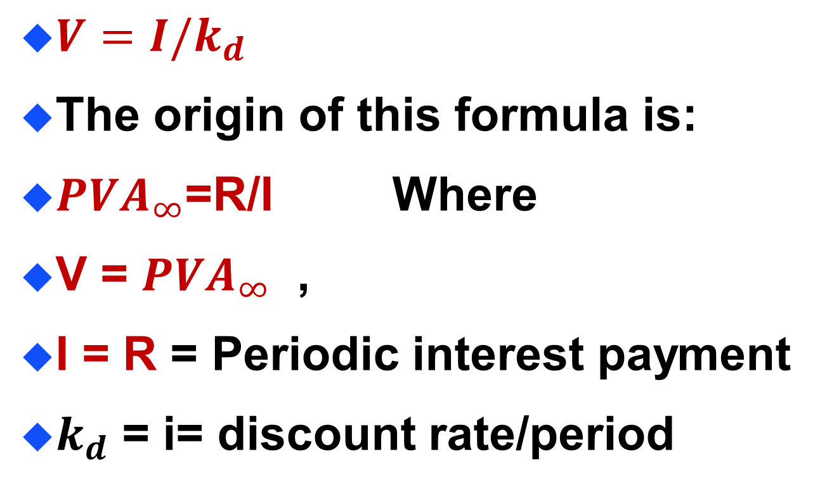
Perpetual Bonds Formula

Slide 19
Perpetual Bond Example
Bond P has a $1,000 face value and provides an 8% annual coupon. The appropriate discount rate is 10%. What is the value of the perpetual bond?
I = $1,000 ( 8%) = $80.
k_{d} = 10%.
V = I / k_{d} [Reduced Form]
= $80 / 10% = $800. Maximum payment

Slide 20
Another Example
Suppose you could buy a bond that pay SR 50 a year forever. Required rate of return for this bond is 12%, what is the PV of this bond?
V = I/kd = 50/0.12 = SR 416.67

Slide 21
Comment on the example
This is the maximum amount that should be paid for this bond.
If the market price more than this never buy it.

Slide 22
Nonzero Coupon Bonds
1) A Nonzero Coupon Bond is a coupon paying bond with a finite life (MV).
I
I
I + MV
V =
+
+ ... +
(1 + k_{d})¹
(1 + k_{d})²
(1 + k_{d})^{n}
n
I
MV
= Σ
+
(1 + k_{d})^{t}
(1 + k_{d})^{n}
t=1
V = I (PVIFA _{kd, n}) + MV (PVIF _{kd, n})

Slide 23
Coupon Bond Example
Bond C has a $1,000 face value and provides an 8% annual coupon for 30 years. The appropriate discount rate is 10%. What is the value of the coupon bond?
V or PV= $80 (PVIFA_{10%, 30}) + $1,000 (PVIF_{10%, 30}) = $80 (9.427) + $1,000 (.057)
[Table IV] [Table II]
= $754.16 + $57.00 = $811.16.

Slide 24
Comments on the Example
The interest payments have a present value of $754.16, where the principal payment at maturity has a present value of $57. This bond PV is $811.16
So, no one should pay more than this price to buy this bond.

Slide 25
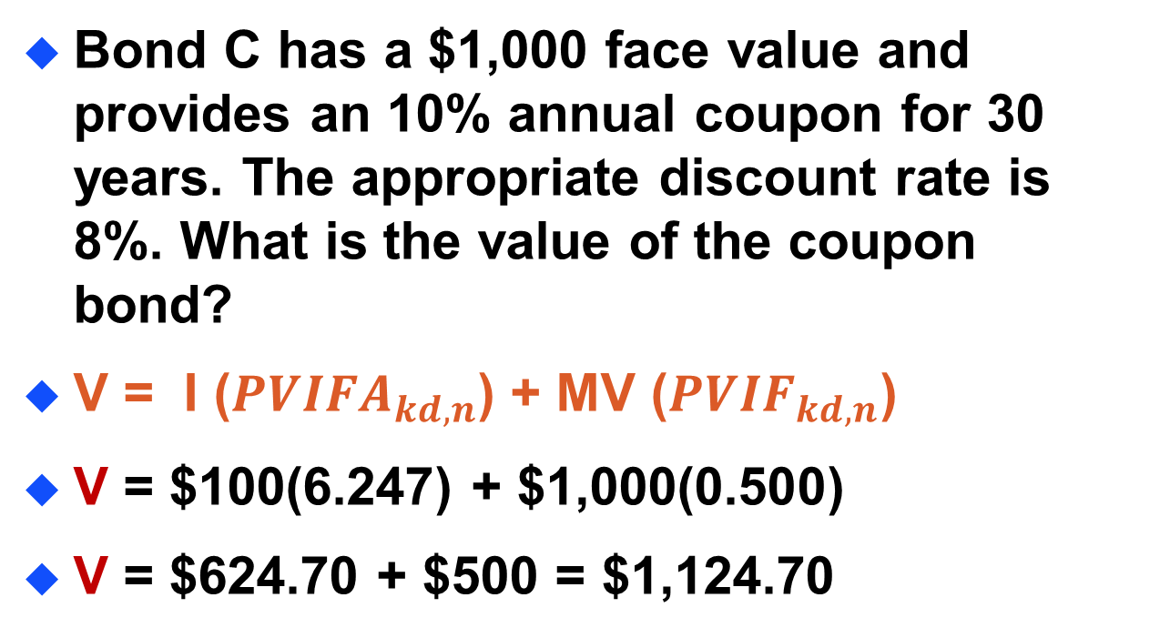
Another Example

Slide 26
Important Note
In this case, the present value of the bond is in excess of its $1,000 par value because the required rate of return is less than the coupon rate. Investors are willing to pay a premium to buy this bond.

Slide 27
Important Note
When the required rate of return is greater than the coupon rate, the bond PV will be less than its par value. Investors would buy this bond only if it is sold at a discount from par value.

Slide 28
Semiannual Compounding
Most bonds in the US pay interest twice a year (1/2 of the annual coupon).
Adjustments needed:
(1) Divide k_{d} by 2
(2) Multiply n by 2
(3) Divide I by 2

Slide 29
Semiannual Compounding
A non-zero coupon bond adjusted for semi-annual compounding.
I / 2
I / 2
I / 2 + MV
V =
+
+ ... +
(1 + k_{d}/2 )¹
(1 + k_{d}/2 )²
(1 + k_{d}/2 ) ²*^{n}
I / 2
MV
2*n
= Σ
+
(1 + k_{d} /2 )^{t}
(1 + k_{d} /2 ) ²*^{n}
t=1
= I/2 (PVIFA_{kd /2 ,2*n}) + MV (PVIF_{kd /2 ,2*n})

Slide 30
Semiannual Coupon Bond Example
Bond C has a $1,000 face value and provides an 8% semi-annual coupon for 15 years. The appropriate discount rate is 10% (annual rate). What is the value of the coupon bond?
V = $40 (PVIFA_{5%, 30}) + $1,000 (PVIF_{5%, 30}) = $40 (15.373) + $1,000 (.231)
[Table IV] [Table II]
= $614.92 + $231.00 = $845.92

Slide 31
Zero-Coupon Bonds
2) A Zero-Coupon Bond is a bond that pays no interest but sells at a deep discount from its face value; it provides compensation to investors in the form of price appreciation.
MV
V =
= MV (PVIF_{kd, n})
(1 + k_{d})^{n}

Slide 32
Zero-Coupon Bond Example
Bond Z has a $1,000 face value and a 30 year life. The appropriate discount rate is 10%. What is the value of the zero-coupon bond?
V = $1,000 (PVIF_{10%, 30}) = $1,000 (0.057) = $57.00

Slide 33
Note on the example
The investor should not pay more than this value ($57) now to redeem it 30 years later for $1,000. The rate of return is 10% as it is stated here.

Slide 34
Preferred Stock Valuation
Preferred Stock is a type of stock that promises a (usually) fixed dividend, but at the discretion of the board of directors.
Preferred Stock has preference over common stock in the payment of dividends and claims on assets.

Slide 35
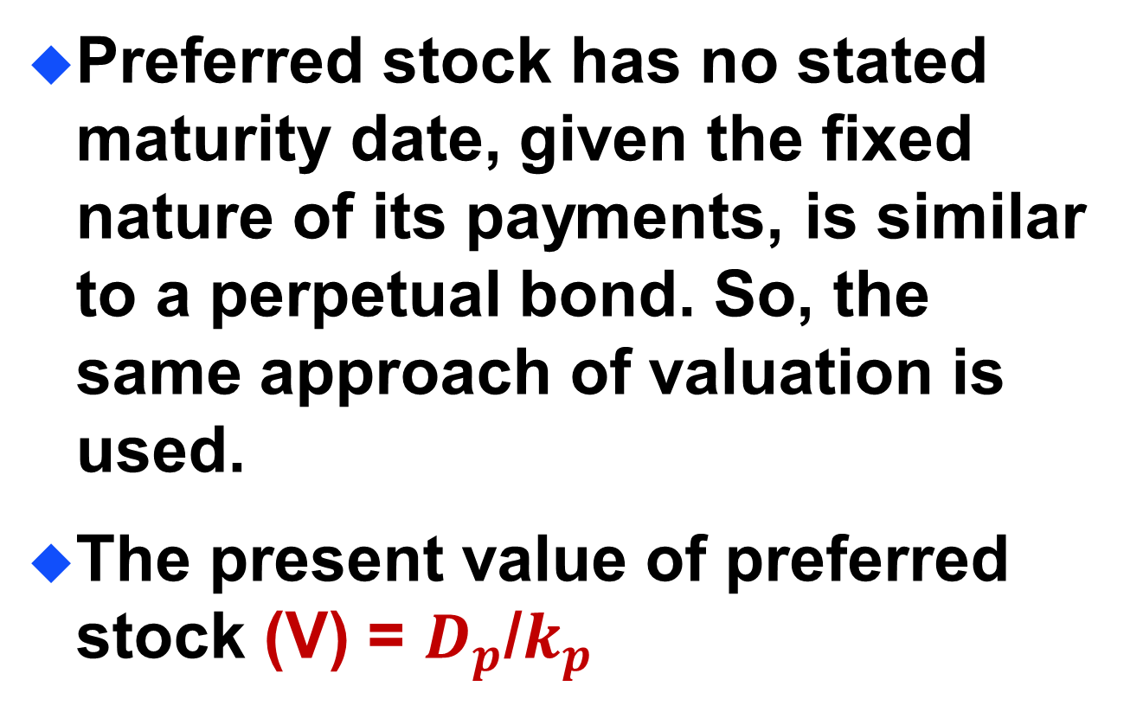
Preferred Stock Valuation

Slide 36
Preferred Stock Valuation
Div_{P}
Div_{P}
Div_{P}
V =
+
+ ... +
(1 + k_{P})¹
(1 + k_{P})²
(1 + k_{P})∞
∞
Div_{P}
= Σ
or Div_{P}(PVIFA _{kP, ∞} )
(1 + k_{P})^{t}
t=1
This reduces to a perpetuity!
V = Div_{P} / k_{P}

Slide 37
Preferred Stock Example
Stock PS has an 8%, $100 par value issue outstanding. The appropriate discount rate is 10%. What is the value of the preferred stock?
Div_{P} = $100 ( 8% ) = $8.00. k_{P} = 10%. V = Div_{P} / k_{P} = $8.00 / 10% = $80

Slide 38
Common Stock Valuation
Common stock represents the ultimate ownership (and risk) position in the corporation.
Pro rata share of future earnings after all other obligations of the firm (if any remain).
Dividends may be paid out of the pro rata share of earnings.

Slide 39
Common Stock Valuation
What cash flows will a shareholder receive when owning shares of common stock?
(1) Future dividends
(2) Future sale of the common stock shares

Slide 40
Common Stock Valuation
It is the expectation of future dividends and a future selling price that gives value to the stock.
Cash dividends are all that stockholders, as a whole, receive from the issuing company.

Slide 41
Dividend Discount Model
Dividend discount models are designed to compute the intrinsic value of the common stock under specific assumptions:
1) The expected growth pattern of
future dividend.
2) The appropriate discount rate.

Slide 42
Dividend Valuation Model
Basic dividend valuation model accounts for the PV of all future dividends.
Div₁
Div₂
Div∞
V =
+
+ ... +
(1 + k_{e})¹
(1 + k_{e})²
(1 + k_{e})∞
Div_{t}
Div_{t}: Cash Dividend at time t
k_{e}: Equity investor’s required return
∞
= Σ
(1 + k_{e})^{t}
t=1

Slide 43
Adjusted Dividend Valuation Model
The basic dividend valuation model adjusted for the future stock sale.
Div₁
Div₂
Divn + Pricen
V =
+
+ ... +
(1 + k_{e})¹
(1 + k_{e})²
(1 + k_{e})^{n}
n: The year in which the firm’s shares are expected to be sold.
Price_{n}: The expected share price in year n.

Slide 44
Dividend Growth Pattern Assumptions
The dividend valuation model requires the forecast of all future dividends. The following dividend growth rate assumptions simplify the valuation process.
Constant Growth
No Growth
Growth Phases

Slide 45
Constant Growth Model
The constant growth model assumes that dividends will grow forever at the rate g.
D₀(1+g)
D₀(1+g)²
D₀(1+g)∞
V =
+
+ ... +
(1 + k_{e})¹
(1 + k_{e})²
(1 + k_{e})∞
D₁: Dividend paid at time 1.
g : The constant growth rate.
k_{e}: Investor’s required return.
D₁
=
(k_{e} - g)

Slide 46
Constant Growth Model Example
Stock CG has an expected dividend growth rate of 8%. Each share of stock just received an annual $3.24 dividend. The appropriate discount rate is 15%. What is the value of the common stock?
D₁ = $3.24 ( 1 + 0.08 ) = $3.50
V_{CG} = D₁ / ( k_{e} - g ) = $3.50 / (0.15 - 0.08 ) = $50

Slide 47
Zero Growth Model
The zero growth model assumes that dividends will grow forever at the rate g = 0.
D₁
D₂
D∞
V_{ZG} =
+
+ ... +
(1 + k_{e})¹
(1 + k_{e})²
(1 + k_{e})∞
D₁
D₁: Dividend paid at time 1.
k_{e}: Investor’s required return.
=
k_{e}

Slide 48
Zero Growth
Model Example
Stock ZG has an expected growth rate of 0%. Each share of stock just received an annual $3.24 dividend per share. The appropriate discount rate is 15%. What is the value of the common stock?
D₁ = $3.24 ( 1 + 0 ) = $3.24
V_{ZG} = D₁ / ( k_{e} - 0 ) = $3.24 / (0.15 - 0 ) = $21.60

Slide 49
Growth Phases Model
The growth phases model assumes that dividends for each share will grow at two or more different growth rates.
n
D₀(1 + g₁)^{t}
∞
D_{n}(1 + g₂)^{t}
V =Σ
Σ
+
(1 + k_{e})^{t}
(1 + k_{e})^{t}
t=1
t=n+1

Slide 50
Growth Phases Model
Note that the second phase of the growth phases model assumes that dividends will grow at a constant rate g₂. We can rewrite the formula as:
n
D₀(1 + g₁)^{t}
1
D_{n+1}
V =Σ
+
(1 + k_{e})^{t}
(1 + k_{e})^{n}
(k_{e} – g₂)
t=1

Slide 51
Growth Phases Model Example
Stock GP has an expected growth rate of 16% for the first 3 years and 8% thereafter. Each share of stock just received an annual $3.24 dividend per share. The appropriate discount rate is 15%. What is the value of the common stock under this scenario?

Slide 52
Growth Phases Model Example
0 1 2 3 4 5 6
∞
D₁ D₂ D₃ D₄ D₅ D₆
Growth of 16% for 3 years
Growth of 8% to infinity!
Stock GP has two phases of growth. The first, 16%, starts at time t=0 for 3 years and is followed by 8% thereafter starting at time t=3. We should view the time line as two separate time lines in the valuation.

Slide 53
Growth Phases Model Example
0 1 2 3
Growth Phase
#1 plus the infinitely long Phase #2
D₁ D₂ D₃
0 1 2 3 4 5 6
∞
D₄ D₅ D₆
Note that we can value Phase #2 using the Constant Growth Model

Slide 54
Growth Phases Model Example
D₄
k-g
We can use this model because
dividends grow at a constant 8%
rate beginning at the end of Year 3.
V₃ =
0 1 2 3 4 5 6
∞
D₄ D₅ D₆
Note that we can now replace all dividends from year 4 to infinity with the value at time t=3, V₃! Simpler!!

Slide 55
Growth Phases Model Example
0 1 2 3
New Time
Line
D₁ D₂ D₃
0 1 2 3
D₄
k-g
Where V₃ =
V₃
Now we only need to find the first four dividends to calculate the necessary cash flows.

Slide 56
Growth Phases Model Example
Determine the annual dividends.
D₀ = $3.24 (this has been paid already)
D₁ = D₀(1 + g₁)¹ = $3.24(1.16)¹ =$3.76
D₂ = D₀(1 + g₁)² = $3.24(1.16)² =$4.36
D₃ = D₀(1 + g₁)³ = $3.24(1.16)³ =$5.06
D₄ = D₃(1 + g₂)¹ = $5.06(1.08)¹ =$5.46

Slide 57
Growth Phases Model Example
0 1 2 3
Actual
Values
3.76 4.36 5.06
0 1 2 3
5.46
0.15–0.08
Where $78 =
78
Now we need to find the present value of the cash flows.

Slide 58
Growth Phases Model Example
We determine the PV of cash flows.
PV(D₁) = D₁(PVIF_{15%, 1}) = $3.76 (0.870) = $3.27
PV(D₂) = D₂(PVIF_{15%, 2}) = $4.36 (0.756) = $3.30
PV(D₃) = D₃(PVIF_{15%, 3}) = $5.06 (0.658) = $3.33
P₃ = $5.46 / (0.15 - 0.08) = $78 [CG Model]
PV(P₃) = P₃(PVIF_{15%, 3}) = $78 (0.658) = $51.32

Slide 59
Growth Phases
Model Example
Finally, we calculate the intrinsic value by summing all of cash flow present values.
V = $3.27 + $3.30 + $3.33 + $51.32
V = $61.22
3
D₀(1 +0.16)^{t}
1
D₄
V = Σ
+
t=1
(1 +0.15)^{t}
(1+0.15)^{n}
(0.15–0.08)

Slide 60
Rates of Return(or Yields)
Rates of return is the profit on a securities or capital investment, usually expressed as an annual percentage rate.
Return is usually called yield.

Slide 61
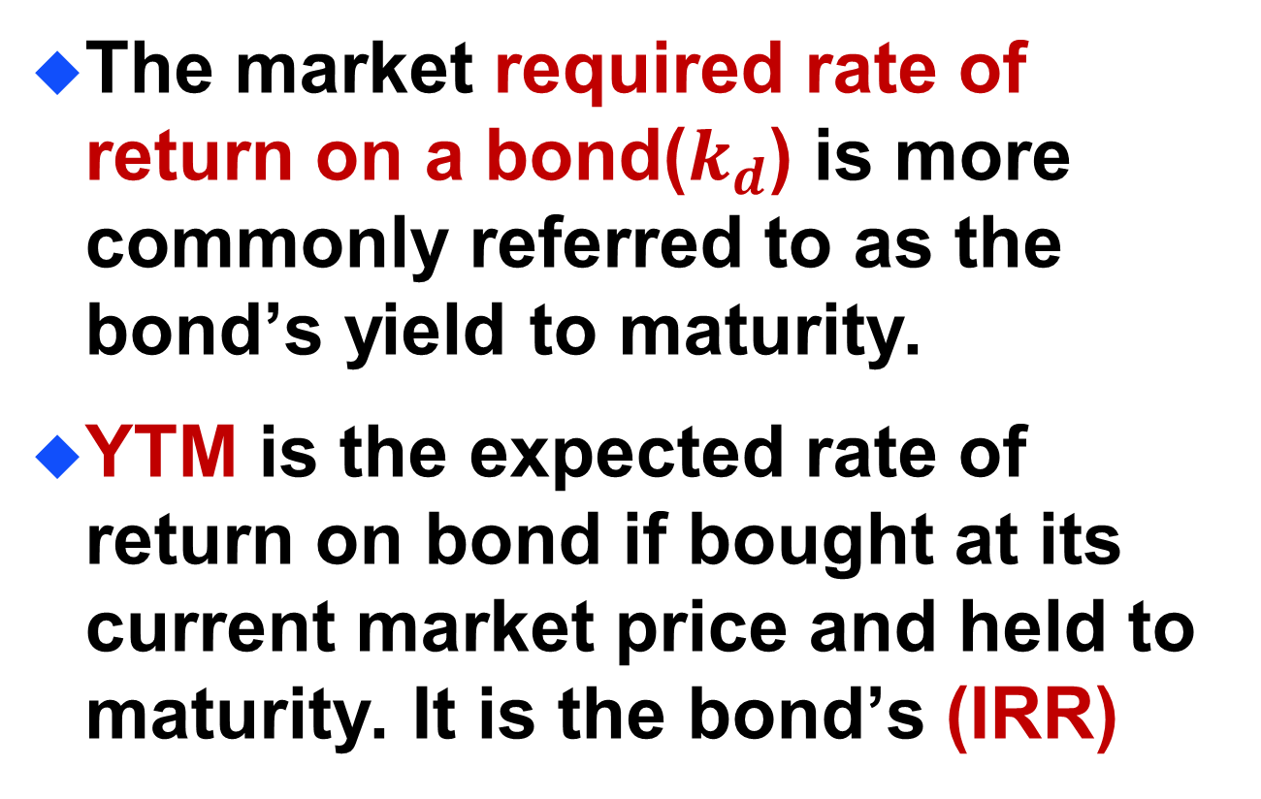
Yield to Maturity(YTM) on Bonds

Slide 62
Calculating Rates of Return (or Yields)
Steps to calculate the rate of return (or Yield).
1. Determine the expected cash flows.
2. Replace the intrinsic value (V) with the market price (P₀).
3. Solve for the market required rate of return that equates the discounted cash flows to the market price.

Slide 63
Determining Bond YTM
Determine the Yield-to-Maturity (YTM) for the annual coupon paying bond with a finite life.
n
I
MV
P₀ =
Σ
+
(1 + k_{d} )^{t}
(1 + k_{d} )^{n}
t=1
= I (PVIFA _{kd , n}) + MV (PVIF _{kd , n})
k_{d} = YTM

Slide 64
Determining the YTM
Julie Miller want to determine the YTM for an issue of outstanding bonds at Basket Wonders (BW). BW has an issue of 10% annual coupon bonds with 15 years left to maturity. The bonds have a par value of $1,000 and a current market value of $1,250.
What is the YTM?

Slide 65
YTM Solution (Try 9%)
$1,250 = $100(PVIFA_{9%,15}) + $1,000(PVIF_{9%, 15})
$1,250 = $100(8.061) + $1,000(0.275)
$1,250 = $806.10 + $275.00
= $1,081.10 [Rate is too high!]

Slide 66
YTM Solution (Try 7%)
$1,250 = $100(PVIFA_{7%,15}) + $1,000(PVIF_{7%, 15})
$1,250 = $100(9.108) + $1,000(0.362)
$1,250 = $910.80 + $362.00
= $1,272.80
[Rate is too low!]

Slide 67
YTM Solution (Interpolate)
0.07 $1,273
0.02 IRR $1,250 $192
0.09 $1,081
0.02 = 0.09 – 0.07, 23=1273-1250, 192=1273-1081
X $23 0.02 $192
X
$23
=

Slide 68
YTM Solution (Interpolate)
0.07 $1,273
0.02 IRR $1,250 $192
0.09 $1,081
X $23 0.02 $192
X
$23
=

Slide 69
YTM Solution (Interpolate)
0.07 $1273
0.02 YTM $1250 $192
0.09 $1081
($23)(0.02) $192
X
$23
X =
X = 0.0024
YTM =0.07 + 0.0024 = 0.0724 or 7.24%

Slide 70
Determining Semiannual Coupon Bond YTM
Determine the Yield-to-Maturity (YTM) for the semiannual coupon paying bond with a finite life.
2n
I / 2
MV
P₀ =
Σ
+
(1 + k_{d} /2 )^{t}
(1 + k_{d} /2 )^{2n}
t=1
= (I/2)(PVIFA_{kd /2, 2n}) + MV(PVIF_{kd /2 , 2n})
[ 1 + (k_{d} / 2)² ] –1 = YTM

Slide 71
Determining the Semiannual Coupon Bond YTM
Julie Miller want to determine the YTM for another issue of outstanding bonds. The firm has an issue of 8% semiannual coupon bonds with 20 years left to maturity. The bonds have a current market value of $950.
What is the YTM?

Slide 72
Determining Semiannual Coupon Bond YTM
Determine the Yield-to-Maturity (YTM) for the semiannual coupon paying bond with a finite life.
[ (1 + k_{d} / 2)² ] –1 = YTM
YTM=effective annual interest rate
[ (1 + 0.042626)² ] –1 = 0.0871
or 8.71%
Note: make sure you utilize the calculator answer in its DECIMAL form.

Slide 73
Bond Price - Yield Relationship
Discount Bond – The market required rate of return is more than the coupon rate, the price of the bond will be less than its face value (Par > P₀ ). Such a bond is said to be selling at a discount from face value.

Slide 74
Bond Price - Yield Relationship
Premium Bond – The market required rate of return is less than the stated coupon rate, the price of the bond will be more than its face value (P0 > Par). Such a bond is said to be selling at a premium over face value.

Slide 75
Bond Price - Yield Relationship
Par Bond – The market required rate of return equals the stated coupon rate, the price will equal the face value (P0 = Par). Such a bond is said to be selling at par.

Slide 76
Behavior of Bond Prices
If interest rates rise so that the market required rate of return increases, the bond price will fall.
If interest rates fall, the bond price will increase. In short, interest rates and bond prices move in opposite direction.

Slide 77
Behavior of Bond Prices
The more bond price will change, the longer its maturity.
The more bond price will change, the lower the coupon rate. In short, bond price volatility is inversely related to coupon rate.

Slide 78
Determining the Yield on Preferred Stock
Determine the yield for preferred stock with an infinite life.
P₀ = Div_{P} / k_{P}
Solving for k_{P} such that
k_{P} = Div_{P} / P₀

Slide 79
Preferred Stock Yield Example
Assume that the annual dividend on each share of preferred stock is $10. Each share of preferred stock is currently trading at $100. What is the yield on preferred stock?
k_{P} = $10 / $100.
k_{P} = 10%.

Slide 80
Determining the Yield on Common Stock
Assume the constant growth model is appropriate. Determine the yield on the common stock.
P₀ = D₁ / ( k_{e} – g )
Solving for k_{e} such that
k_{e} = ( D₁ / P₀ ) + g

Slide 81
Common Stock
Yield Example
Assume that the expected dividend (D₁) on each share of common stock is $3. Each share of common stock is currently trading at $30 and has an expected growth rate of 5%. What is the yield on common stock?
k_{e} = ( $3 / $30 ) + 5%
k_{e} = 10% + 5% = 15%

